Slide 1
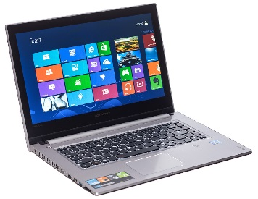
ENVIRONMENTAL SCIENCE Catalyst 6/6/14
PLEASE HAVE YOUR UNIFORMS AND IDs ON PROPERLY.
Go on the class website http://aofscience.weebly.com and answer the Catalyst questions online and press submit. (Use phone or paper, if no laptop.)
QUESTIONS:
FLASHBACK FRIDAY! What are three things scientists look at to study climate in the past?
FRIDAY FEELINGS! Write about your feelings and emotions right now.

Slide 2
Agenda 6/6/14
Catalyst
Announcements***
Verbal Drill
Solar Power and Wind Energy Discussion
Waste Management Discussion
Project Work Time
Reminders
Socrative Exit Slip

Slide 3
Announcements
Study your note packet. Complete the blanks! STUDY WASTE MANAGEMENT (last pages in Chapter 18 packet).
Start studying for final exams by looking at the SGO Post-Test Study Guide!
P10: Call to Action Project – DUE June 16th.**
P6: Renewable Energy Source Business Plan Project DUE June 17th. (NO LATE WORK!!!)

Slide 4
Environmental Science Gpoints
Your class can earn class points if:
everyone in class:
Comes to class quietly and on time
Stays focused and on task during class
Leaves classroom neat and organized
Students are teaching other students
Majority of class participates
Follows all classroom expectations and procedures
And more…
P6: 62 (on time, focused, neat room)
P10: 56 (on time, neat room)

Slide 5
Environmental Science Verbal Drill
You must answer if the toy is passed to you. (Points deducted from your weekly participation grade if you refuse.)
If you don’t know the answer, look it up in your notes or discuss it with a classmate. (i.e. don’t just ask for the answer)
If the class reaches 25 points, extra points will be given on the next unit exam.
The class will have 3 minutes to earn as many points as possible.

Slide 6
Environmental Science Verbal Drill Points
Period 6:
98 pts
Period 10:
96pts
Note: 10% extra credit added to last quiz.

Slide 7
Why do we need to find alternative sources of energy?
THINK. PAIR. SHARE.

Slide 8
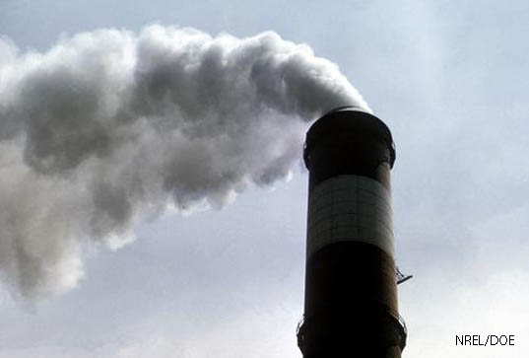
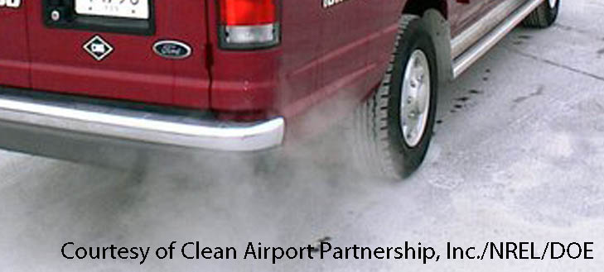
Why We Need Alternative Energy Sources
Economic reasons:
Fossil fuels won’t last forever.
Renewables provide new jobs.
Our country will be less dependent on others for fuel.
Environmental reasons:
Renewables will decrease air pollution and greenhouse gas emissions.

Slide 9
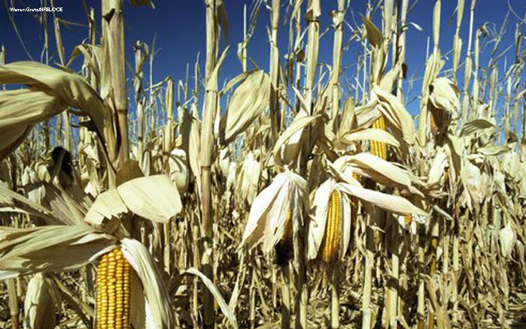
Lesson 18.1 Biomass and Geothermal Energy
Agricultural waste, methane gas from landfills, and heat from the Earth are just a few renewable energy sources that can help replace fossil fuels.

Slide 10
Biomass Energy
Biomass is material—such as wood, manure, and grain—that makes up living organisms or comes from living organisms.
Biomass energy, called biopower, is produced by burning biomass.
Biomass energy can be used for heating, cooking, lighting, vehicle fuel, or electricity generation.

Slide 11
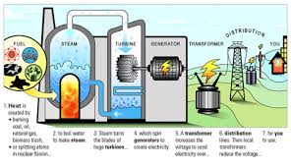
How Biomass Works
https://www.youtube.com/watch?v=-ck3FYVNl6s

Slide 12
Biomass Energy Sources
Did You Know? Wood, charcoal, and manure supply 35% of the energy in developing nations, and over 90% of the energy in the world’s poorest nations.
Solids: Wood, charcoal, manure, agricultural and timber waste, switchgrass
Gases: Methane “landfill gas” produced by breakdown of waste in landfills
Switchgrass

Slide 13
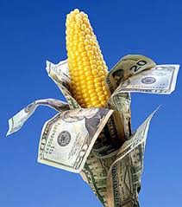
Biofuels
Liquids (biofuels):
Ethanol:
Produced by fermentation of starches and sugar
Mainly produced from corn
2. Biofuel:
Produced from vegetable oil

Slide 14
THINK. PAIR.SHARE. Turn to a partner and discuss: What do you think are the benefits of biomass energy?

Slide 15
THINK. PAIR.SHARE. Turn to a partner and discuss: What do you think are the disadvantages of biomass energy?

Slide 16
Benefits and Costs of Biomass Energy
Benefits:
Costs/Disadvantages
Takes away land from food crops or natural habitats
Deforestation, soil erosion, and desertification can result if plant biomass is harvested too rapidly.
Large energy input is needed.
Burning biomass indoors can lead to indoor air pollution.
No net change in atmospheric carbon dioxide
Can be produced by all nations
Did You Know? It takes 1 unit of energy input to gain just 1.5 units of energy from ethanol.
Notes:
Image - http://www.flickr.com/photos/carolynconner/4264882098/ (Creative Commons licensed)
Geyser info source - National Park Service: http://www.nps.gov/yell/planyourvisit/noldfaith.htm

Slide 17
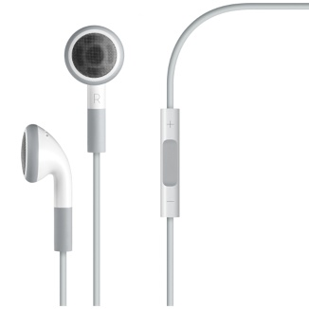
Objective 6/4/14
We will be able to
Describe how geothermal energy is used to generate electricity.
Explain the advantages and disadvantages of geothermal energy.



Slide 18
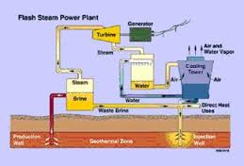
GEOTHERMAL ENERGY

Slide 19
Geothermal Energy
Underground heat generated by high pressures and breakdown of radioactive elements
Usually accessed by drilling deep below ground; steam turns turbines, generating electricity.
https://www.youtube.com/watch?v=CUeo81dJpdM
Notes:
Image - http://www.flickr.com/photos/carolynconner/4264882098/ (Creative Commons licensed)
Geyser info source - National Park Service: http://www.nps.gov/yell/planyourvisit/noldfaith.htm

Slide 20
Geothermal Power Plant

Slide 21
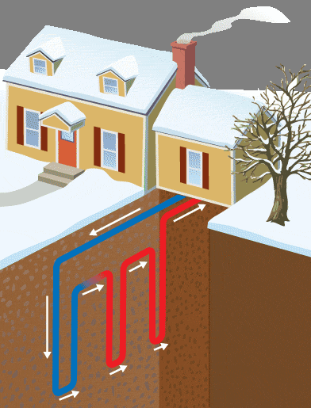
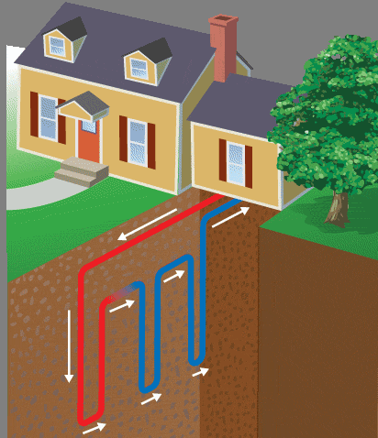
Using Geothermal Energy
Can be used directly by piping hot water from its source into homes and businesses
Ground source heat pumps use naturally temperate soil, a few feet underground, to heat homes in winter and to cool them in summer.
A ground source heat pump in winter and summer

Slide 22
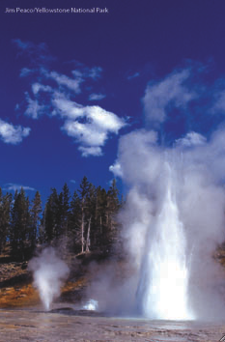
Geysers
Geysers erupt because of geothermal energy.

Slide 23
Benefits and Costs of Geothermal Energy
Benefits
Costs/Disadvantages
Causes much less air pollution than fossil fuels
Low greenhouse gas emissions
Not sustainable if hot groundwater is used faster than it is naturally replenished
Hot groundwater can contain pollutants that damage machines or add to pollution.
Notes:
Image - http://www.flickr.com/photos/carolynconner/4264882098/ (Creative Commons licensed)
Geyser info source - National Park Service: http://www.nps.gov/yell/planyourvisit/noldfaith.htm

Slide 24
Benefits and Costs of Geothermal Energy Continued
Benefits
Costs/Disadvantages
Some geothermal energy projects can trigger earthquakes.
Geothermal power plants can only be built in places with easy access to geothermal energy.
Notes:
Image - http://www.flickr.com/photos/carolynconner/4264882098/ (Creative Commons licensed)
Geyser info source - National Park Service: http://www.nps.gov/yell/planyourvisit/noldfaith.htm

Slide 25
PERIOD 6 ONLY: Objective 6/4/14
We will be able to
Create a business presentation convincing business leaders to invest in renewable energy resources



Slide 26
Renewable Energy Resources Business Plan Project
You are a scientist working for the Environmental Protection Agency (EPA). You’ve been given the task to convince a Fortune 500 company (choose whichever one) to invest in a renewable energy resource. In groups of 3-4, choose one type of renewable energy resource. Create a business plan that includes:
Description of the energy source and how it works
Benefits and Advantages
Costs and Disadvantages
Examples of current use
Future Application of Technology

Slide 27
Renewable Sources of Energy
Biomass
Geothermal
Hydropower
Solar
Wind
Hydrogen Fuels

Slide 28
Project Work Time Expectations
You use every minute EFFICIENTLY.
No heads down
No sitting doing nothing or playing with phones and getting on irrelevant websites
One third of your grade will be how productive you are during class.

Slide 29
During Classwork Time
Stay focused on the assignments you are given.
Do the questions INDEPENDENTLY (on your own).
Keep the noise level down.
Ask THREE before you ask ME.
You may put earphones on and listen to music quietly as you do your work. (Pick a playlist and stick with it!)
You must make CLEAR progress (depends on the person) by the end of the period.
PERIOD 6 TASK:
Renewable Energy Source Business Plan Project

Slide 30
During Classwork Time
Stay focused on the assignments you are given.
Do the questions INDEPENDENTLY (on your own).
Keep the noise level down.
Ask THREE before you ask ME.
You may put earphones on and listen to music quietly as you do your work. (Pick a playlist and stick with it!)
You must make CLEAR progress (depends on the person) by the end of the period.
PERIOD 10 TASK:
CALL TO ACTION PROJECT

Slide 31
Objective 6/5/14
We will be able to
Describe how hydropower is used to generate electricity.
Explain the advantages and disadvantages of hydropower.



Slide 32
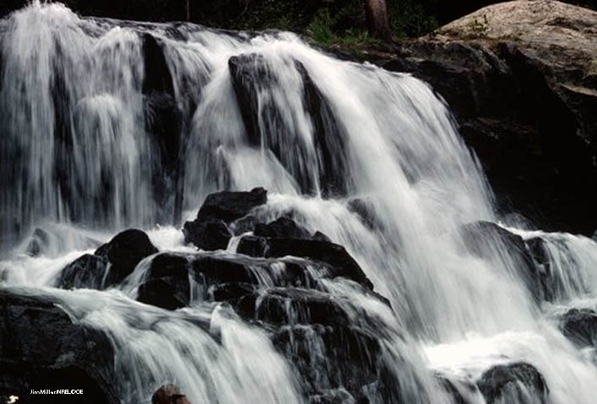
Lesson 18.2 Hydropower and Ocean Power
Currently, 19% of the world’s electricity is made using hydropower.

Slide 33
Generating Electricity With Hydropower
Hydropower is generated by turbines turned by moving water.
Two basic approaches:
Water flows through a dam and pushes turbines.
Naturally flowing water is diverted through turbines.
Naturally flowing water can lead to a variable supply of electricity. Dams provide constant electricity but can disturb natural habitats.

Slide 34
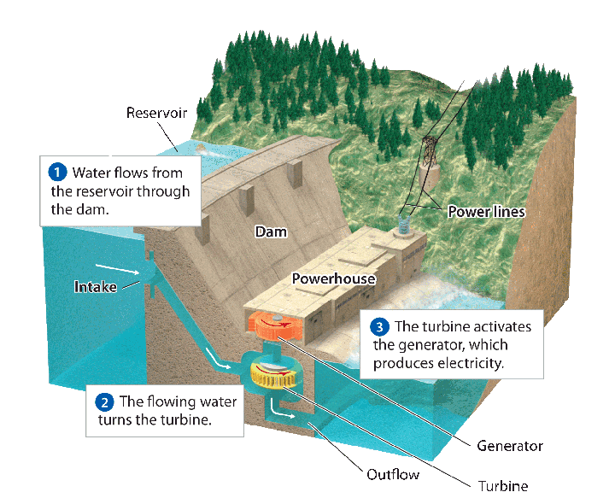
Generating Electricity from Hydropower

Slide 35
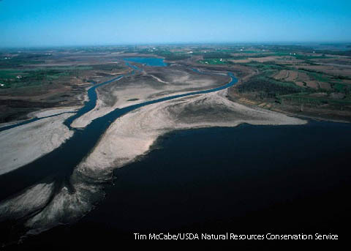

Slide 36
Benefits and Costs of Hydropower
BENEFITS | COSTS
Completely renewable No air pollution or greenhouse gas emissions Yields relatively cheap electricity | Dams alter ecosystems and affect organisms (especially fish). Dams trap soil-enriching silt, preventing it from reaching downstream. Building dams and reservoirs can displace people.

Slide 37
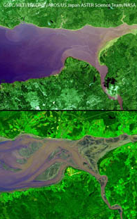
Tidal Energy
Electricity generated by the flow of ocean water as tides go in and out
Tidal waters push turbines in a dam.
The best places to harness tidal energy have big differences in the heights of high and low tides.
Generates little to no pollution, but shore ecosystems can be negatively affected and very few locations are currently suitable
High and low tide in the Bay of Fundy, Nova Scotia

Slide 38
Objective 6/5/14
We will be able to
Describe how solar energy is used to generate electricity.
Explain the advantages and disadvantages of solar energy.



Slide 39
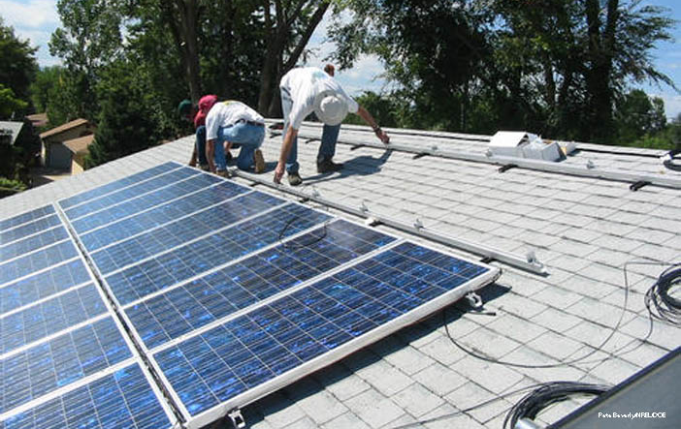
Lesson 18.3 Solar and Wind Energy
In one day, the Earth receives enough energy from the sun to meet human energy needs for 25 years—if it could all be harnessed.

Slide 40
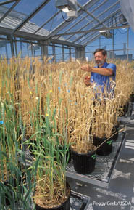
Harnessing Solar Energy for Heat
Passive solar heating: Designing a building to efficiently capture, store, and distribute the sun’s energy; can be used to heat homes and businesses
Active solar heating: Uses technology, such as solar panels, to capture, store, and distribute the sun’s energy

Slide 41
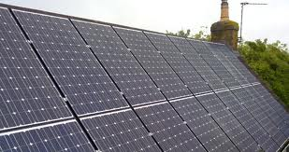
Harnessing Solar Energy to Make Electricity
Photovoltaic cells (solar panels): Convert solar energy directly into electricity

Slide 42
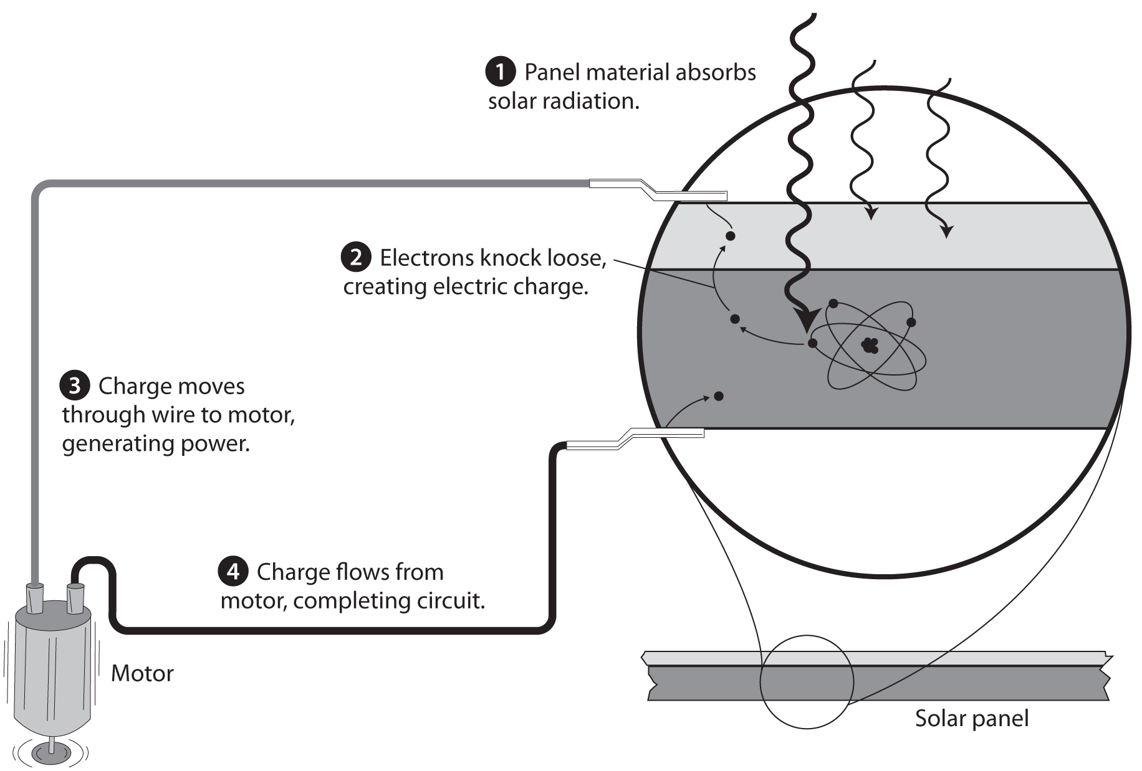
Harnessing Solar Energy

Slide 43
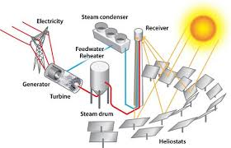
Harnessing Solar Energy to Make Electricity
Concentrating solar power: Uses mirrors to focus the sun’s rays on a vessel containing fluid; creates steam to push turbines and generate electricity.

Slide 45
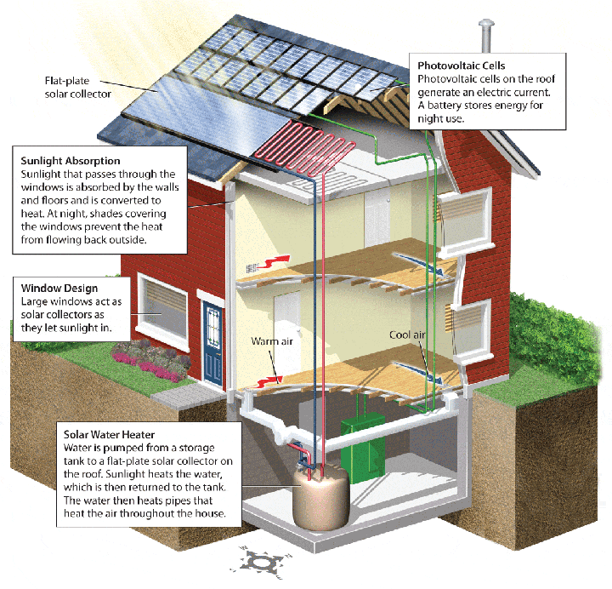

Slide 46
Benefits and Costs of Solar Power
Benefits | Costs/Disadvantages
Inexhaustible Clean—no air or water pollution produced during operation Low maintenance devices New jobs to make solar devices | Some pollution during manufacture Many regions aren’t sunny enough. Devices are expensive.

Slide 47
How Does Solar Energy Work
https://www.youtube.com/watch?v=c1yirT_WqMs

Slide 48
REMINDERS
DON’T FORGET YOUR PACKET STAMPS!
Benchmark dates – June 10 and June 11.
PERIOD 10 ONLY: Call to Action Project, DUE June 16, 2014.
Period 6 ONLY: Renewable Energy Source Business Plan Project DUE June 17, 2014.

Slide 49
Objective 6/5/14
We will be able to
Describe how wind energy is used to generate electricity.
Explain the advantages and disadvantages of wind energy.



Slide 50
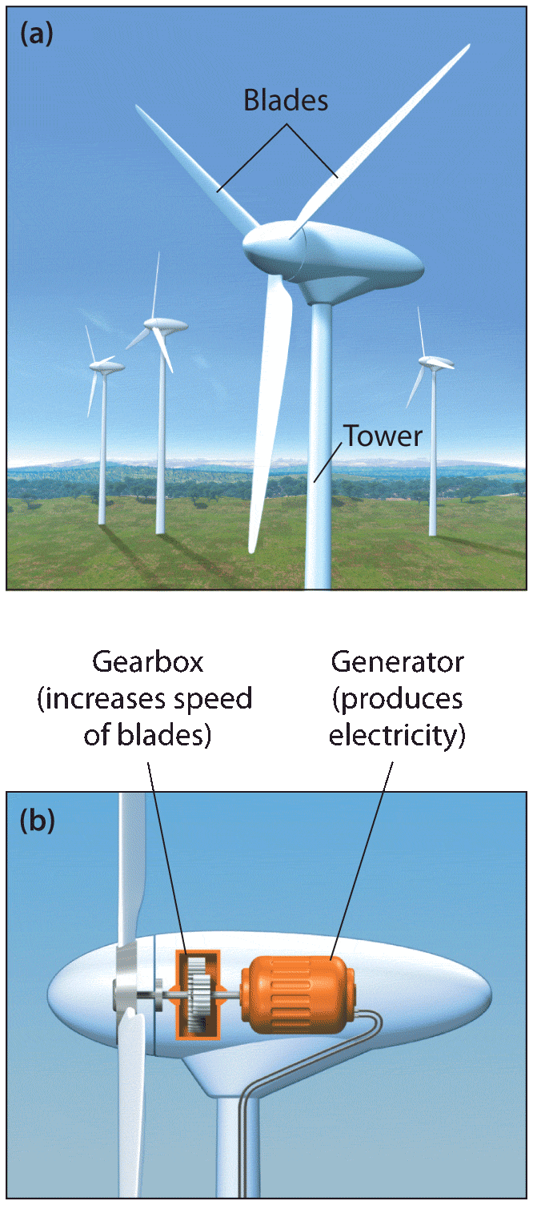
Using Wind to Make Electricity
Wind turbines (windmills) convert wind’s kinetic energy to electrical energy.
Wind turbines can be placed on land or offshore.
Turbines can be solitary or built in groups called wind farms.

Slide 51
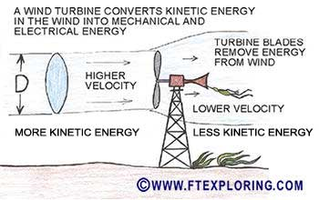

Slide 52
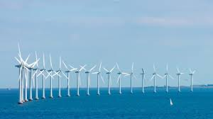
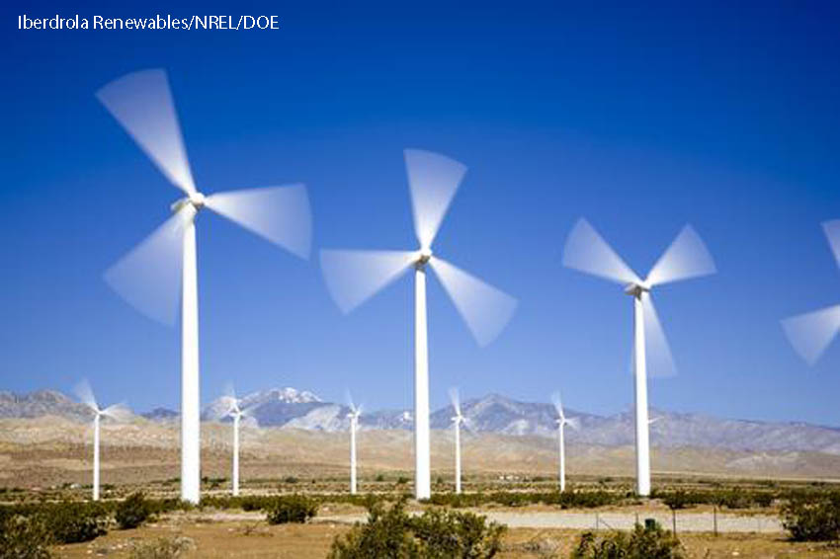
Why?
Did You Know? Average wind speeds are 20% faster offshore than on land.

Slide 53
Wind Energy Fun
https://www.youtube.com/watch?v=tsZITSeQFR0
What are some benefits of using wind energy?
What are some disadvantages of using wind energy?

Slide 54
Benefits and Costs of Wind Power
Benefits:
Costs:
No pollution or greenhouse gases produced during operation
Under good wind conditions, produces far more energy than it uses
Relatively cheap to operate
High startup costs
Winds can be unpredictable.
Fastest winds are often not near population centers.
Communities complain about the looks and noise of wind farms.
Can be harmful to birds and bats

Slide 55
REMINDERS
DON’T FORGET YOUR PACKET STAMPS!
Benchmark dates – June 10 and June 11.
PERIOD 10 ONLY: Call to Action Project, DUE June 16, 2014.
Period 10 ONLY: Chapter 18 Classwork Packet DUE Friday, June 13, 2014.
Period 6 ONLY: Renewable Energy Source Business Plan Project DUE June 17, 2014.

Slide 56
Socrative Exit Slip
Go to http://m.socrative.com
Join room #66355
Wait for instructions.
Answer the following questions in the space provided:
What are the benefits and disadvantages of wind energy?

Slide 57
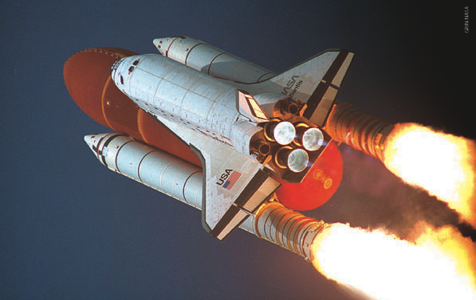
Lesson 18.4 Energy From Hydrogen
Hydrogen is the most abundant element in the universe.
Rockets, such as those that powered the space shuttle, have been powered by hydrogen fuel.

Slide 58
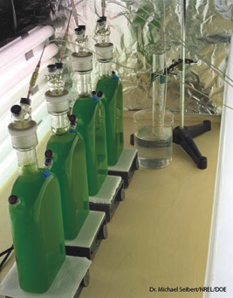
Hydrogen (H₂) as a Fuel Source
H₂ gas can be combusted to produce heat, with just water as a byproduct.
On Earth, H₂ is commonly found in compounds such as water, though it is rare in its elemental form, H₂ gas.
H₂ can be produced by breaking down water (H₂O) or methane (CH₄).
A new technology involves using green algae to produce H₂ from water.
Algae used to produce hydrogen gas

Slide 59
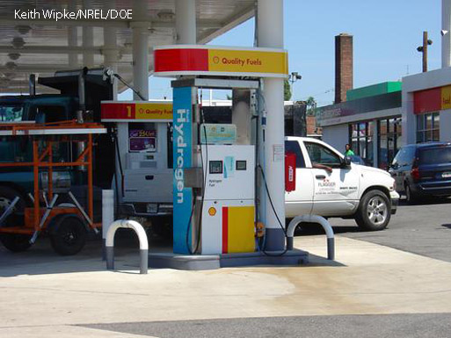
Benefits and Costs of Hydrogen as a Fuel Source
Benefits:
Inexhaustible supply of hydrogen
Few greenhouse gases or pollutants
Water and heat might be the only byproducts.
Can be stored and transported
Costs:
Hydrolysis (splitting of water to generate H₂) is expensive, and breaking down methane yields carbon dioxide. Both require energy from an outside source.
H₂ gas must be compressed if used for vehicle fuel.

Slide 60
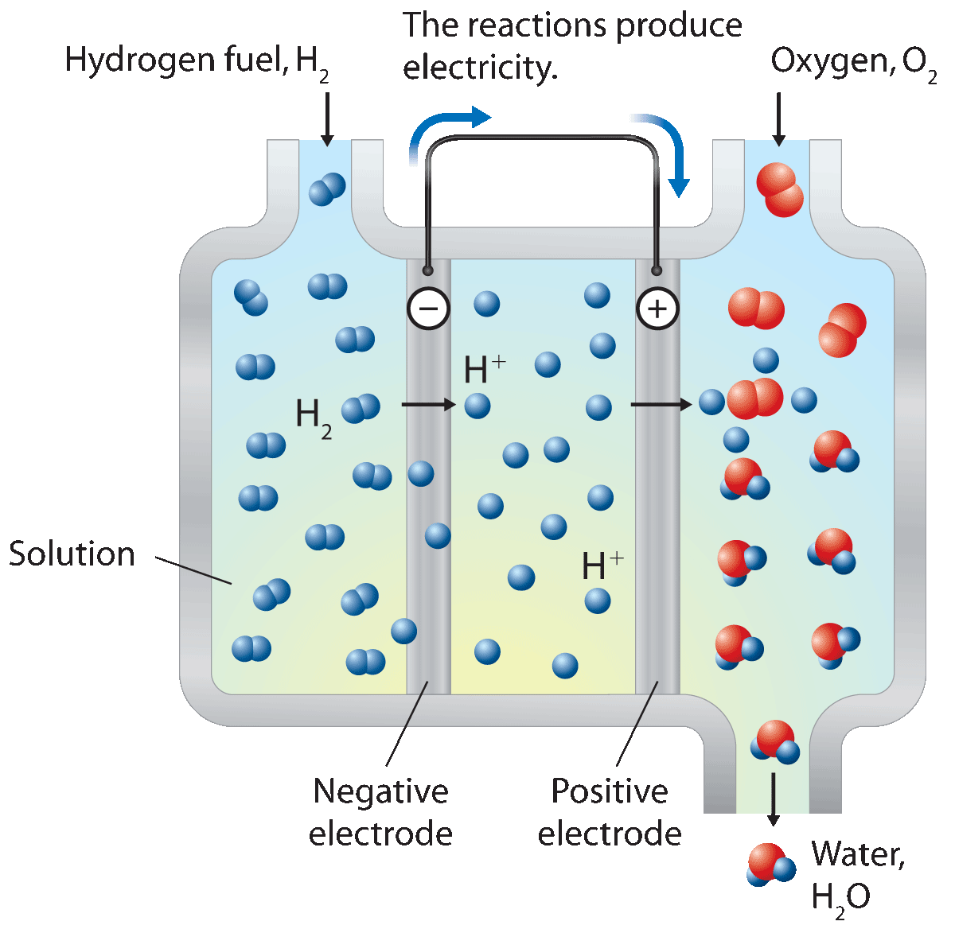
Fuel Cells
H₂ and O₂ react to form water, producing electricity in the fuel cell’s electrodes.
Only byproducts are water vapor and heat.
Can power vehicles or power plants
Can provide electricity to places “off-grid” or unreachable by conventional power companies
Fuel Cell

