Slide 1
Catalyst 3/20/13
1. Write a balanced chemical equation that describes the reaction below:
solid iron (III) oxide reacts with solid aluminum metal to yield solid aluminum oxide and solid iron metal
Please have your uniform on properly and ID around your neck.

Slide 2
solid iron (III) oxide reacts with solid aluminum metal to yield solid aluminum oxide and solid iron metal

Slide 4
Element of the Day
I am found in some jewelry, but my main use is found in the catalytic converters inside cars. (These catalytic converters help reduce smog in cities by burning up unburned fuel in the exhaust.) I also have an AMAZING ability to absorb hydrogen gas. In fact, I can absorb 900 times my volume in hydrogen gas. Organic chemists love me because I can be used as a catalyst (a substance that speeds up a chemical reaction) and make their lives much easier! I sometimes like to imitate my brother, Platinum, to get some attention.
Who am I?

Slide 5
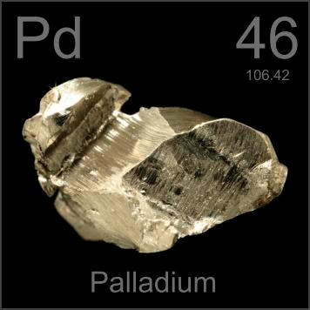
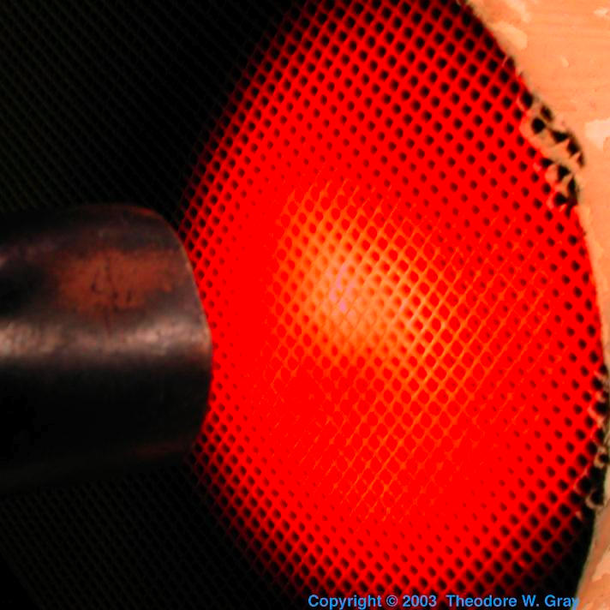
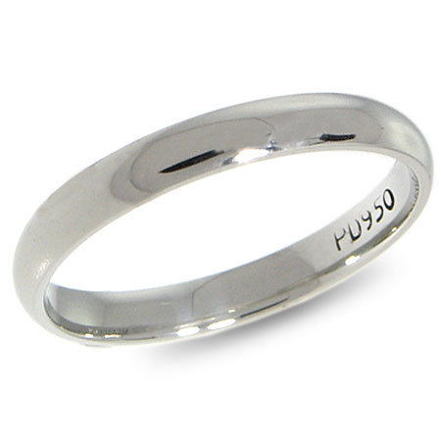
Element of the Day: Palladium

Slide 6
Agenda 3/20/13
Catalyst
Element of the Day
Balancing Chemical Equations Mini-Review
Class Practice
Exit Slip

Slide 7
Class Points
Your class can earn class points if everyone in class:
Comes to class quietly and on time
Stays focused and on task during class
Leaves classroom neat and organized
Students are teaching other students
Majority of class participates
Follows all classroom expectations and procedures
And more…
P3: 25 pts (focused)
P4: 40 pts (on time, focused)
P6: 43 pts (on time)

Slide 8




Objective 3/20/13 – Period 3
We will be able to
Determine whether a chemical equation is balanced
Balance a chemical equation by modifying the coefficients



Slide 9
Student Mini-Lesson!
I need three volunteers to show the class how to solve a balancing equation.
  You get to choose the problem (or make one of your own!)
You do NOT need to be 100% correct.
If you’re stuck on a step, we will help you!
Remember balancing equations is all about patience and persistence!

Slide 12
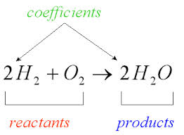
Chemical Equation
A chemical equation summarizes a chemical reaction through symbols and chemical formulas.

Slide 14
Chemical Equations Must have
All reactants and products
Correct chemical formulas for reactants and products
Satisfy the Law of the Conservation of Mass**

Slide 15
Law of the Conservation of Mass
The Law of the Conservation of Mass states that MATTER cannot be CREATED or DESTROYED.
To follow this law, chemical equations must be BALANCED.

Slide 16
Before we start Balancing Chemical Equations…
We must first be able to count the number of atoms of each element in a given compound and decide whether or not a compound is balanced.

Slide 17
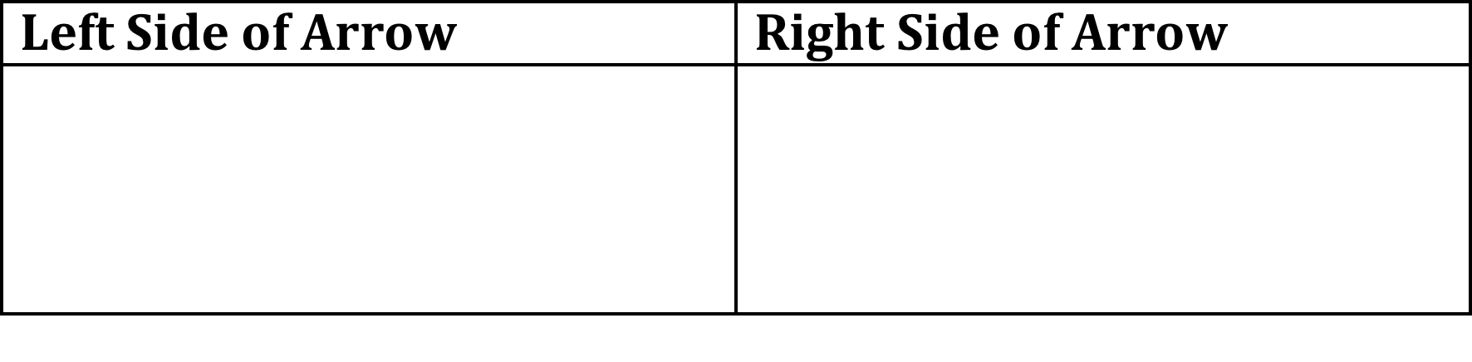
Balanced?
Example#1:
Zn(s) + HCl (aq) → ZnCl₂(aq) + H₂(g)

Slide 18
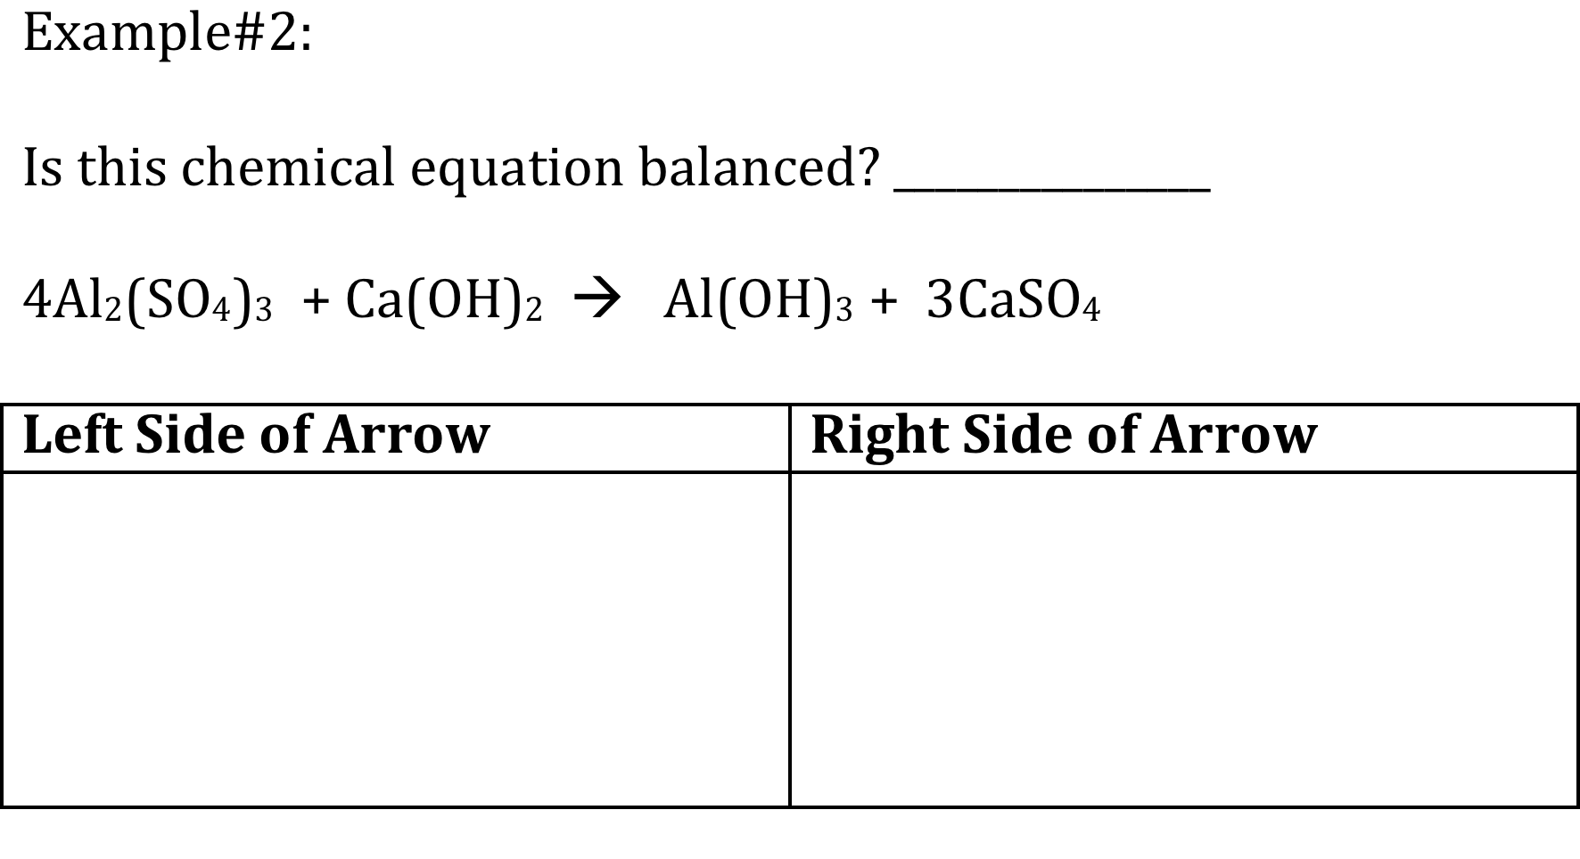

Slide 19
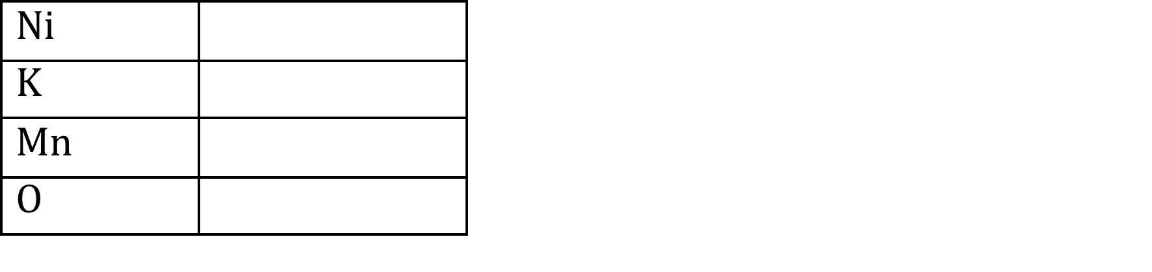
Example#3:
Determine how many atoms of each element you have in the following compound: Nickel (II) permanganate
Chemical formula =

Slide 20
Balancing Chemical Equations

Slide 21
Balancing ChemIcal Equations
In order to follow the Law of the Conservation of Mass, chemical equations must be BALANCED.

Slide 22
How to Balance a Chemical Equation
Count the number of atoms of each element you have in each molecule on both sides of the arrow.
If the numbers of atoms of each element are not equal on both sides of the arrow, you must balance the equation by adding a number in front of the chemical formula. (This number in front is called the coefficient.)
Multiply the coefficient by the subscripts of each element to get the number of atoms.
If the numbers of atoms are still not equal, try a different coefficient. Balancing equations requires a lot of trial and error.

Slide 23
Tips on Balancing
BE PATIENT
If you’re frustrated, take a moment and BREATHE.
Remember to ONLY change the COEFFICIENTS and NOT the subscripts!
Treat polyatomic ions as a “single unit”
PRACTICE, PRACTICE, PRACTICE! (the right away)

Slide 24
Example#3
Balance the following chemical equation described below: aluminum sulfate reacts with calcium hydroxide to produce aluminum hydroxide and calcium sulfate.

Slide 25
Practice Problem
Write a balanced chemical equation for the following reaction: Solid sodium combines with chlorine gas to produce solid sodium chloride.

Slide 27
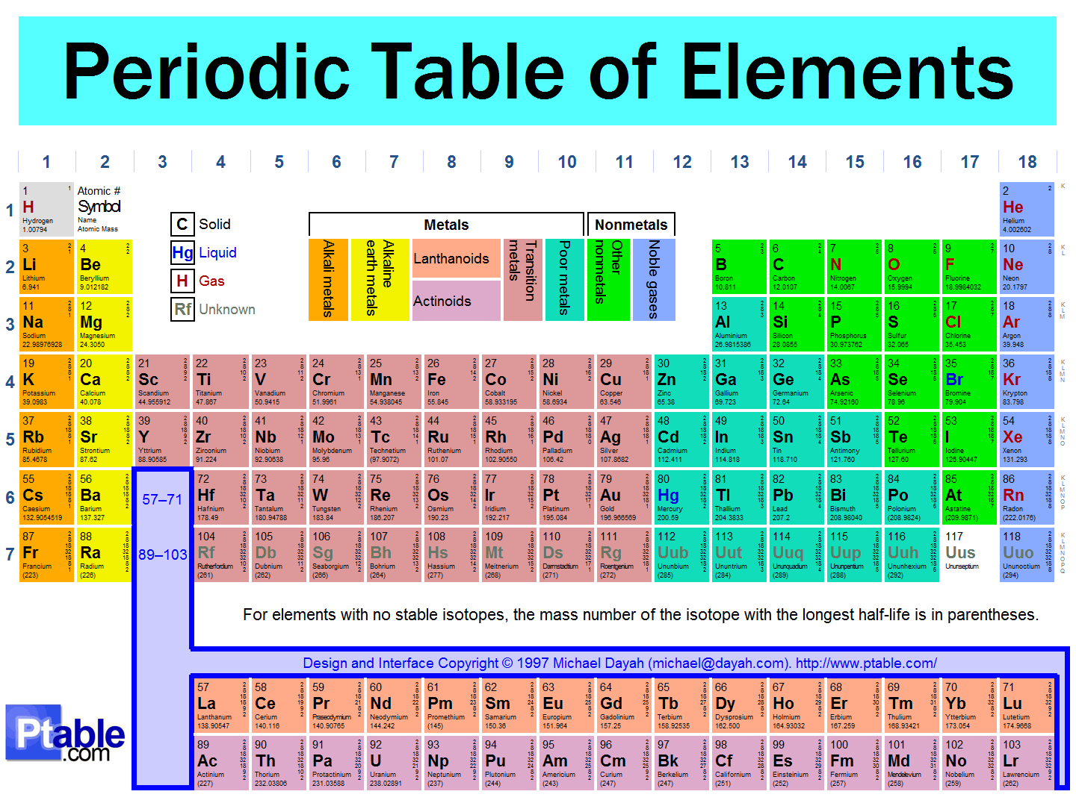

Slide 28
During Classwork Time
Stay focused on the assignments you are given.
Do the questions INDEPENDENTLY (on your own).
Keep the noise level down.
Ask THREE before you ask ME.
You may put earphones on and listen to music quietly as you do your work.
You must finish a certain number of questions (depends on the person) by the end of the period.
DO NOT FORGET YOUR STAMPS! You cannot get them once you leave the class.

Slide 29
Exit Slip
QUIETLY and INDEPENDENTLY answer the following on Notability and email it to gutierrezbr@elizabeth.k12.nj.us with “p3 ES 3/19” on the subject line. I must receive it by the end of the period. If you are talking or copying, you will not receive credit.
Balance the chemical equation below that shows the combustion of glucose.
C₆H₁₂O₆ + O₂ → CO₂ + H₂O

