Slide 1
Catalyst 3/20/12
Balance the following equation:
Fe₂O₃ (s)+ CO(g) → Fe(s) + CO₂(g)
Don’t give up.

Slide 2
Element of the Day
I used to be found in incandescent lightbulb, but I’m extremely inefficient when it comes to making light. Only 10% of the electricity I use is converted to light, while the rest is converted to heat and radiation. I’m an extremely strong metal and you can heat me up to a very high temperature. I’m commonly used in cutting wheels and am much tougher than diamond and steel. My name in German means “heavy stone.”
Who am I?

Slide 4
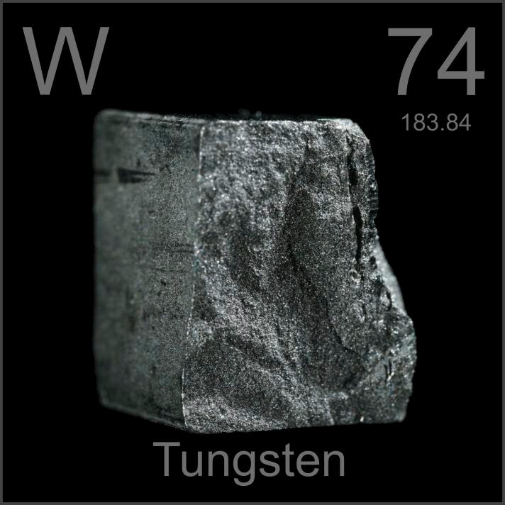
Element of the Day: Tungsten

Slide 5
Agenda
Catalyst
Element of the Day
Announcements
Balancing Chemical Equations
Class Practice
Exit Slip

Slide 6
Announcements
Make up exam by Friday, March 23. Schedule a time during 7th period or after school.
Benchmark Exam#3: March 29 and 30.**
Reinforcement Notebook (extra credit opportunity)

Slide 7
Reinforcement Notebook
On a spiral notebook, summarize your packet notes from the daily lesson into this notebook. You can make charts, reword notes, draw diagrams, write songs, and etc. to help you remember content.
If you show me the Reinforcement Notebook the next day during the exit slip or independent practice time, you’ll get a stamp and can earn up to 40 points extra credit on your packet grade.
If you submit your Reinforcement Notebook by the end of the week, you can earn up to 20 points extra credit on your packet grade.

Slide 8
Agenda (8th Period)
Catalyst
Announcements
Post-Lab Discussion
Exam Reflection
Balancing Equations Practice

Slide 9
Objectives
SWBAT define the Law of the Conservation of Mass.
SWBAT balance a chemical equation.

Slide 10
The Law of the Conservation of Mass
The Law of the Conservation of Mass states that matter can neither be created nor destroyed. It is simply converted from one form to the other.
In a chemical equation, the mass of the reactants MUST equal the mass of the products.

Slide 11
Balancing Chemical Equations
Why is it important to balance Chemical Equations?
The Law of the Conservation of Mass MUST be obeyed.
To know how the quantities of the reactants and products relate

Slide 12
Balancing a Chemical Equation
Determine the number of each type of atom on both sides of the reaction.
If the equation is not balanced, add a coefficient in front of a chemical formula and repeat step 1.
Repeat step 2 as needed until the numbers of each type of atom are equal in both sides.

Slide 13
Exit Slip
Balance the following chemical equation:
Fe₂O₃ (s)+ CO(g) → Fe(s) + CO₂(g)
2. What does the Law of Conservation of Mass state?

Slide 14
Exam Reflection (8th Period)
Go through your test and redo all the questions that you got wrong on a separate piece of paper.
Explain WHY you think you got those questions wrong. (Some explanations might include: I multiplied the molar mass instead of dividing.)

Slide 15
Balancing Equations Practice
Balance the following chemical equations on a separate piece of paper.
Na₃PO₄ + KOH → NaOH + K₃PO₄
2) MgF₂ + Li₂CO₃ → MgCO₃ + LiF
3) P₄ + O₂ → P₂O₃
4) RbNO₃ + BeF₂ → Be(NO₃)₂ + RbF
5) Al₂(SO₄)₃ + Ca(OH)₂ → Al(OH)₃ + CaSO₄
6) AgNO₃ + K₃PO₄ → Ag₃PO₄ + KNO₃
7) Calcium hydroxide reacts with phosphoric acid (H₃PO₄) to produce calcium phosphate and water.
8) Copper iodide reacts with potassium carbonate to yield potassium iodide, copper (I) oxide and carbon dioxide.

