Slide 1
Catalyst 5/21/13
Name three circumstances where a burglar could enter a house without leaving a toolmark.
What is the most important tool for a firearms and toolmark examiner?
Compare and contrast the three main types of bullets. Discuss their shapes and functions.
Please make sure your IDs and uniforms are on properly.

Slide 2
Agenda 5/20/13
Catalyst
Announcement
Firearms and Ballistics Quiz on Wednesday 5/22/13
Start filming next week
Detecting Gunshot Residue
Classwork

Slide 3
Firearms and Ballistics Overview
Types of Guns
Gun Mechanism
Parts of a Bullet and Ammunition
Gunshot Residue
Tool marks and Impressions*
Gun Control Debate*
✔
✔
✔

Slide 4
Objective 5/21/13
We will be able to
Explain how to test for the presence of gunshot residue.



Slide 5
How a handgun works
https://www.youtube.com/watch?v=5Lj0HX5jcX4

Slide 6
For the sake of memory retention, I highly recommend that you take notes. I’ll give you time.

Slide 7
Gun Key Note
Research a gun of your own choice.
Explain how your particular gun works.
Describe the types of bullets your gun uses and any special characteristics that makes your gun unique.
Explain at least two types of tests you can do on your gun and its bullets when investigating a crime scene.
You will place your research on Key Note. (You do not need to present.)

Slide 8
CSI Web Adventure – Ballistics*
1. Click on "Case One: Rookie Training"
2. Click on Login As Guest
3.Click on Firearms and Toolmarks
4. Click on Training Demos first. TAKE NOTES on your iPad (Notability or pages.)
5. After the training demos, test your "skills" at the firing range.
*Yes, we’ve done this before, but we’re going to make sure we pay close attention to the details.

Slide 9
Handling Guns
NEVER, EVER POINT a gun to another person!
Pay close attention to the small features and understand its function

Slide 10
Firearm Safety Video
https://www.youtube.com/watch?v=VwyKMyhs1GQ

Slide 11
Firearms
Forensic analysis is vital to solve a crime that uses a gun.
The vast majority of
U.S. homicides involve
guns. And they are more
powerful than ever.
Lansing State Journal, July 2007
In 2004, there were 12,000 homicides in the United States.

Slide 12
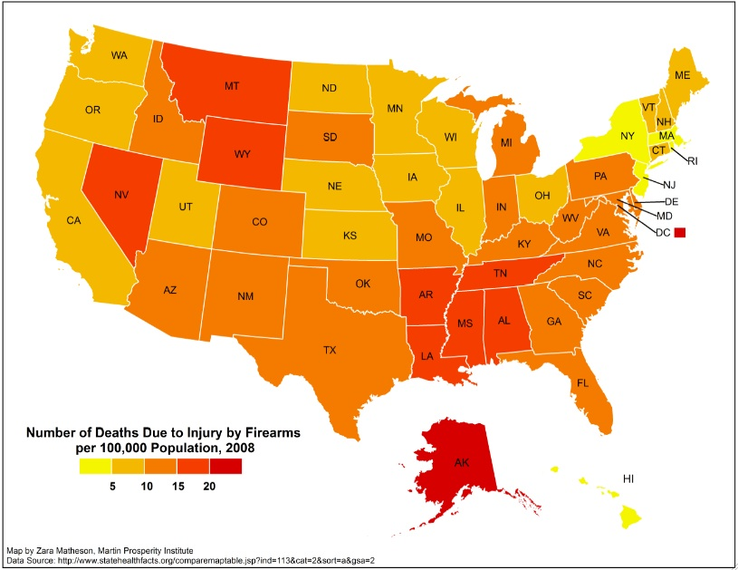

Slide 13
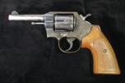
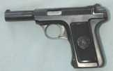
Types of Firearms
Handguns (pistols)
Revolver
Semiautomatic
Rifles
Shotguns
Air or BB guns

Slide 14
Types of Hand Guns
Revolvers
Older style
Single or double action
No safety
5-8 rounds
Retains shells when fired
Pistols
Modern design
Semi-Automatic
Varied safeties
10-20 rounds
Ejects shells when fired

Slide 15
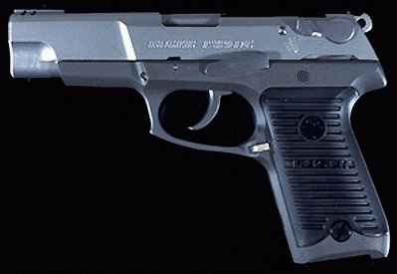
This is a 9 mm Ruger Pistol
Cost: ~ $300
Simi-automatic
Capacity: 10-15 rounds
bsapp.com

Slide 16
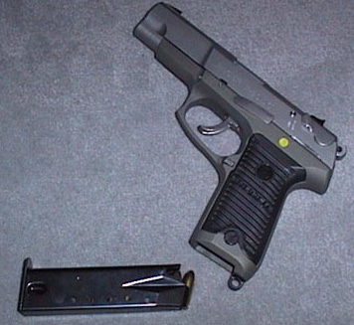
This is the same 9 mm shown with its clip
bsapp.com

Slide 17
9 mm Glock
bsapp.com

Slide 18
Cost: ~ $200
Simi-automatic
Capacity: 10-12 rounds
bsapp.com

Slide 19
25 Auto Bauer
Saturday Night Special
Simi-automatic
Capacity: 10 rounds
bsapp.com

Slide 20
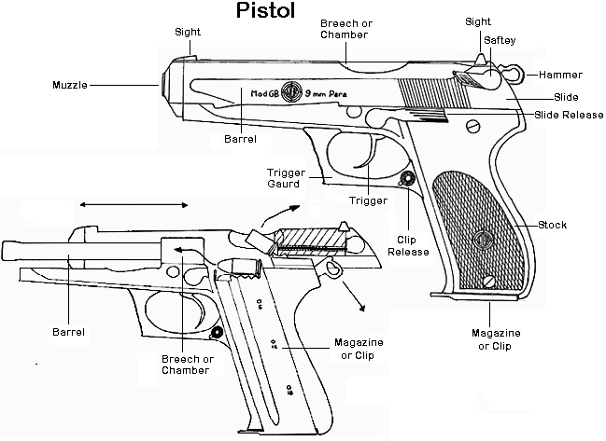
The inner workings:
bsapp.com

Slide 21
357 Magnum Smith & Wesson Revolver
Double Action
Capacity: 6 rounds
bsapp.com

Slide 22
6 rounds 38 Special with a speed loader
bsapp.com

Slide 23
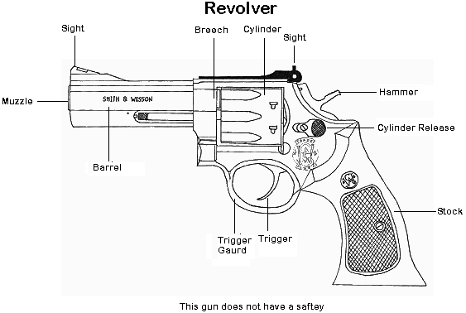
Revolver Diagram
bsapp.com

Slide 24
Ammunition
Components:
Cartridge case
Primer
Propellant
Projectile

Slide 25
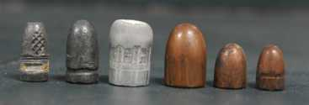
Bullets
Made of lead, sometimes jacketed with brass, copper, or steel
Bullet size—diameter (caliber or gauge)
Shapes

Slide 26
How can forensic scientists analyze evidence obtained from guns and its bullets?
What are they looking for?

Slide 27
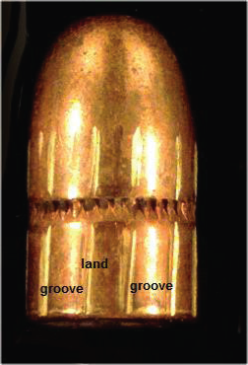
Rifling
The grooved spirals inside the barrel of a gun that produce lands and grooves on a bullet
Lands and grooves are class characteristics.

Slide 28
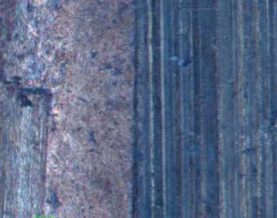
Striae
Scratches on a fired bullet, like a barcode,
that can serve as individual evidence, matching bullets or bullet to a firearm

Slide 29
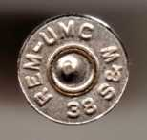
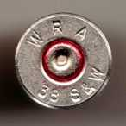
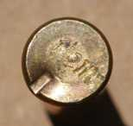
Cartridge Case
Usually brass or nickel-clad brass
Head stamps
Rimfire and centerfire cartridges

Slide 30
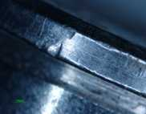
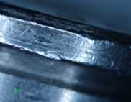
Cartridge Case, continued
Individual characteristics
Firing pin marks
Extractor marks
Breech marks

Slide 31
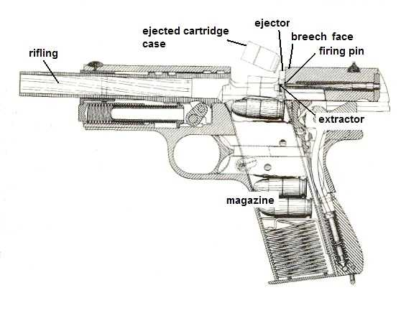
Features of a Semiautomatic Handgun

Slide 32
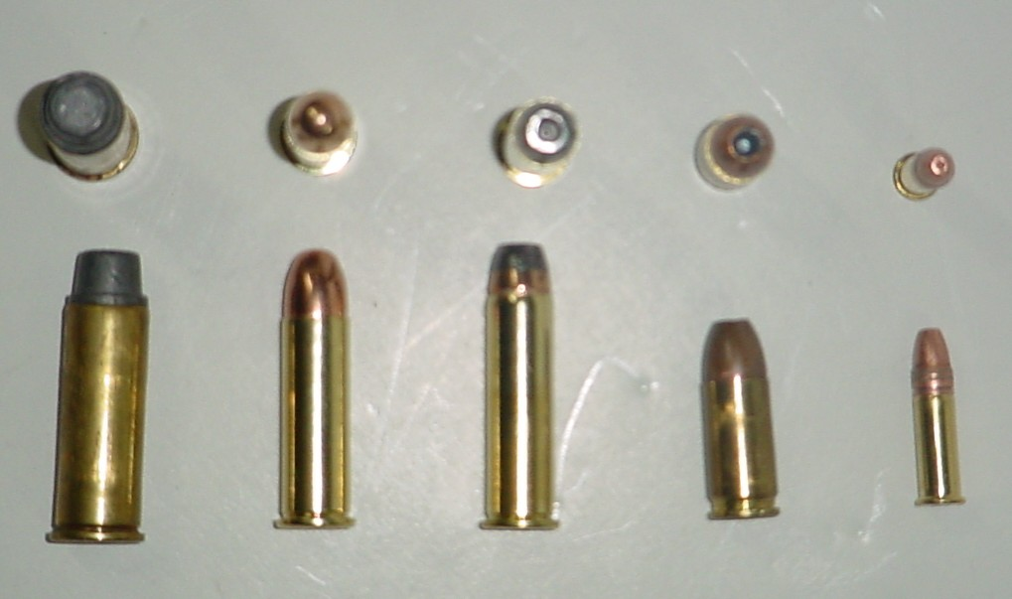
Ammunition
bsapp.com

Slide 33
Mass of Bullet
Measured in “grains”
1 gram = 15.4 grains

Slide 34
bsapp.com

Slide 35
bsapp.com

Slide 36
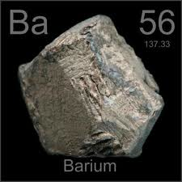
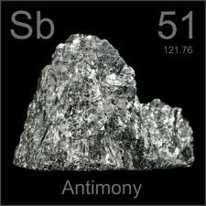
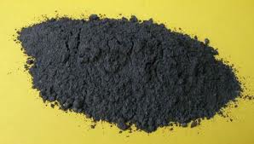
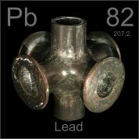
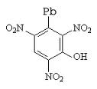
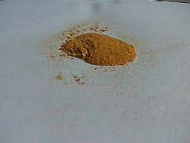
Chemicals in Bullets
Primer
antimony sulfide – Sb₂S₃
barium nitrate – Ba(NO₃)₂
lead styphnate - C₆HN₃O₈Pb
Propellant
Nitrocellulose
Nitroglycerine

Slide 37
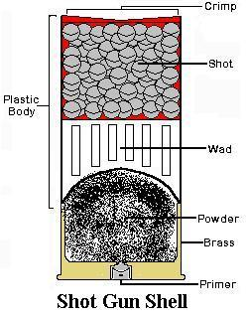
bsapp.com

Slide 38
Bullet Design
“Bullet” refers to the projectile(s) which actually exits the barrel of the gun when fired
Bullets vary in shape and composition
There exist hundreds of different types of bullets
Most types are variations on three main shapes & three basic compositions
bsapp.com

Slide 39
Three Main Shapes
bsapp.com

Slide 40
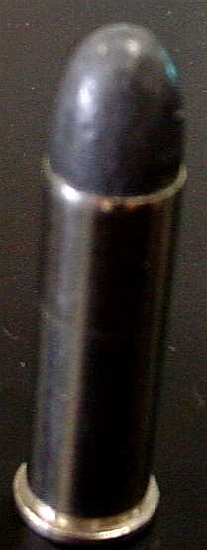
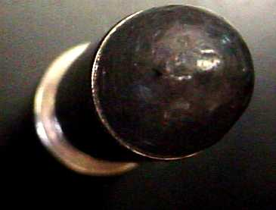
Round Nose
Maximum penetration
Cheapest shape to manufacture
Easily loads into chambers
bsapp.com

Slide 41
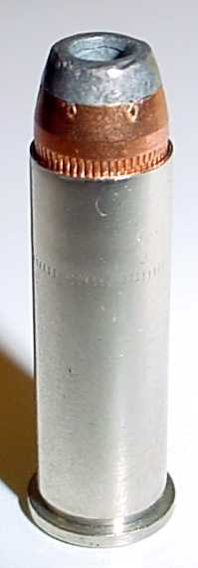
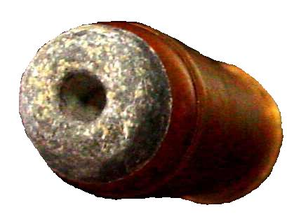
Hollow Point
Spreads or mushrooms on impact
Causes additional damage to target
Inhibits penetration
bsapp.com

Slide 42
Wad Cutter
Used exclusively as a practice load
Minimizes penetration
Rips a hole in target paper which is visible by the shooter
bsapp.com

Slide 43
Three Basic Compositions of Bullets
Lead
½ Jacketed
Jacketed (Full metal jacket)
bsapp.com

Slide 44
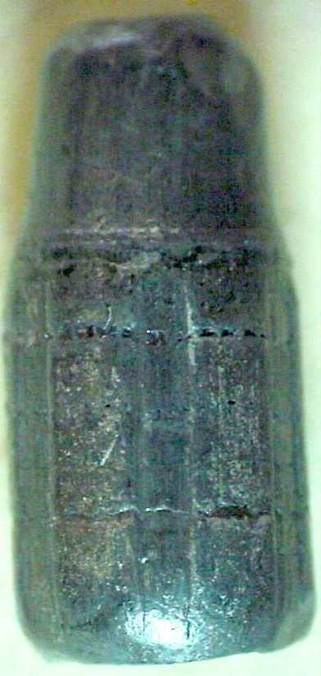
Lead
Cheap
Dense
Soft
Easy to mold
bsapp.com

Slide 45
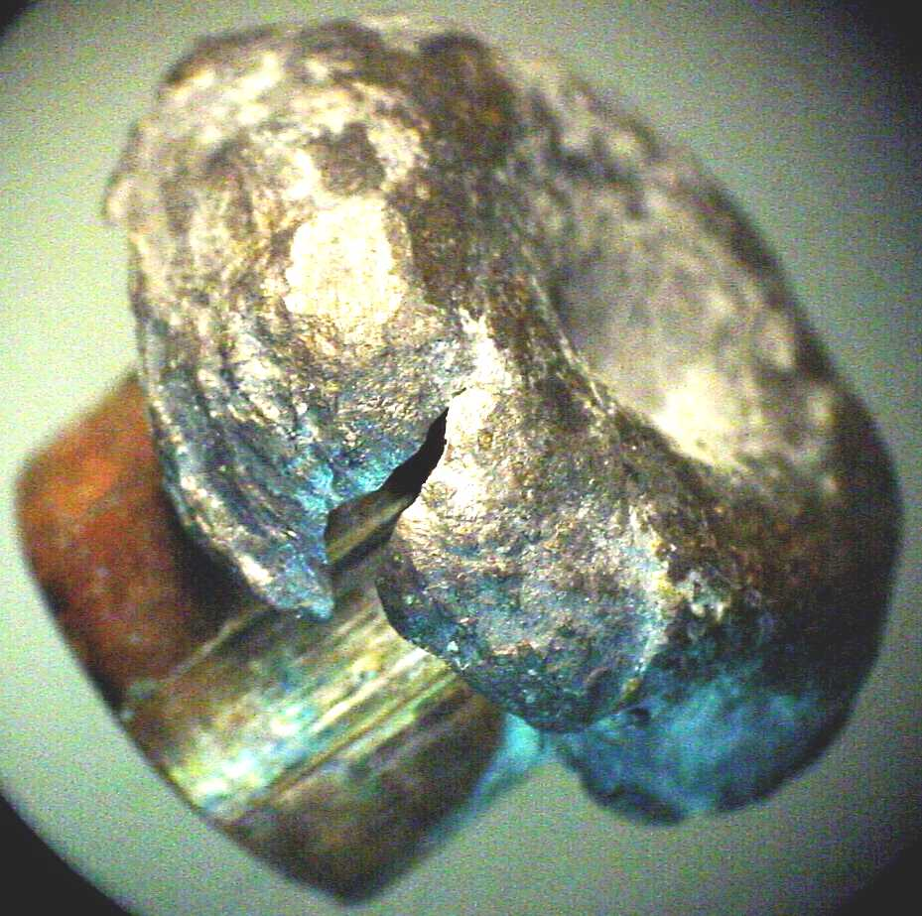
½ Jacketed
A lead bullet coated with copper half way up the exposed portion of the bullet
Used primarily for
hollow points
Copper improves
exit velocity
Lead promotes mushrooming
bsapp.com

Slide 46
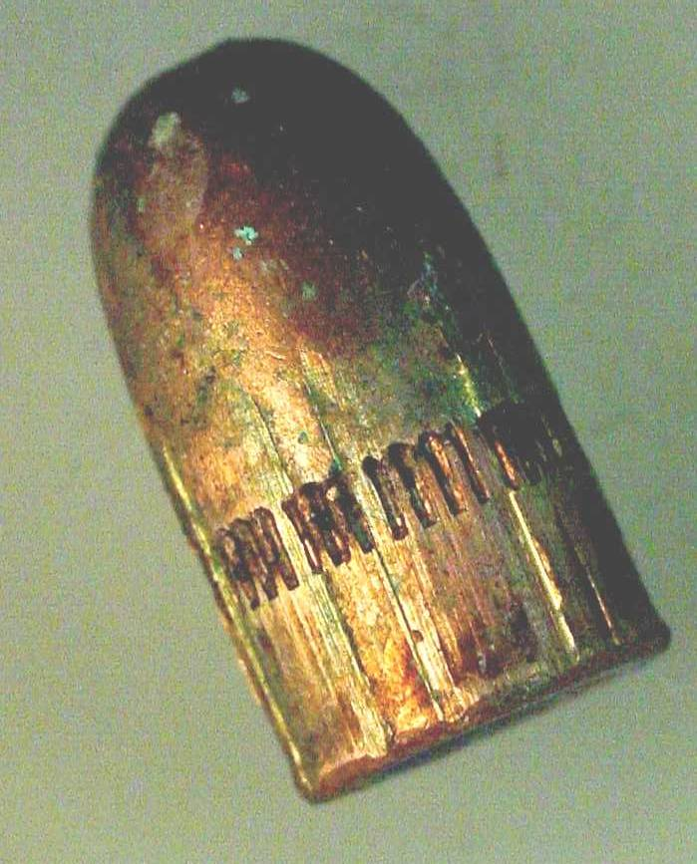
Jacketed
A lead bullet completely coated in copper
Copper improves exit velocity
Used to hold the shape of the bullet in an effort to maximize penetration
bsapp.com

Slide 47
Bullet Analysis & Comparison
bsapp.com

Slide 48
Bullets to Guns
It is extremely difficult to convict some one of a murder without possession of the murder weapon.
In the case of a shooting, matching a bullet with a gun is essential in most cases.
bsapp.com

Slide 49
Bullets become scared by rifling as they travel down the barrel of a gun
bsapp.com

Slide 50
Striations
bsapp.com

Slide 51
bsapp.com

Slide 52
bsapp.com

Slide 53
bsapp.com

Slide 54
bsapp.com

Slide 55
Matching Procedure
Fire bullets from a suspected weapon
With the aid of a comparison microscope, compare these “test fires” to the suspected bullets
Striations must be identical for a positive match
bsapp.com

Slide 56
Comparison Microscope
Two scopes- One Field
bsapp.com

Slide 57
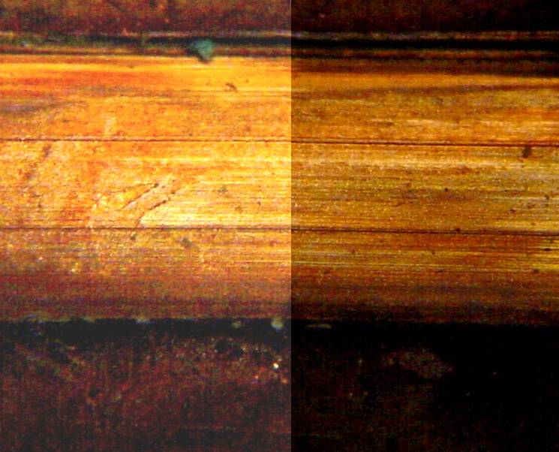
bsapp.com

Slide 58
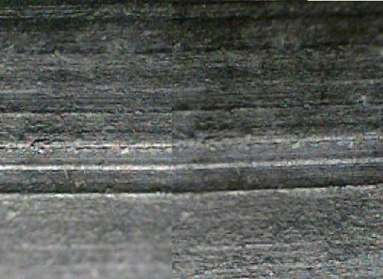
bsapp.com

Slide 59
Forensic Chemistry Lab, Ballistics
http://www.youtube.com/watch?v=WGHCTMTh7TE
Pay close attention to the techniques.

Slide 60
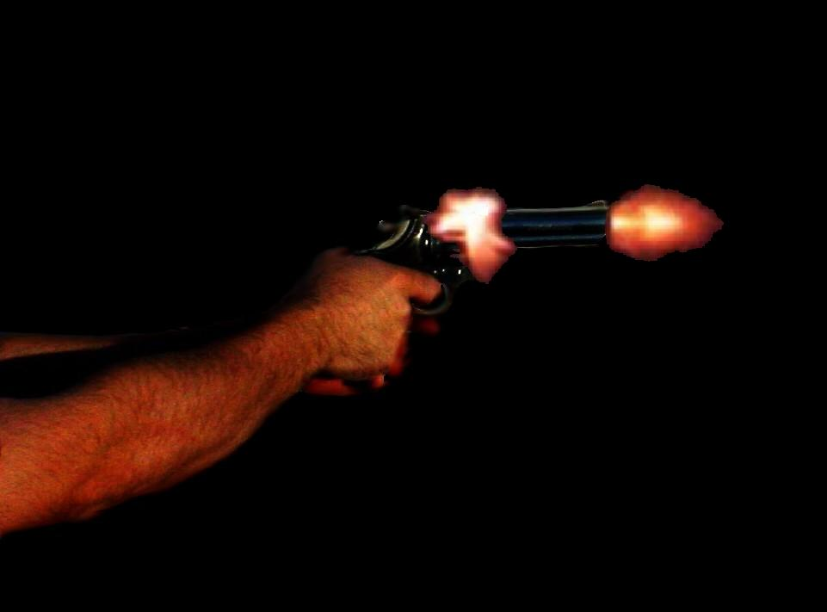
What happens to bullets when they are fired?
bsapp.com

Slide 61
Pull the Trigger and . . .
A pin or hammer strikes the primer. This causes a spark.
The powder is then ignited causing an explosion.
This explosion starts the bullet down the barrel of the gun
bsapp.com

Slide 62
Down the Barrel
As a bullet travels down the barrel of a gun it is twisted by the lands and grooves of the barrel.
bsapp.com

Slide 63
Out of the Barrel
5.This rifling causes the bullet to exit the end of the barrel in a spiral motion.
bsapp.com

Slide 64
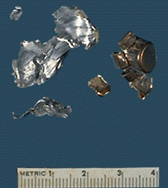
What happens to a bullet when it hits a target?
Most bullets tend to mushroom when they hit a target.
Some bullets nearly disintegrate.
Left are bullet fragments from a ½ jacketed hollow point.
bsapp.com

Slide 65
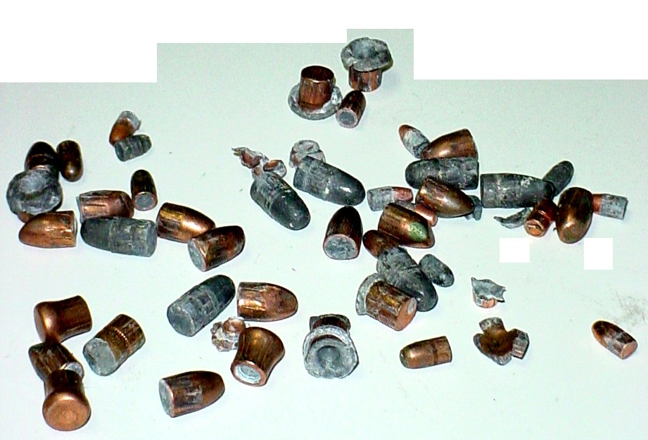
Not all bullets mushroom the same. A lot depends on the speed and shape of the bullet, and the characteristics of the target.
bsapp.com

Slide 66
bsapp.com

Slide 67
Some more bullets recovered after firing
The striations from the rifling are still visible
bsapp.com

Slide 68
What happens to bullets when they are fired?
Think. Pair. Share.
1. How do you know a gun was recently fired?
2. How can you estimate the distance from which it was fired?
bsapp.com

Slide 69
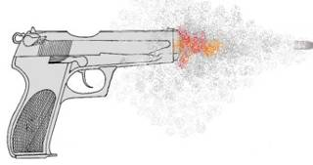
Gunshot Residue (GSR)
When a weapon is fired:
Primer and propellant particles blowback toward the shooter.
What follows the bullet includes:
Combustion products, mostly nitrites NO₂⁻)
unburned propellant (nitroglycerin or nitrocellulose)
particles of lead (Pb)

Slide 70
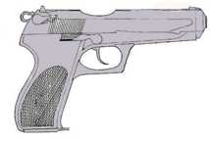
Distance to Target
The Greiss Test converts nitrites to an orange-red color.
Sodium rhodizonate reacts with traces of lead to make purple spots.

Slide 71
After firing pin hits primer…

Slide 72
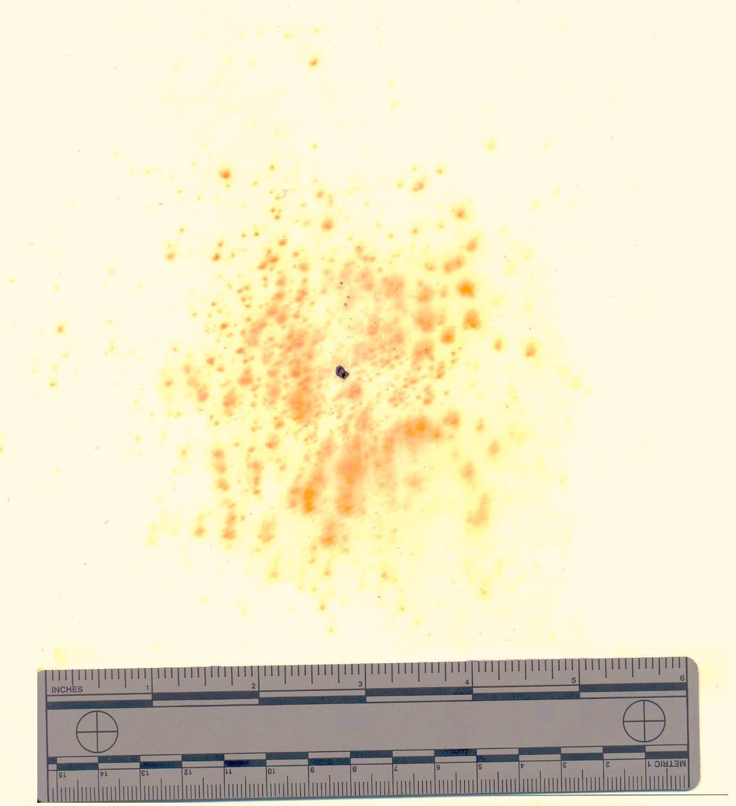
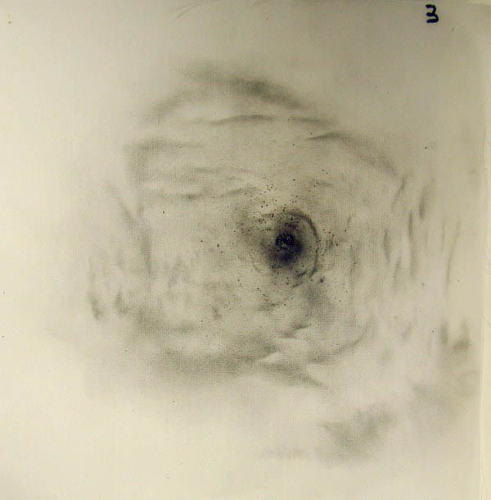

Slide 73
Greiss Test

Slide 74
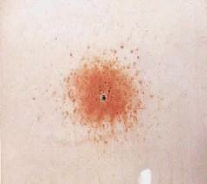
Greiss Test

Slide 76
Which aspects of firearms and ballistics evidence are considered class evidence? Which are considered individual evidence?
INDIVIDUAL | CLASS

Slide 77
Firearms Evidence
Individual:
Striae
Firing pin marks
Breech marks
Extractor marks
Ejector marks
Chamber marks
Class:
Bullet type
Bullet caliber
Bullet weight
Lands and grooves
Rifling
Cartridge case
Head stamp

Slide 78
A slightly fancier forensics test…
http://www.youtube.com/watch?v=JgbdaQWfjDk

Slide 79
Work on Firearms and Ballistics Packet
If you lost it, work on the chapter 15 checkpoint questions as I make you copies.

Slide 80
During Classwork Time
Stay focused on the assignments you are given.
Do the questions INDEPENDENTLY (on your own).
Keep the noise level down.
Ask THREE before you ask ME.
You may put earphones on and listen to music quietly as you do your work.
You must finish a certain number of questions (depends on the person) by the end of the period.

