Slide 1
P6 Environmental Science Catalyst 1/9/14
Read and outline pages 178 – 179 in your notebook. In your outline make sure to include:
Climate – temperature and precipitation
Geographical Location
Types of Animals and their adaptations
Types of Plants and their adaptations

Slide 2
P10 Environmental Science – Thursday, Catalyst 1/9/14
1. Take a textbook.
2. Visit the class website (http://aofscience.weebly.com) and scroll until you see “CATALYSTS!”
3. Answer the questions and click “Submit” when you are done. (You should see: “your response has been recorded.” after you hit submit.)
If you do not have a laptop for whatever reason, take a Catalyst sheet and answer the questions on the paper. Be sure to submit it to me when I call time so you can receive credit.

Slide 3
Agenda 1/9/14
Catalyst
Announcements
Benchmark Exam: January 23 and 24
HW: 1) 6.1 Biomes Worksheet DUE Friday, January 10th. 2) Watch Biome videos posted online
Biome Project Instructions
Independent Work Time
Informal Status Check

Slide 4
Gpoints
Your class can earn class points if:
everyone in class:
Comes to class quietly and on time
Stays focused and on task during class
Leaves classroom neat and organized
Students are teaching other students
Majority of class participates
Follows all classroom expectations and procedures
And more…
P6: 27 (on time, neat room, followed directions)
P10: 26 (followed directions)

Slide 5
Tropical Rain Forest
CLIMATE
Year-round warm temperatures
Receives 6 meters of rain per year. (Most rain out of all biomes)
GEOGRAPHICAL LOCATION
South America, Central America, Southeast Asia, West Africa
Close to the equator
ANIMALS
Most species of animals than other biome
Monkeys have long limbs and grasping tail to swing through canopy trees
PLANT S
Tall trees (50 – 80 meters) create dense covering called canopy (canopy keeps forest dark and damp)
Large, flat leaves of understory plants allow max. surface for light absorption
Shallow roots to max. absorption of nutrients in uppermost layer of soil
Bright attractive flowers to lure pollinators

Slide 6
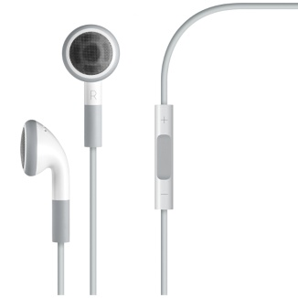
Objectives 1/9/14
We will be able to
Explain how biomes are characterized
Describe the different characteristics of each biome


Slide 7
Biomes
A biome is a group of ecosystems that share similar abiotic and biotic conditions.
(An ecosystem includes all the living things and their physical environments within a particular area.)
http://www.youtube.com/watch?v=hIy0ZlyPPDg

Slide 8
Determining Biomes
Climate – average temperature and precipitation over long periods in a given area
Different temperatures and precipitation can support different types of organisms

Slide 9
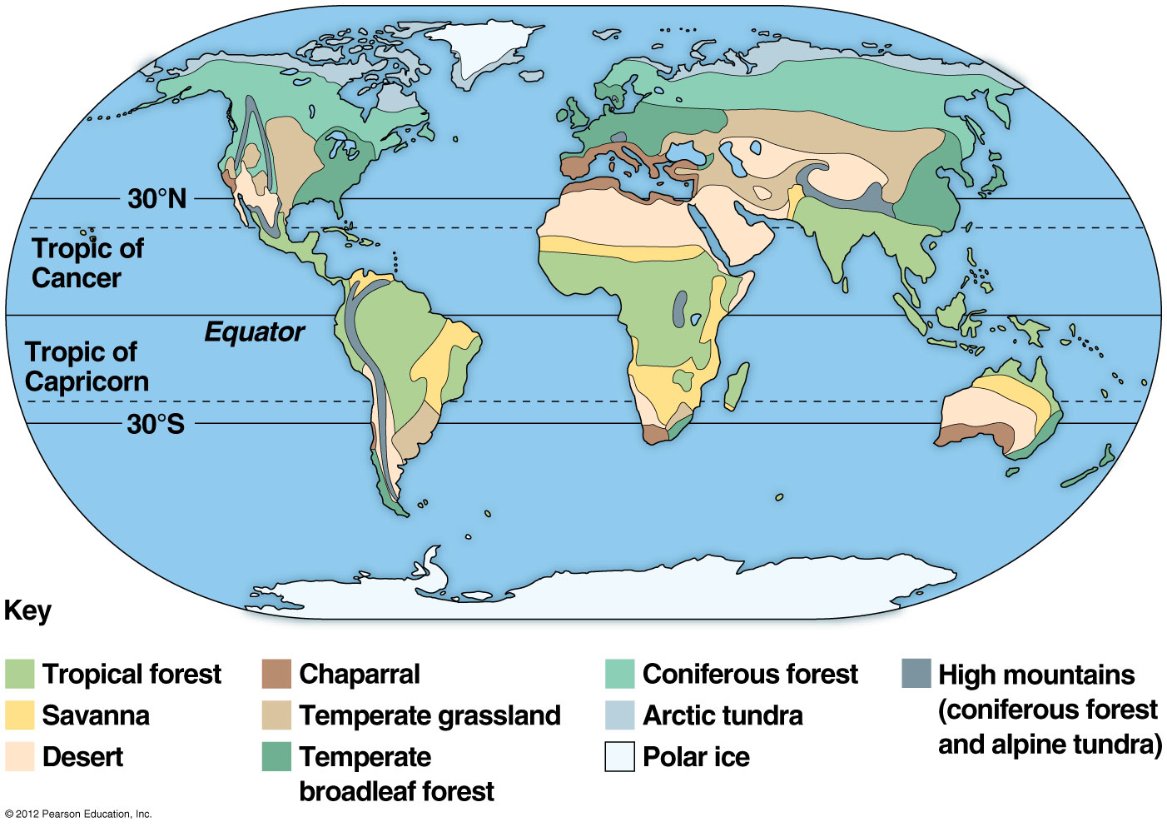

Slide 10
Biome Project
A travel agency is trying to boost travel to different parts of the world by increasing the advertising and selling vacation packages. You have been hired to make a presentation to sell a travel package.

Slide 11
Biome Project
All details are posted on the class website (http://aofscience.weebly.com)
Presentation (brochure, board poster, website, PowerPoint, flyer, Museum Box, and more.)
Divided into groups of 2. You have been assigned a partner. These are non-negotiable. Every time you complain about your partner, one point will be deducted from your grade.

Slide 12
Biome Project – DUE January 27th, 2014.
Keep track of ALL the resources you use for your research! You must cite them using MLA format. (Check on Edmodo for instructions.)
Use class time efficiently! Your level of productivity in class will be evaluated! (Points deducted for off task behavior.)
After presentations are done, class will vote for the best presentations. Winners will earn extra credit. (Presentations will take place after the benchmark.)

Slide 13
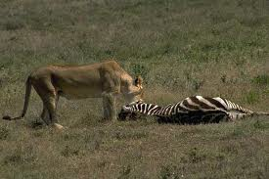
Examples: - Lions Cats Wolves Bears Sharks
Textbook: The process by which an individual of one species, a predator, hunts, captures, kills, and consumes an individual of another species.
Own words: an animal that kills and eats other types of animals for food
Predation
Characteristics:
-excellent senses to detect prey
-very fast
-sharp teeth, claw, and jaws

Slide 14
Extra Credit Opportunity
Want to make a Vocabulary Frayer Model? Type the vocabulary word(s) from chapter 5 that you would like to focus on Edmodo so that no one else will choose those words.

