Slide 1
Catalyst 5/20/13
What is kinetic energy?
How do you increase the kinetic energy of gases?
What are the values of Standard Temperature and Pressure (STP)?
Describe the relationship between volume and pressure when the temperature does not change.
Please have your IDs and uniforms on properly.

Slide 2
Agenda 5/20/13
Catalyst
Announcements
  Packet#13 DUE Wednesday, 5/22/13.
Boyle’s Law Calculations
Class Practice
Exit Slip

Slide 3
Class Points
Your class can earn class points if everyone in class:
Comes to class quietly and on time
Stays focused and on task during class
Leaves classroom neat and organized
Students are teaching other students
Majority of class participates
Follows all classroom expectations and procedures
And more…
P3: 14 (on time, focused, respectful during lessons)
P4: 14 (on time, focused, neat room)
P6: 14 (on time, neat room, focused)

Slide 4




Objective 5/20/13
We will be able to
Calculate pressure-volume changes at constant temperature using Boyle’s Law.



Slide 5
Quick Review!
What’s pressure? Force over area.
What are the units of pressure? mmHg, Torr, atm, kPa, Pa, Psi

Slide 6
What’s volume?
The amount of space something takes. Some units of volume include: mL, cm³, L and m^{3.}

Slide 7
Boyles’ Law Virtual Lab
Open the link posted on Edmodo.
http://www.sciencegeek.net/VirtualLabs/BoylesLaw.html
Input your pressure and volume data into two columns using the NUMBERS APP on your iPad

Slide 8
What did we observe in the Boyle’s Law virtual lab?

Slide 9
What do you notice?

Slide 10
Boyle’s Law
Boyle’s law states that at a fixed temperature, volume and pressure are inversely proportional.
Mathematically:
P₁V₁ = P₂V₂

Slide 11
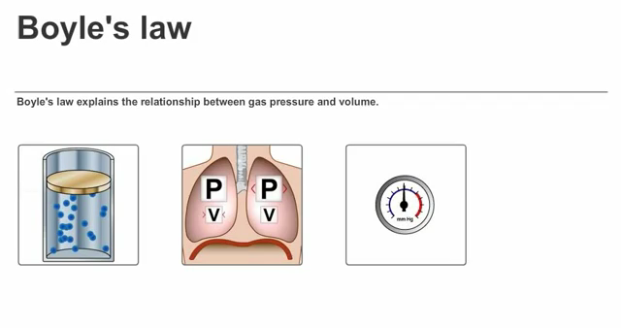

Slide 12
Boyle’s Law Calculations
Example#1. A sample of oxygen gas has a volume of 150.0 mL when its pressure is 0.947 atm. What will the volume of the gas be at a pressure of 0.987 atm if the temperature remains constant?
Find a partner next to you and try to solve it with the equation you’ve been given!

Slide 13
Example#1. A sample of oxygen gas has a volume of 150.0 mL when its pressure is 0.947 atm. What will the volume of the gas be at a pressure of 0.987 atm if the temperature remains constant?

Slide 14
Example#1. A sample of oxygen gas has a volume of 150.0 mL when its pressure is 0.947 atm. What will the volume of the gas be at a pressure of 0.987 atm if the temperature remains constant?
Formula*
List information from question
Isolate unknown variable
Plug In numbers from list
Solve the equation and do the math

Slide 15
Extra Credit Opportunity! Make a FLIPS poster. (+20% on Packet#13)

Slide 16
Example#2. A sample of oxygen gas has a volume of 300.0 mL when its pressure is 0.80 atm. What will the pressure of the gas be if its final volume is 250.0 mL if the temperature remains constant?

Slide 18
Summarize Boyle’s Law in your own words…
Write your response in the space at the bottom of page 11.

Slide 19
During Classwork Time
Stay focused on the assignments you are given.
Do the questions INDEPENDENTLY (on your own).
Keep the noise level down.
Ask THREE before you ask ME.
You may put earphones on and listen to music quietly as you do your work.
You must finish a certain number of questions (depends on the person) by the end of the period.
DO NOT FORGET YOUR STAMPS! You cannot get them once you leave the class.

Slide 20
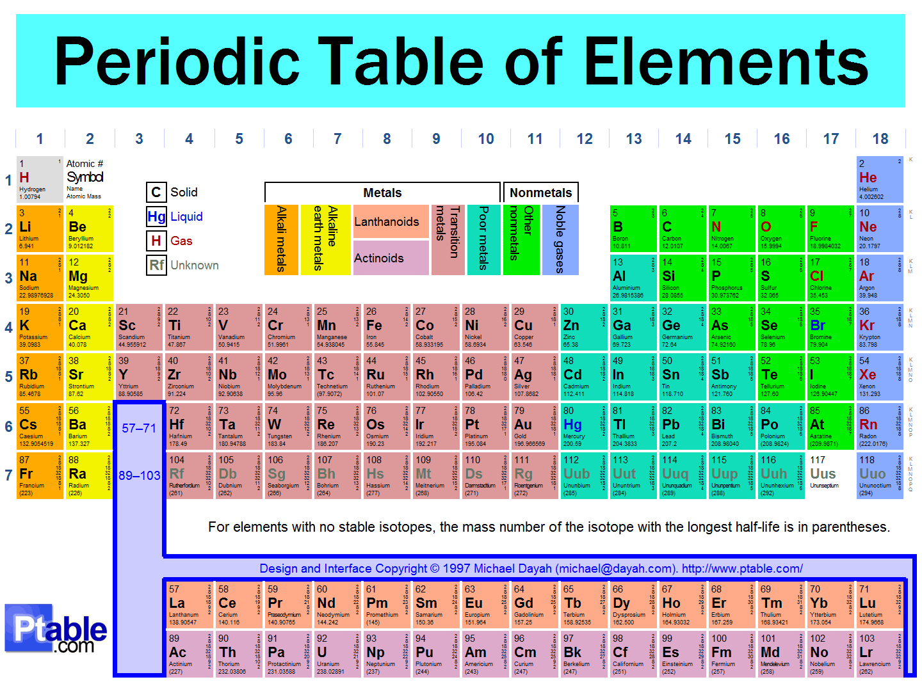

Slide 21
Exit Slip
QUIETLY and INDEPENDENTLY answer the following on Notability and email it to gutierrezbr@elizabeth.k12.nj.us with “p6 ES 5/20” on the subject line. I must receive it by the end of the period. If you are talking or copying, you will not receive credit.*Each E.S. worth 20 pts.
How much will the volume of 75.0 mL of neon change if the pressure is lowered from 50.0 torr to 8.00 torr? Show ALL your work.

