Slide 1
Catalyst 9/13/12
Make sure you have Packet#1. Please answer on a sheet of paper. You have 5 minutes.
How many emergency passes do you receive in a marking period?
If for some reason you were unable to do your work, when should you tell Mr. Gutierrez about your reason(s)?
What happens if you have your phone out during class?
What concerns do you have about this class or classroom procedures?

Slide 2
Agenda 9/12/12
Catalyst
Chemistry as a Science Lesson
Independent Class Practice
Exit Slip

Slide 3
Objectives
We will be able to
1. Define chemistry and list the six main branches of chemistry.
2. Compare and contrast basic research, applied research, and technological development.

Slide 4
During a Lesson
Put all phones and other electronic devices away. (iPads will be discussed in a minute.)
No talking or noise-making.
Stay seated at all times (unless you are dying.)
Participate when asked.
Keep your head up and stay focused.
Raise your hand if you have a question RELATED to the current lesson. (Personal problems are addressed later.)

Slide 5
Packet Notes
Open your packet to page 3 and follow along. Fill in the necessary words.

Slide 6
Chemistry is a Science
Chemistry is the study of the composition, structure, and properties of matter, the processes that matter undergoes, and the energy changes that come with these processes.

Slide 7
Six Main Branches of Chemistry
Organic Chemistry
Inorganic Chemistry
Physical Chemistry
Biochemistry Chemistry
Theoretical Chemistry
Analytical Chemistry

Slide 8
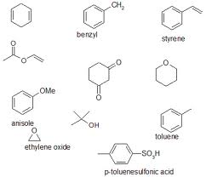
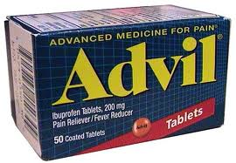
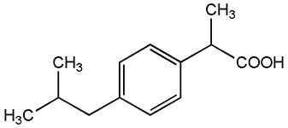
Organic Chemistry
Study of carbon-containing compounds
Pharmacists, doctors,
drug researchers, and
Etc. often use organic
chemistry

Slide 9
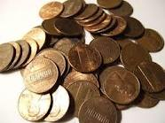
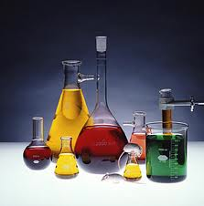
Inorganic Chemistry
Study of compounds not containing carbon (what organic chemistry doesn’t cover)
Scientists who study metals and other non-living materials often use inorganic chemistry

Slide 10
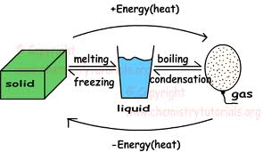
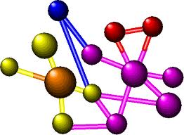
Physical Chemistry
Study of the properties and changes of matter and their relation to energy
Physical chemists focus on how energy
is involved within atoms

Slide 11
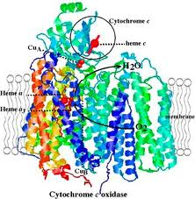
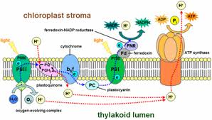
Biochemistry
Study of substances and
process occurring in living things
Closely related to organic chemistry
Many doctors, medical professionals, and researchers use organic chemistry on a daily basis

Slide 12
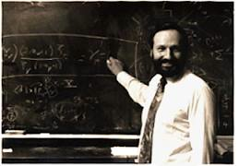
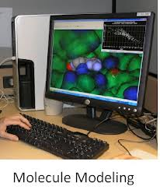
Theoretical Chemistry
The use of mathematics and computers to understand the principles behind chemical behavior and to design and predict the properties of new compounds

Slide 13
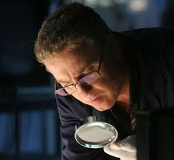
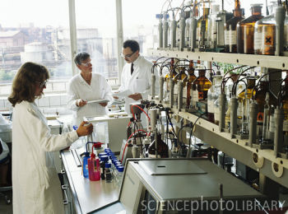
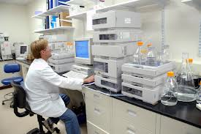
Analytical Chemistry
The identification of components and composition of materials
Forensic scientists, detectives, medical researchers, and more use analytical chemistry to help identify certain materials

Slide 14
Types of Research
Scientific research has expanded our knowledge and improved our lives in many ways. The three main types of research are:
Basic Research
Applied Research
Technological Development

Slide 15
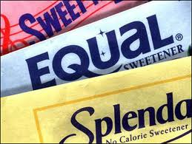
Basic Research (I want to know…)
Done for the sake of increasing knowledge
Answers why and how a chemical reaction occurs
Can result in random discoveries
James M. Schlatter, a chemist who accidentally discovered the sweet taste of aspartame

Slide 16
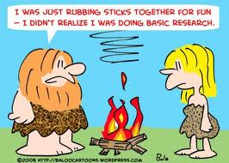
Basic Research

Slide 17
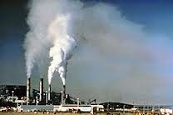
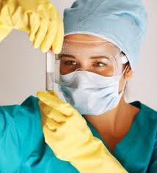
Applied Research
Done to solve a problem
Scientists do research to solve problems such as finding a cure for cancer and reducing pollution.

Slide 18
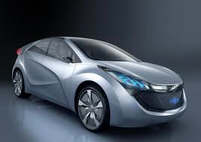
Technological Development
Involves the production and use of products that improve our lives
The results of technological development are: computers, cars, cell phones and etc.
Usually depends on basic research and/or applied research

Slide 19
Chemistry Gallery Walk
If you are given a scenario on a slip of paper, you are to walk to the slide that matches that branch of chemistry and post it under that slide. (use masking tape)
If you are NOT given a scenario, brainstorm with a partner and write an example of a scenario that relates to that branch of chemistry.
For the three types of research, come up as many examples as you can and write them under the appropriate slide.

Slide 20
During Classwork Time
Stay focused on the assignments/projects you are given.
Keep the noise level down.
Answer as many questions as possible independently (unless I tell you it is group work).
Ask THREE before you ask ME.

Slide 21
Packet Stamp
If you follow all classroom policies and expectations, you will receive a stamp.
If you use your time efficiently and complete as many questions as you can independently, you will receive a stamp for classwork. (Any work not completed must be finished for homework.)
It is YOUR RESPONSIBILITY to make sure you get a STAMP by the end of the period! You can only get a stamp for that day only.
DO NOT LOSE THAT BACKSHEET.

Slide 22
Exit Slip
On a half sheet of paper:
1. Summarize the main differences between basic research, applied research, and technological development.

Slide 23
Coming Soon…
Emergency Passes
Catalyst Sheets
Late Binder

