Slide 1
Catalyst 10/26/11
Which subatomic particles are positively charged?
Which subatomic particles are negatively charged?
Which subatomic particles are electrically neutral (no charge)?
Where in the atom is the nucleus found?
(Refer to your notes on Tuesday!)
Period 4: Submit your work from Tuesday with the Catalyst

Slide 2
Agenda
Catalyst (7 minutes)
Announcement (1 minute)
Verbal Drill (2 minutes)
Counting Subatomic Particles Lesson (12 minutes)
Class Practice (15 minutes)
Exit Slip (5 minutes)

Slide 3
Announcements
Re-take exam today at 7th period or at 4pm.
You may re-take it on Friday as well if you still need extra help.

Slide 4
Verbal Drill
One person speaking at a time (so everyone can hear the question and answer!)
You may only go once
If you don’t know the answer, have a classmate help you. You still need to say the answer if its your turn!
Have your periodic table ready
Class with the most Verbal Drill points will receive 5 points in the Chapter 4 test

Slide 5
Objective(s)
SWBAT determine the number of protons and electrons of an element’s atom based on its atomic number.
SWBAT determine the number of neutrons based on atomic number and atomic mass.
Remember DO NOT ask me what to copy down. I will tell you.

Slide 6
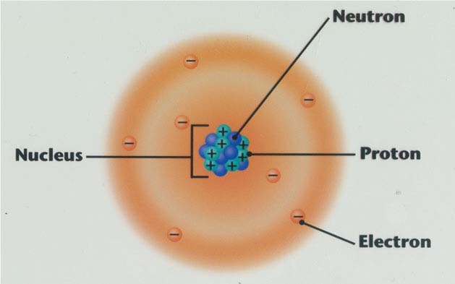
Parts of the Atom
Nucleus: very small region near the center of the atom
Protons: POSITIVELY charged subatomic particles
Neutrons: electrically NEUTRAL subatomic particles (NO CHARGE)
Electrons: NEGATIVELY charged subatomic particles

Slide 7
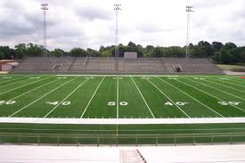
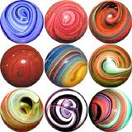
Nucleus is like a marble in a football field

Slide 8
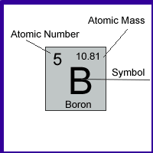
Periodic Table Review
The Periodic Table tells us:
Atomic Number (# of protons)
Relative Atomic Mass
Element Symbol
Take out your periodic table and follow along.

Slide 10
Finding the number of protons
The atomic number on the periodic table tells us the number of protons that type of atom has.
The number of protons is what IDENTIFIES an element.
(i.e. carbon is carbon because it has 6 protons)

Slide 11
On your whiteboards…
How many protons does Neon have?
How many protons does Lithium have?

Slide 12
Finding the number of electrons
Because an atom is electrically neutral, an atom has the same number of electrons as protons.
In other words:
Atomic # = # of protons = # electrons

Slide 13
On your whiteboards…
How many electrons does Neon have?
How many electrons does Magnesium have?

Slide 14
Finding the number of neutrons
Number of neutrons = Atomic Mass Number – Atomic Number
Example:
Carbon has a mass number of 12 and an atomic number of 6.
# of neutrons = 12 – 6 = 6 neutrons

Slide 15
On your whiteboards…
Oxygen has an atomic mass number of 16. How many neutrons does an oxygen atom have?
(Hint: Look at the periodic table for Oxygen’s atomic number.)

Slide 16
Finding the number of subatomic particles
# of Protons | # of Electrons | # of Neutrons
Atomic Number | Atomic Number (for electrically neutral atoms) | Mass number – atomic number
COPY THIS DOWN

Slide 17
Quick Summary
To find the number of protons and electrons in an element’s atom, look at the atomic number of that element.
To find the number of neutrons: Mass number – atomic number.
To find the mass number: atomic number + number of neutrons

Slide 18
Exit Slip (Complete this silently and independently)
On a half a slip of paper, answer the following:
Which subatomic particles identifies an element?
How many protons does Carbon have?
How many electrons does Nitrogen have?
A Boron atom has a mass number of 11 and an atomic number of 5. How many neutrons does it have?

