Slide 1
Catalyst 1/4/13
Draw the Lewis dot structure of Krypton.
Express 30 kg in grams.
*Honors: Submit homework in the bin before you sit down.

Slide 3
Agenda 1/4/13
Catalyst ✔
Octet Rule
Cations
Class Practice
Exit Slip

Slide 4
Class Points
Your class can earn class points if:
everyone in class:
Comes to class quietly and on time
Stays focused and on task during class
Leaves classroom neat and organized
Students are teaching other students
Majority of class participates
Follows all classroom expectations and procedures
And more…
P3: 34 pts (on time, neat room, followed test procedures)
P4: 34 pts (on task, on time, neat room)
P6: 40 pts (on time, neat room, helping each other, focused)

Slide 5
Objective
We will be able to
Describe the Octet Rule and explain why ions form.
Write the electron configuration of cations



Slide 6
Why do elements react?

Slide 8
The Octet Rule
The Octet Rule States that atoms tend to gain, lose, or share electrons so that they have a total of 8 valence electrons.*
*Common Exceptions: Helium, Lithium, Beryllium, and Boron

Slide 9
The Octet Rule
Many atoms become ions in order to have 8 valence electrons. Ionization is the process by which ions form.

Slide 10
Most atoms want to get Noble or “Die trying”
Another way of looking at the Octet Rule is that atoms of almost all elements wants to have a Noble Gas configuration (8 valence electrons.)

Slide 11
The Octet Rule and Ions
An ion is an atom or group of bonded atoms, that has a positive or negative charge.

Slide 12
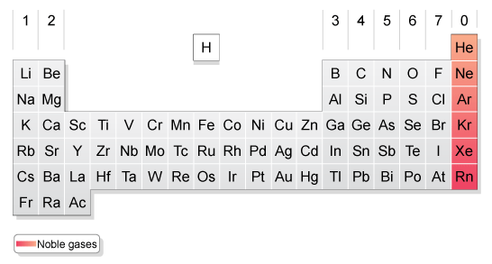
All Noble Gases have 8 valence electrons.

Slide 13
Ions
Two types:
Cations – positive +
Anions – negative -

Slide 14
Cation (+)
A cation is a positively charged ion. Cations form when neutral atoms LOSE electrons.*
*The process of LOSING electrons is called OXIDATION.

Slide 15
Cation Examples
Li+
1s²
2. Al³⁺
1s²2s²2p⁶

Slide 16
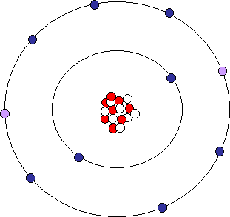

Slide 18
Electron Configuration of Cations
Element | Neutral | Cation | Cation Symbol
K | 1s²2s²2p⁶3s²3p⁶4s¹

Slide 19
Electron Configuration of Cations
Element | Neutral | Cation | Cation Symbol
Ca | 1s²2s²2p⁶3s²3p⁶4s²

Slide 20
Electron Configuration of Cations
Element | Neutral | Cation | Cation Symbol
Sc | 1s²2s²2p⁶3s²3p⁶4s²3d¹

Slide 21
Real World Connection – Why should I care?
Your body depends on certain ions to regulate its functioning. We need calcium ions, sodium ions, and potassium ions to survive.

Slide 22
During Classwork Time
Stay focused on the assignments you are given.
Do the questions INDEPENDENTLY (on your own).
Keep the noise level down.
Ask THREE before you ask ME.
You may put earphones on and listen to music quietly as you do your work.
You must finish a certain number of questions (depends on the person) by the end of the period.
DO NOT FORGET YOUR STAMPS! You cannot get them once you leave the class.

Slide 23
Exit Slip
QUIETLY and INDEPENDENTLY answer the following on Notability and email it to gutierrezbr@elizabeth.k12.nj.us with “p4 (or p6) ES 1/3” on the subject line. I must receive it by the end of the period. If you are talking or copying, you will not receive credit.
Predict the type of ion that Bromine will form. Write the electron configuration of the cation AND its symbol.

