Slide 1
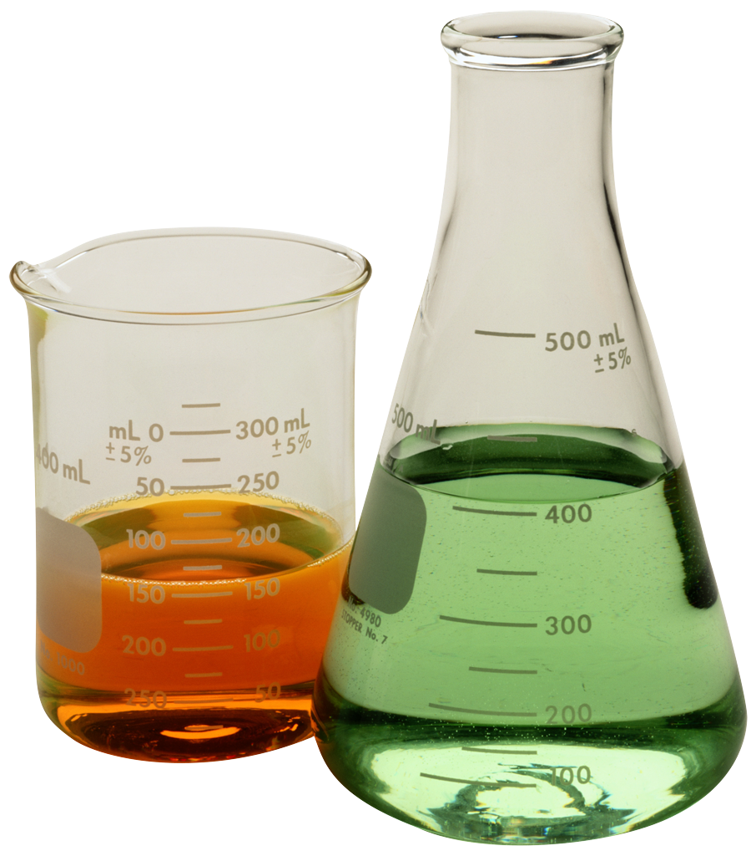
Chemistry
Chapter 1 Review

Slide 2
Chemistry as a science
Chemistry is the study of the composition, structure, and properties of matter and the changes it undergoes.

Slide 3
Matter
Matter is anything that has mass and takes up space. (Everything is made up of matter)
Mass is the measurement of the amount of matter.

Slide 4
Atom
The atom is the smallest unit of an element that maintains the chemical identity of that element.
An element is a pure substance that cannot be broken down into simpler, stable substances and is made of only one type of atom.

Slide 5
Physical and Chemical Properties
A physical property is a characteristic that can be observed or measured without changing the identity of the substance.
A chemical property relates to a substance’s ability to undergo changes that transform it into different substances.

Slide 6
Physical and Chemical Changes
Physical change affects size, texture, and shape. (ex: cutting, boiling, melting, molding, and grinding)
Signs of a chemical change/reaction: bubbling, color change, temperature change, explosion.
  Not as easy to observe

Slide 7
Classifying Matter
A mixture is a blend of two or more kinds of matter, each with its own identity and properties. (NOT necessarily two or more elements)
  CAN be physically separated
  Homogenous mixture = uniform (the same) in composition
  Heterogenous mixture = not uniform (different) in composition
A pure substance has a fixed composition and every sample of a pure substance has the same characteristics.
  CANNOT be PHYSICALLY separated
  An element by itself is a pure substance
  A compound by itself is a pure substance (ex: NaCl, CO)
    Compounds can be CHEMICALLY separated into elements

Slide 9
Periodic Table
Has all 118 known chemical elements
GROUPS (families) = vertical columns (18 groups)
PERIODS = horizontal rows (7 periods)
Arranged in order of atomic number.
The periodic table tells you 3 main pieces of information:
Atomic Number
Element Symbol
Atomic Mass

Slide 10
Periodic Table Continued
Elements in the same group have similar chemical properties.
Elements close to each other in a period tend to be more similar.
Group 1 Elements = Alkali Metals
Group 2 Elements = Alkaline Earth Metals
Groups 3 to 12 Elements = Transition Metals
Group 17 Elements = Halogens
Group 18 Elements = Noble Gases (non-reactive)

Slide 11
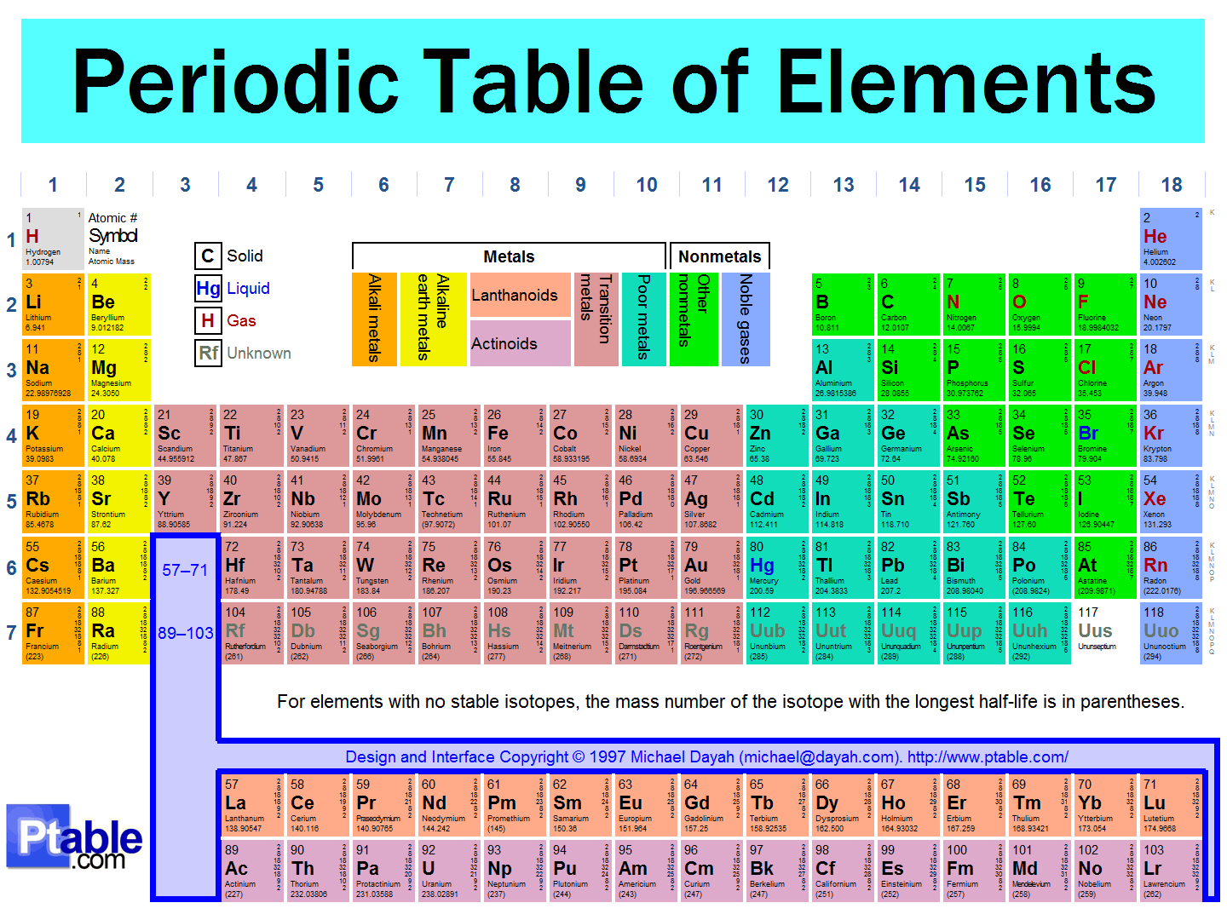

Slide 12
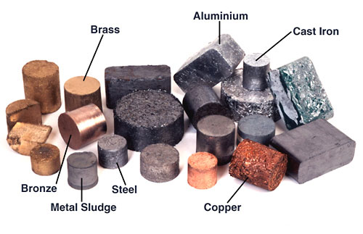
Metals
an element that is a good conductor of heat and electricity
CHARACTERISTICS OF METALS
Malleable (can be hammered or rolled into thin sheets)
Ductile (can be drawn into a fine wire)
Lustrous (shiny)
Most are SOLIDS at room temperature (25 degrees Celsius)

Slide 13
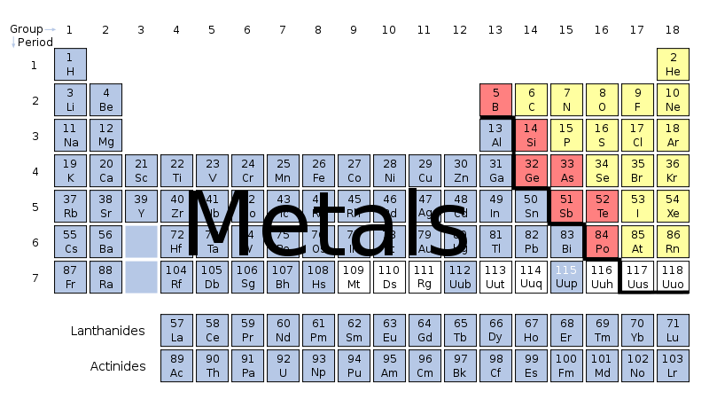
METALS

Slide 14
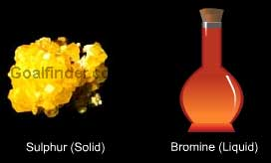
Nonmetals
An element that is a poor conductor of heat and electricity
Many nonmetals are gases at room temperature
Nonmetal solids tend to be brittle rather than malleable and ductile

Slide 15
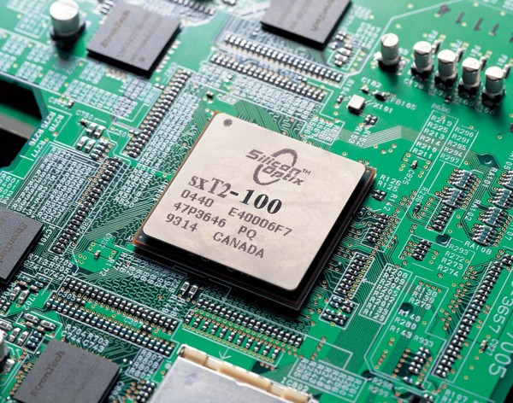
Metalloids
Elements that have some characteristics of metals and some characteristics of nonmetals
Tend to be semiconductors of electricity
ALL metalloids are solids at room temperature
Metalloids are used in materials found in computers, calculators, phones, and radios

Slide 16
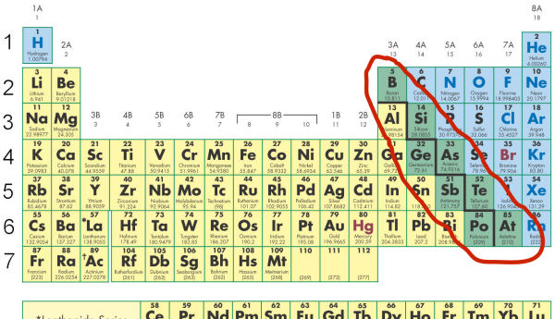
Metalloids

