Slide 1
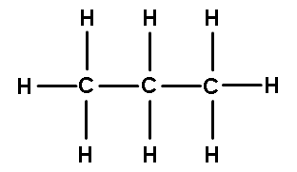
Catalyst 11/8/12
Polar bears roam the Artic ice and have the ability to hibernate for long periods of time. They need to have a way to store a lot of energy in their bodies for a long time. Which of the following macromolecules are primarily used for long-term energy storage?
Look at the image below. This macromolecule is a _________. a) Fatty acid
b) Hydrocarbon
c) Nitrate
d) Carbohydrate
3. Which subatomic particle has greater mass—an electron or proton?
4. If something is made up of amino acids, it is a _______. (CHOOSE ONE: atom, lipid, carbohydrate, or protein.)

Slide 2
Agenda 11/7/12
Catalyst
Macromolecules Review
Announcements
Packet #1 DUE Friday, November 9, 2012.
Packet #2 DUE Tuesday, November 13, 2012.
Population Size, Density, and Distribution
Independent Work Time
Exit Slip

Slide 3
Objective
We will be able to:
Describe the different

Slide 4
Population Size
Population size describes the number of individual organisms present in a given population at a given time. The overall health of a population can often be monitored by tracking how its size changes.

Slide 5
Determining Population Size
Counting every individual in a population can be difficult.
Sampling is how population size is often estimated.
Sampling is helpful for estimating population size in very LARGE POPULATIONS and populations that are WIDELY SPREAD OUT

Slide 6
How Sampling Works
1. Ecologists count the number in a smaller sample area.
2. Ecologists use that information to estimate the number of individuals in the larger overall area.
Ex: If there are 100 oak trees in one square kilometer of a large forest, it is reasonable to estimate that there are about 1000 oak trees in ten square kilometers of the same forest.
3. Ecologists may also use signs of organisms such as animal tracks or droppings to estimate population sizes.

Slide 7
Population Density
Population density describes the number of individual within a population per unit area. For example, the 1500 golden toads were found within 4 square kilometers and thus, their population density was 1500 toads/4 km²
Units for area = m², km², cm², hectare, acre…
Mathematically, population density = Number of organisms/area

Slide 8
Population Density Practice
On Notability, calculate the population density of:
9500 mice found in a 15 m x 15 m room.
3.2 x 10³ chickens in 42 m²

Slide 9
Population Density of Halsey AOF Students
What would you do to calculate the population density of Halsey AOF students?
What information do you need?
How are you going to get it?
What might be some challenges? How are you going to overcome these challenges?

Slide 10
Catalyst 11/13/12
Compile your data with your neighbors and estimate the population density of Halsey AOF. Do this quietly.
Think about your “data collection methods” from last Friday. What went well? What could you have improved upon? Be specific.

Slide 11
Agenda 11/13/12
Catalyst
Announcements
Benchmark Exam#1 November 19th/November 20th
Purchase spiral notebook for pre-work*
Packet#2 can be submitted tomorrow
Population Arrangement Lesson
Independent Work Time
Atmosphere, Hydrosphere, and Water Cycle Review
Study Strategies

Slide 12
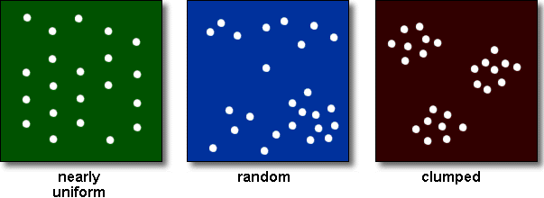
Population Distribution
Population distribution describes how organisms are arranged in a given area. There are three different distribution types: random, uniform, and clumped.

Slide 13
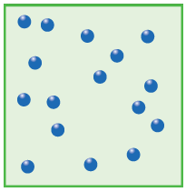
Random Distribution
No particular pattern
Resources are readily available throughout a given area

Slide 14
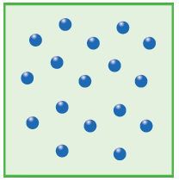
Uniform Distribution
Individual organisms evenly spaced throughout an area
Can happen when individuals compete for space or holding a territory

Slide 15
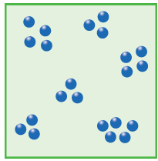
Clumped Distribution
Organisms grouped near resources like food, sunlight, or heat
Most common distribution in nature

Slide 16
How do you think human populations are arranged?

Slide 17
Uniform, clumped, or random?

Slide 18
Uniform, clumped, or random?

Slide 19
Uniform, clumped, or random?

Slide 20
Exit Slip 11/13/12
Calculate the population density of Elizabeth if the population is 125, 660 people and the area is 35.48 km². Show all your work.
Discuss the three different types of population distribution. Draw a diagram showing the differences. Why are human populations commonly found in a clumped arrangement?
Email to gutierrezbr@elizabeth.k12.nj.us with “p5 ES 11/13” as the subject line.

Slide 21
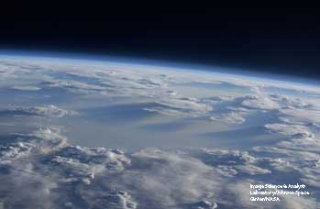
The Biosphere and Atmosphere
Lesson 3.3 Earth’s Spheres
Biosphere: The part of Earth in which living and nonliving things interact
Atmosphere: Contains the gases that organisms need, such as oxygen; keeps Earth warm enough to support life
Earth’s atmosphere, seen from space

Slide 22
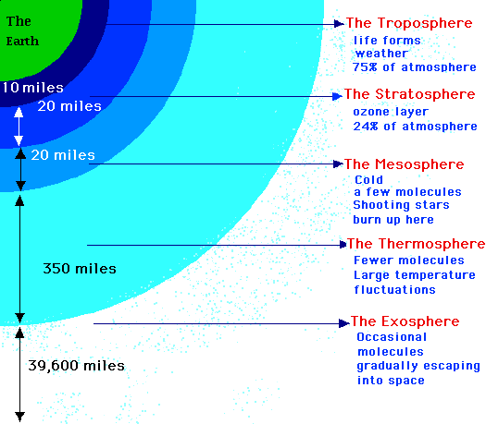
This looks like:

Slide 23
Facts About the Atmosphere Layers
Layer of the Atmosphere | Type of Activity
Troposphere | Weather & Humans
Stratosphere | Airplanes/ozone
Mesosphere | Destruction of meteors
Thermosphere | Space shuttles only
Exosphere | Connects to outer space

Slide 25
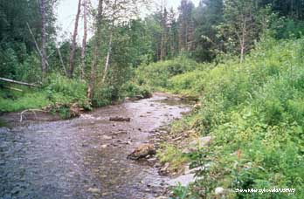
The Hydrosphere
Lesson 3.3 Earth’s Spheres
Consists of Earth’s water
Most of Earth’s water (97.5%) is salt water.
Only 0.5% of Earth’s water is unfrozen fresh water usable for drinking or irrigation.
Earth’s available fresh water includes surface water and ground water.
Greenlaw Brook, Limestone, Maine
Did You Know? If it is depleted, groundwater can take hundreds or even thousands of years to recharge completely.

Slide 26
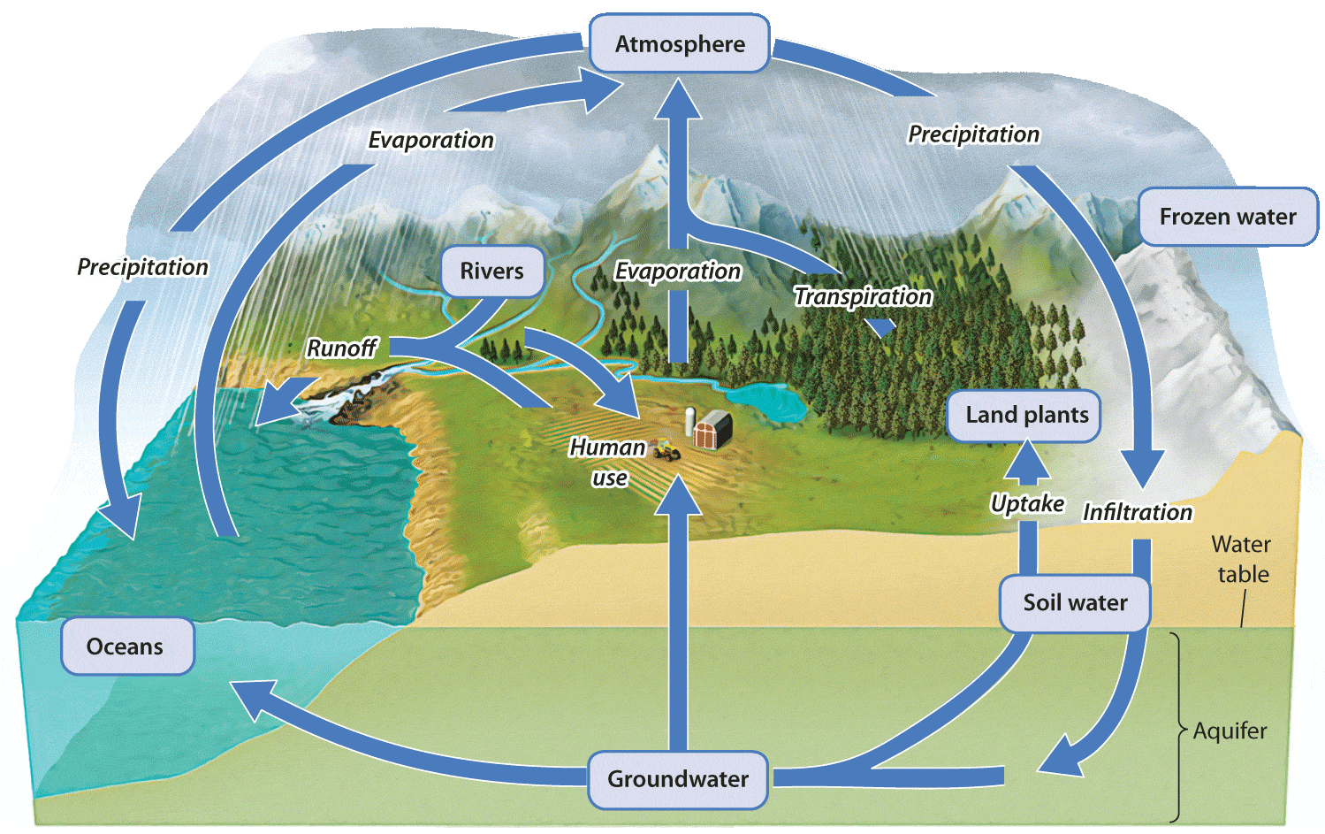
The Water Cycle
Lesson 3.3 Earth’s Spheres

Slide 27
Study Strategies
Create Flash Cards
On the front: Picture and/or Term
On the back:
Examples (if applicable)
Definition in your OWN WORDS
Pictures or diagrams that help you remember that term or concept
Find a partner and explain the whole process. Your partner must point out what you got wrong and repeat your explanation until it is 100% accurate.**
Create QuickStudy Sheets
Summarize large concepts into short phrases or words
Use flow charts, pictures, and other diagrams

Slide 28
Quick Study Sheet
ONE SHEET PER TOPIC
Atoms and Compounds
pH
Macromolecules – Due TOMORROW
Cellular Respiration and Photosynthesis
Biogeochemical Cycles
Parts of the Earth
Plate Tectonics
Different Spheres (Atmosphere, Lithosphere, Hydrosphere…)

Slide 29
Quick Sheet – Atoms and Compounds
Model of the atom
Properties of subatomic particles (mass, charge, location)
Electrons
Protons
Neutrons
Information from the Periodic Table
Atomic Number
Relative Atomic Mass Number
Compounds
Ionic vs. Covalent
Water and Hydrogen Bonding (cohesion, resistance to temperature etc.)

Slide 30
When we feel a little bit more confident with this material, we will do verbal drill to enforce it!

