Slide 1
Catalyst 2/12/13
Take a Catalyst sheet by the door.
Describe 2-3 toxic substances commonly found in your environment. Based on what you know, predict some of the health effects of these substances.

Slide 2
Agenda 2/12/13
Catalyst
Announcements
HW: Read and outline Chapter 9, Lesson 2. DUE TOMORROW 2/13/13.
Environmental Toxins Discussion
Exit Slip
Finish Planet Earth Video.

Slide 3
Class Points
Your class can earn class points if:
everyone in class:
Comes to class quietly and on time
Stays focused and on task during class
Leaves classroom neat and organized
Students are teaching other students
Majority of class participates
Follows all classroom expectations and procedures
And more…
P5: 23 pts (on time, focused, have IDs on)

Slide 4
New Note Taking Procedure
PowerPoints will be uploaded on Edmodo (or website if there are technical issues)
Open these files on Notability and take notes as needed
During mini-lectures, give me your undivided attention and be prepared to discuss.
When you go home, write a summary of the notes AFTER your outline.

Slide 5
Class Discussion Expectations
No disrespectful language (teasing, name-calling, cursing, etc.)
Speak one at a time.
Address the ISSUE NOT the person.
Clarify another student’s response by rephrasing or asking a clarifying question.
Avoid general statements like “all _____ people do______”
Use “I” statements
Take notes (will help you write your paper)
Be mindful of “air time.”

Slide 6
Environmental Hazards
What are the different ways that the environment can harm us?

Slide 7
Environmental Hazards
How can we protect ourselves from such harmful effects?

Slide 8
Advertisement
http://www.youtube.com/watch?v=ZaX67ztJjrA

Slide 9
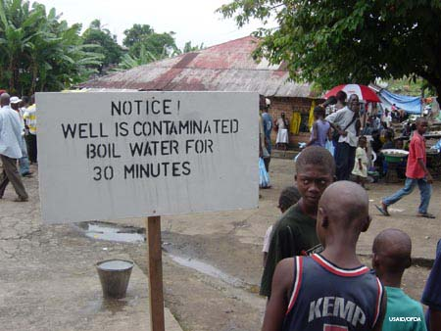
One third of death and disease in the least developed nations is a direct result of environmental causes.

Slide 10
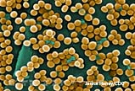
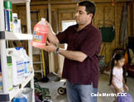
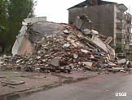
Types of Environmental Health Hazards
Lesson 9.1 An Overview of Environmental Health
Biological: Viruses, bacteria, and other organisms that cause disease
Social: Lifestyle choices that endanger health
Chemical: Harmful artificial and natural chemicals in the environment
Physical: Natural disasters and ongoing natural phenomena, such as UV radiation, that can cause health problems

Slide 11
Epidemiology
Lesson 9.1 An Overview of Environmental Health
The study of disease in human populations—how and where they occur and how they can be controlled
Often involves studying large groups over long periods
Can determine statistical associations between health hazards and effects, but can’t prove the hazards actually caused the effects

Slide 12
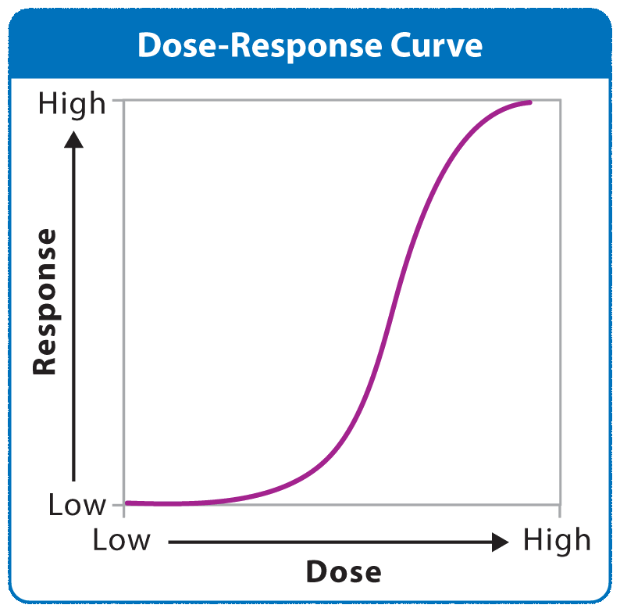
Toxicology
Lesson 9.1 An Overview of Environmental Health
The study of how poisonous substances affect an organism’s health
Toxicity is a measure of how harmful a substance is.
Toxicologists look at toxicity by determining dose-response relationships.

Slide 13
Individual Responses
Lesson 9.1 An Overview of Environmental Health
Sensitivity to hazards varies with age, sex, weight, and immune system health.
Many diseases have genetic as well as environmental factors.
Did You Know? Thalidomide, a drug that currently shows promise for treatment of Alzheimer's, AIDS, and some cancers, caused thousands of severe birth defects when it was used as an anti-nauseal in the 1950s and 60s.
Notes:
Image - http://www.flickr.com/photos/carolynconner/4264882098/ (Creative Commons licensed)
Geyser info source - National Park Service: http://www.nps.gov/yell/planyourvisit/noldfaith.htm

Slide 14
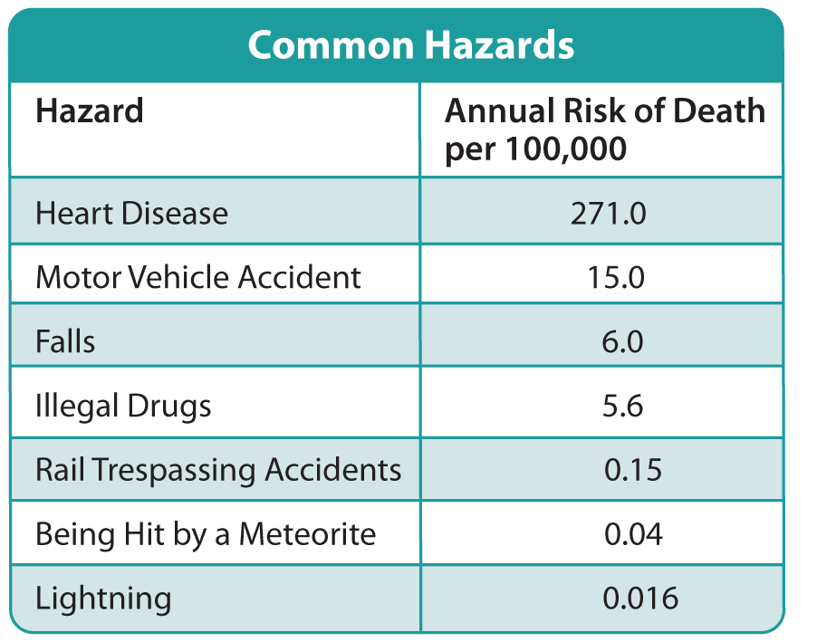
Risk Assessment
Lesson 9.1 An Overview of Environmental Health
Risk: The probability that a hazard will cause harm
Risk assessment: The process of measuring risk
Takes into account:
The type of hazard
How frequently humans will be exposed to it
How sensitive people are to it

Slide 15
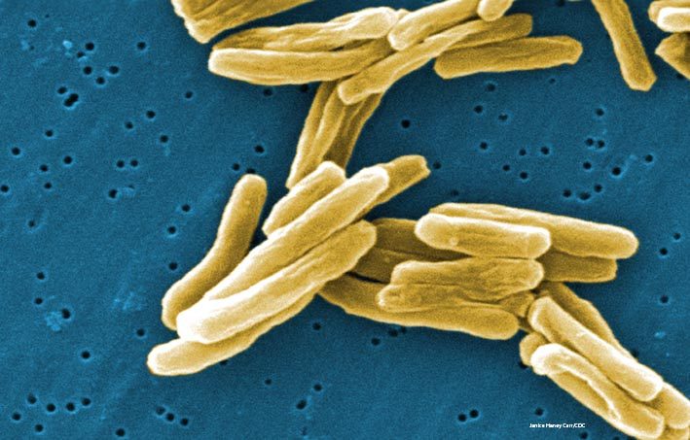
Lesson 9.2 Biological and Social Hazards
Three quarters of infectious disease deaths are caused by five types of diseases: respiratory infections, AIDS, diarrheal diseases, tuberculosis, and malaria.
Tuberculosis-causing bacteria

Slide 16
Infectious Diseases
Lesson 9.2 Biological and Social Hazards
Caused by pathogens
Spread by human and animal contact and through contaminated food and water
Cause of almost half of all deaths in developing nations
Covering your mouth when you cough, washing your hands often, and staying home from school if you’re sick help prevent the spread of infectious disease.
Did You Know? In 2002, AIDS killed about 2 million people worldwide— almost equal to the entire population of Arkansas.

Slide 17
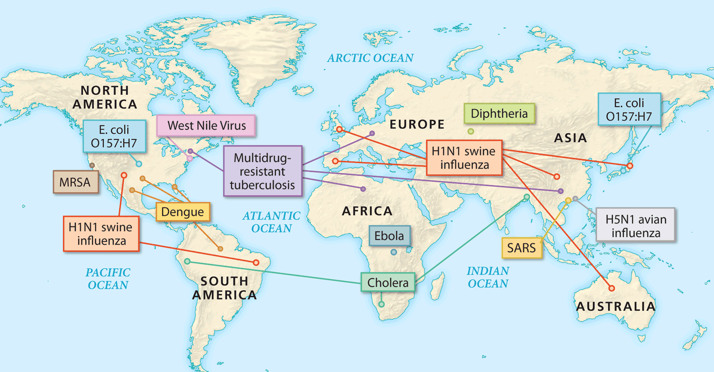
Emerging Diseases
Lesson 9.2 Biological and Social Hazards
Diseases appearing in the human population for the first time or suddenly beginning to spread rapidly
Humans have little or no resistance, and no vaccines have been developed.
Facilitated by increasing human mobility, growing antibiotic resistance, and environmental changes

Slide 18
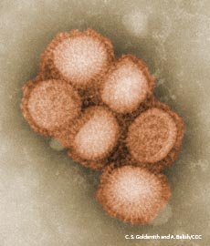
Responding to Emerging Diseases
Lesson 9.2 Biological and Social Hazards
World Health Organization (WHO): Monitors health events worldwide and coordinates international responses to emerging diseases
Centers for Disease Control and Prevention (CDC): Responds to emerging diseases in the United States; the CDC developed pandemic plans to deal with the spread of the H1N1 flu virus.
H1N1 Virus

Slide 19
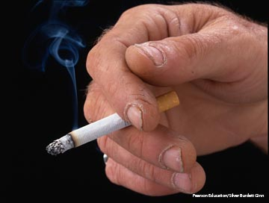
Social Hazards
Lesson 9.2 Biological and Social Hazards
Some social hazards are easier to avoid than others.
Examples of social hazards include smoking, being exposed to secondhand smoke, living near an old toxic waste site, working with harmful chemicals, and eating fatty foods.

