Slide 1
Welcome to AP Chemistry
Please have a seat and silently read the AP Chemistry Syllabus. Jot down any questions you may have.

Slide 2
Agenda 9/7/12
Introduction to AP Chemistry
Verbal Drill
CP Chemistry Review
Review Packet

Slide 3
What is AP Chemistry?
Equivalent to a first-year college chemistry course
Covers atomic structure, gas laws, thermodynamics, stoichiometry, kinetics, equilibria, oxidation-reduction and electrochemistry in depth

Slide 4
Course Objectives
1. Provide students with a solid foundation in chemical concepts
2. Empower students to become confident problem solvers
3. Engage students in laboratory activities commonly done in first-year college courses
4. Prepare students to score a 4 or 5 on the AP Chemistry exam

Slide 5
Required Materials
A notebook or binder to keep notes (no guided notes will be given in this class)
A lab notebook (preferably a notebook of graphing paper. Go to Staples.)
A calculator (graphing calculator like the TI-89 is preferred)
Any packets or worksheets distributed in class

Slide 6
Grading Policy
Quizzes, Exams, and Lab Reports - 40%
Benchmark Exam – 30%
Classwork/Homework -30%

Slide 7

Are you up for the challenge?

Slide 8

AP Chemistry Exam
Monday, May 6, 2013

Slide 9
If you score a 4 or 5…(sometimes a 3)
Most colleges will grant you credit and you will have the chance to skip introductory chemistry in your first year
  This can save you money!
You must maintain an organized, neat lab notebook

Slide 10
Expectations
ALWAYS give 100% (you must be willing to do a considerable amount of work outside of class)
Never be afraid to ask for help
Never hesitate to offer help
Be proactive (if you foresee a problem, do something about it ahead of time)
Be confident, but not cocky

Slide 11
Verbal Drill
One person at a time
If you’re stuck, ask a friend to help
Everyone should be paying attention to all the questions and answers

Slide 12
CP Chemistry Review
SI Units, Conversions, and Measurements
The Atom and Electron Configuration
Naming Compounds
Writing Chemical Formulas
Monday: Stoichiometry Review

Slide 13
Measurements and Calculations

Slide 14
Unit Conversions
1 kilo = 1000
1 hecto = 100
1 deka = 10
--(no prefix) = 1
deci = 1/10
centi = 1/100
milli = 1/1000

Slide 15
1. Write the following measurements in scientific notation. DON’T FORGET YOUR UNITS:
  12,300 cm
  0.000 078 g
  675.0 L
  90,850 kg

Slide 16
1. Write the following measurements in scientific notation. DON’T FORGET YOUR UNITS:
  12,300 cm = 1.23 x 10⁴ cm
  0.000 078 g = 7.8 x 10⁻⁵ g
  675.0 L = 6.750 x 10² L
  90,850 kg = 9.085 x 10⁴ kg

Slide 17
2. How many significant figures are in each of the measurements below?
  12,300 cm
  0.000 078 g
  675.0 L
  90,850 kg

Slide 18
Rules for Significant Figures (MEMORIZE THESE)
Zeros between nonzero digits are significant. (Example: 50.8 Liters has 3 significant figures)
Zeros in front of all nonzero digits are NOT significant. (Example: 0.00959 grams only has 3 significant figures)
Zeros at the end of a number and to the right of a decimal point are significant. (Example: 8.000 000 000 millimeters have 10 significant figures).
A decimal point after zeros indicates that they are significant. (Example: 2000. meters has four significant figures because of the decimal point explicitly written at the end. 2000 meters only has one because there is no decimal point in the end.)

Slide 19
2. How many significant figures are in each of the measurements above (in #1)?
  12,300 cm = 3 sig figs
  0.000 078 g = 2 sig figs
  675.0 L = 4 sig figs
  90,850 kg = 4 sig figs

Slide 20
3. Calculate the following:
  9.5 x 10⁵ is divided by 2.25 x 10⁴
  1.2 x 10² is multiplied by 3.2x10³

Slide 21
3. Calculate the following:
  9.5 x 10⁵ is divided by 2.25 x 10⁴ =
  42.2 ← DON’T FORGET SIG. FIGS.
  1.2 x 10² is multiplied by 3.2x10³ =
  384,000

Slide 22
4. A sample of ethanol weighs 2.45g and has a volume of 3.1mL. Find its density.
(Do on whiteboard)

Slide 23
5. A sample of alcohol has a volume of 6.2mL. If its density is 0.78g/mL, what is the mass of this sample?
(Do on whiteboard.)

Slide 24
What is the SI unit for the following measurements? (List all the ones you know.)
Volume
Mass
Distance
Area
Energy
Charge
Force

Slide 25
8. How many grams are in 8.29kg?
(Do on whiteboard)

Slide 26
9. Write your answer from #8 in scientific notation.

Slide 27
9. Write your answer from #8 in scientific notation.
8.29 x 10³ g

Slide 28
10. How many centigrams are there in 54.5 grams?
(Do on whiteboard)

Slide 29
Atoms: The Building Blocks of Matter

Slide 30
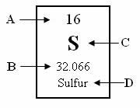
1. A = Atomic Number
B = Average Atomic Mass
C = Element Symbol
D = Element Name

Slide 31
3. For an atom to be electrically neutral (no charge), it must have the same number of _______________ and ____________________.

Slide 32
3. For an atom to be electrically neutral (no charge), it must have the same number of protons and electrons.

Slide 33
4. An atom has 9 protons and 10 neutrons. What is its:
  Atomic Number ______________________
  Element Name _____________________
  Number of electrons _____________________
  Mass Number ___________________________

Slide 34
4. An atom has 9 protons and 10 neutrons. What is its:
  Atomic Number = 9
  Element Name = Flourine
  Number of electrons = 9 electrons
  Mass Number = 19

Slide 35
3. Based on their location on the Periodic Table, how do you know that Lithium (Li), Sodium (Na), and Potassium (K) have similar properties?

Slide 36
3. Based on their location on the Periodic Table, how do you know that Lithium (Li), Sodium (Na), and Potassium (K) have similar properties?
They’re in the same group. Elements in the same group have similar chemical properties.

Slide 37
5. Which of the elements in #4 would be:
  A good conductor of heat/electricity? ________________________
  A semiconductor of heat/electricity? ________________________
  A poor conductor of heat/electricity? ________________________

Slide 38
5. Which of the elements in #4 would be:
  A good conductor of heat/electricity? Barium and Dysprosium (metals)
  A semiconductor of heat/electricity?
  Arsenic (metalloid)
  A poor conductor of heat/electricity? None of them are nonmetals.

Slide 39
6. List 3 differences between metals and nonmetals
Metals Nonmetals

Slide 40
6. List 3 differences between metals and nonmetals.
Metals | Nonmetals
Good conductors of heat and electricity Malleable Shiny | Poor conductors of heat and electricity. Brittle 3. Dull (not shiny)

Slide 41
8. Which of the following describes a physical property of oxygen?
  a. Oxygen has a boiling point of 90.1 Kelvin
  b. Oxygen is highly flammable
  c. Oxygen has an electronegativity value of 3.44
  d. Oxygen is highly reactive

Slide 42
8. Which of the following describes a physical property of oxygen?
  a. Oxygen has a boiling point of 90.1 Kelvin
  b. Oxygen is highly flammable
  c. Oxygen has an electronegativity value of 3.44
  d. Oxygen is highly reactive

Slide 43
9. Which of the following describes a chemical property of oxygen?
  a. Oxygen has a boiling point of 90.1 Kelvin
  b. Oxygen is highly flammable
  c. Oxygen has a melting point of -218.3 Celsius
  d. Oxygen is colorless

Slide 44
How many atoms of sulfur are in Aluminum Sulfate?
Al₂(SO₄)₃

Slide 45
Write the ground-state electron configuration Zirconium

Slide 46
Write the ground-state electron configuration Krypton

Slide 47
Write the ground-state electron configuration of Aluminum using orbital notation

Slide 48
Name the following compound
Al₂(SO₄)₃

Slide 49
Name the following compound
HCN

Slide 50
Name the following compound
HCl

Slide 51
Name the following compound
Na₃PO₄

Slide 52
Name the following compound
P₄O₁₀

Slide 53
Name the following compound
N₂O₄

Slide 54
Write the chemical formula of the following compound: barium sulfate

Slide 55
Write the chemical formula of the following compound: magnesium permanganate

Slide 56
Write the chemical formula of the following compound: sodium bicarbonate

Slide 57
Balancing the Following Chemical Equations:
Ca + H₂O → Ca(OH)₂ + H₂

Slide 58
Balancing the Following Chemical Equations:
Fe₂O₃ (s)+ CO(g) → Fe(s) + CO₂(g)

Slide 59
Balancing Equations Practice
Balance the following chemical equations on a separate piece of paper.
2) MgF₂ + Li₂CO₃ → MgCO₃ + LiF
3) P₄ + O₂ → P₂O₃
4) RbNO₃ + BeF₂ → Be(NO₃)₂ + RbF
5) Al₂(SO₄)₃ + Ca(OH)₂ → Al(OH)₃ + CaSO₄
6) AgNO₃ + K₃PO₄ → Ag₃PO₄ + KNO₃
7) Calcium hydroxide reacts with phosphoric acid (H₃PO₄) to produce calcium phosphate and water.
8) Copper iodide reacts with potassium carbonate to yield potassium iodide, copper (I) oxide and carbon dioxide.

Slide 60
Some Key Words
Combines/Reacts = +
Heat = add the delta(little triangle) above the arrow
Combusts/burns = + O₂(g)
Vapor = (g)
Solid = (s)
Liquid = (l)
A solution of… = (aq)

Slide 61
Remember the diatomic molecules…
When the following elements are by themselves (not bonded to anything) they are found as:
Chlorine is found as Cl₂
Flourine is found as F₂
Oxygen is found as O₂
Nitrogen is found as N₂
Hydrogen is found as H₂
Bromine is found as Br₂

Slide 62
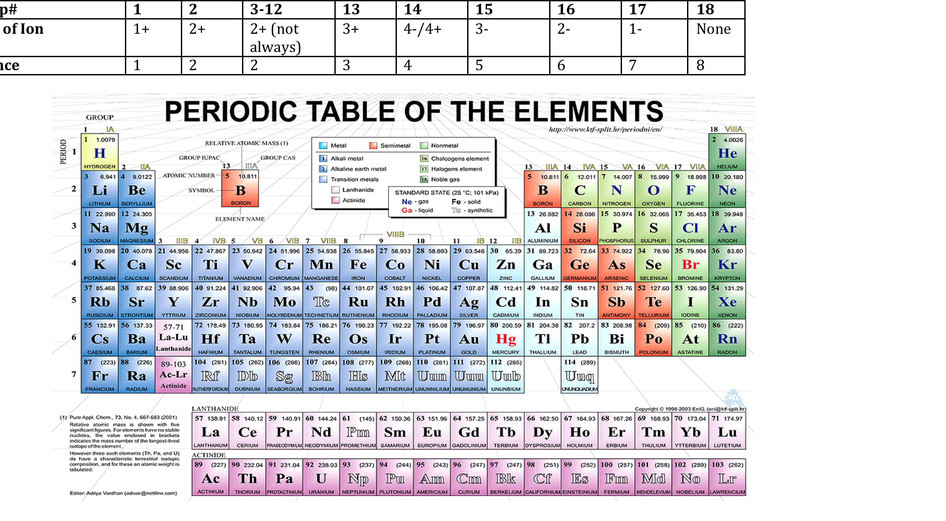

Slide 63
Don’t forget your polyatomic ions!

Slide 64
Example#1
Sentence: Solid sodium reacts with chlorine gas to produce solid sodium chloride.

Slide 65
Example#2
Sentence: When heated, Solid mercury (II) oxide decomposes to liquid mercury and oxygen gas.

Slide 66
Example#3
Sentence: Propane gas is burned to produce carbon dioxide gas and water vapor.

Slide 67
Example #4
A solution of potassium nitrate and sodium sulfate are combined to produce potassium sulfate and sodium nitrate.

Slide 68
FROM NOW ON…
ALWAYS USE CHEMICAL NAMES WHEN REFERRING TO A COMPOUND. For example, instead of calling N2O5 by its symbols and subscripts, actually say “dinitrogen pentoxide”

Slide 69
Homework
Memorize polyatomic ions
Review everything in the review packet

