Slide 1
ENVIRONMENTAL SCIENCE Catalyst 5/29/14
Go on the class website http://aofscience.weebly.com
Answer the questions online and press submit. (Don’t have a computer? Grab a CATALYST SHEET IN THE BACK and answer the questions below.)
QUESTION:
What is energy? *
What are the different forms of energy?*
*Use your prior knowledge. Don’t use your book or Google!

Slide 2
Agenda 5/29/14
Catalyst
Announcements
Benchmark dates – June 10 and June 11.
Chapter 15 and 16 Note Packets will be collected next Monday.
Quiz on Energy on Monday
Verbal Drill
Types of Energy Discussion
Classwork
3,2,1 Exit Slip
Reminders

Slide 3
WE HAVE 7 DAYS TO GET THROUGH NEW MATERIAL. WE WILL NOW SPEED UP 2x. Confused? Come to after school tutoring. Otherwise, it is a personal problem.

Slide 5
Environmental Science Gpoints
Your class can earn class points if:
everyone in class:
Comes to class quietly and on time
Stays focused and on task during class
Leaves classroom neat and organized
Students are teaching other students
Majority of class participates
Follows all classroom expectations and procedures
And more…
P6: 43 (on time, neat room, focused)
P10: 43 (on time, focused, neat room)

Slide 6
Environmental Science Verbal Drill
You must answer if the toy is passed to you. (Points deducted from your weekly participation grade if you refuse.)
If you don’t know the answer, look it up in your notes or discuss it with a classmate. (i.e. don’t just ask for the answer)
If the class reaches 25 points, extra points will be given on the next unit exam.
The class will have 3 minutes to earn as many points as possible.

Slide 7
Environmental Science Verbal drill points
Period 6:
53pts
Period 10:
52pts

Slide 8
Catalyst 5/6/13
Please make sure you have your IDs and uniforms on properly.

Slide 9
Agenda 5/6/13
Catalyst
Announcements
HW: Read and outline pages 516 - 521
Verbal Drill
Introduction to Energy
Velocity Mini-Lesson
Class Check Point
Recycling Plan Discussion

Slide 10
Objective 5/29/14
We will be able to
Define energy and differentiate between kinetic and potential energy.
Identify different forms of energy



Slide 11
Environmental Science Verbal Drill
One person will volunteer to start and that person will chose the next student to answer.
If you don’t know the answer, look it up in your notes or discuss it with a classmate. (i.e. don’t just ask for the answer)
If the class reaches 25 points, extra points will be given on the next unit exam.
The class will have 2 minutes.

Slide 12
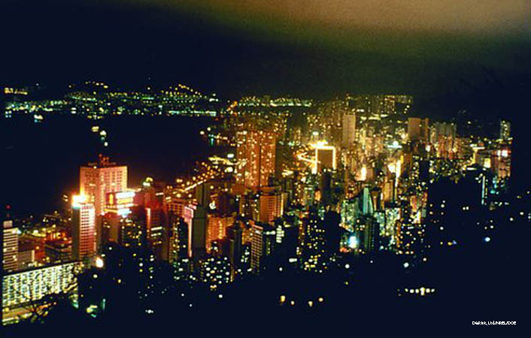
Lesson 17.1 Energy: An Overview
The United States has only 4.5% of the world’s population but uses 21.1% of the world’s energy.

Slide 13
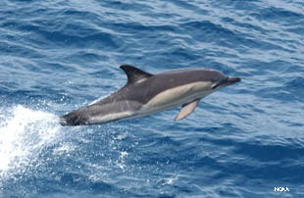
What Is Energy?
The ability to do work or cause a change
Kinetic energy: Due to motion
Potential energy: Due to an object’s position or shape

Slide 14
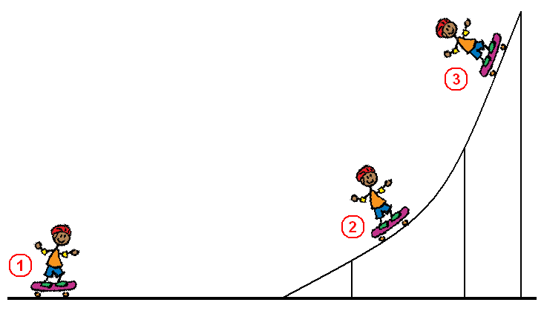
Potential and Kinetic Energy

Slide 15
Potential Energy
Potential Energy: energy of position or “stored energy”
Depends on: mass, height

Slide 16
Potential Energy
The person has more potential energy at the top of the stairs than at the bottom.

Slide 17
What are the different forms of energy?

Slide 18
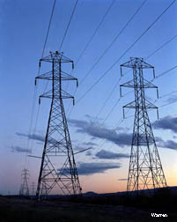
Forms of Energy
Mechanical: Associated with the motion and position of an object; can be kinetic or potential
Electrical: Associated with electric charges; can be kinetic or potential
Overhead transmission lines carry electrical current.

Slide 19
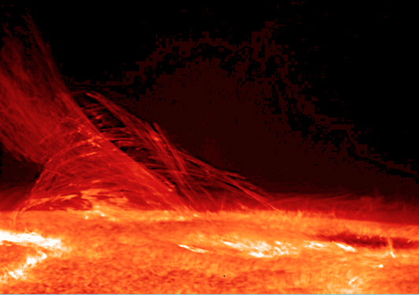
Forms of Energy
Thermal: Kinetic energy of atoms and molecules— the faster atoms and molecules move in an object, the warmer it becomes

Slide 20
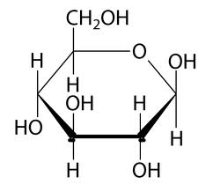
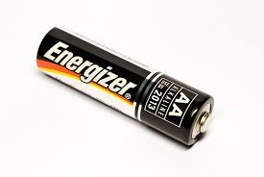
Forms of Energy
Chemical: Potential energy stored in molecular bonds

Slide 21
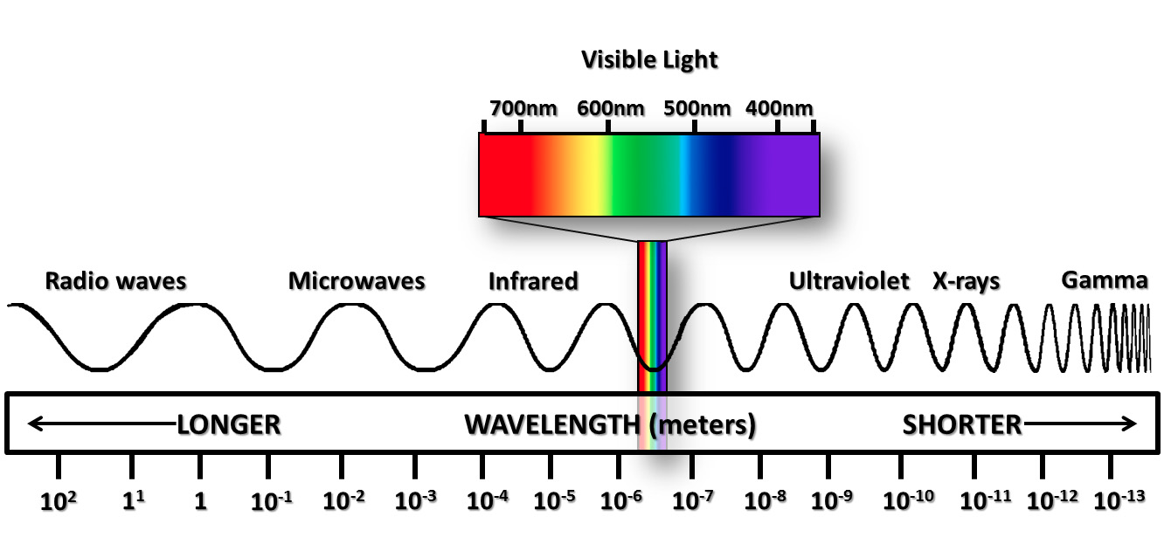
Forms of Energy
Electromagnetic: Kinetic energy that travels as waves

Slide 22
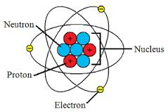
Forms of Energy
Nuclear: Potential energy stored by forces that hold atomic nuclei together

Slide 23
Energy Conversion
Energy cannot be destroyed; it can only be converted, or changed, from one form to another.
Example:
Combustion is the process by which a fuel burns because it combines rapidly with oxygen. It converts chemical energy to electromagnetic and thermal energy. You feel the thermal energy as heat and see the electromagnetic energy as light.

Slide 24
Energy Sources
RENEWABLE SOURCE | NONRENEWABLE SOURCE***
Nearly always available or replaceable in a relatively short time; Includes: sunlight, wind, flowing water, heat from Earth | Cannot be replaced in a reasonable time; Includes: fossil fuels and nuclear energy

Slide 25
Energy Use
Four uses of energy: Industrial, transportation, residential, commercial
Developed nations tend to use more energy than developing nations

Slide 26
CheckPoint
What are the different forms of energy?
Explain the difference between kinetic and potential energy.
How do humans use energy?

