Slide 1

ENVIRONMENTAL SCIENCE
Catalyst 5/30/14
Go on the class website http://aofscience.weebly.com
Answer the questions online and press submit. (Don’t have a computer? Grab a CATALYST SHEET IN THE BACK and answer the questions below.)
QUESTION:
Read "Warmer Water Temperature" on page 499 of your textbook. How does global climate change affect the algae in corals?

Slide 2
Agenda 5/30/14
Catalyst
Announcements
  Benchmark dates – June 10 and June 11.
  Quiz on Energy on Monday
  P6: Climate Change Outlines???
  P10: Koshland WebQuest and Infographic – SUBMIT by Monday, June 2.
Verbal Drill
Fossil Fuels Discussion
Classwork
Socrative Exit Slip
Reminders

Slide 3
Environmental Science Gpoints
Your class can earn class points if:
everyone in class:
Comes to class quietly and on time
Stays focused and on task during class
Leaves classroom neat and organized
Students are teaching other students
Majority of class participates
Follows all classroom expectations and procedures
And more…
P6: 43 (on time, neat room, focused)
P10: 43 (on time, focused, neat room)

Slide 4
Environmental Science
Verbal Drill
You must answer if the toy is passed to you. (Points deducted from your weekly participation grade if you refuse.)
If you don’t know the answer, look it up in your notes or discuss it with a classmate. (i.e. don’t just ask for the answer)
If the class reaches 25 points, extra points will be given on the next unit exam.
The class will have 3 minutes to earn as many points as possible.

Slide 5
Environmental Science Verbal Drill Points
Period 6:
61pts
Period 10:
59pts

Slide 6




Objective 5/30/14
We will be able to
Explain how fossil fuels are formed.
Describe the uses of oil and how it is extracted.
Describe the characteristics and uses of natural gases.



Slide 7
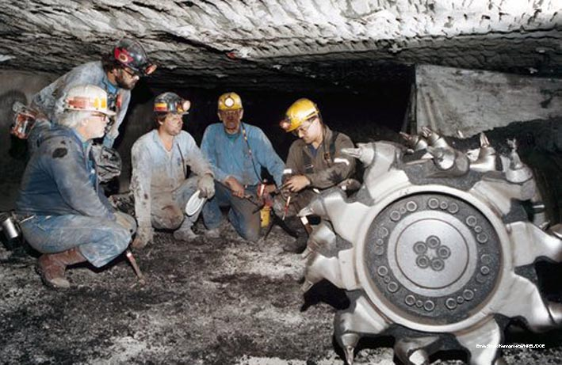
Lesson 17.2 Fossil Fuels
One quarter of global coal reserves are found in the United States.

Slide 8
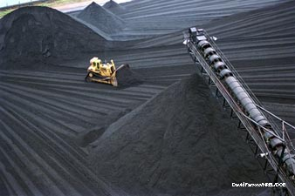
Fossil Fuels
Include coal, oil, and natural gas
Formed from the remains of organisms over millions of years
Different conditions produce different fossil fuels
A front loader
piles coal at a steam station in Dunkirk,
New York.

Slide 9
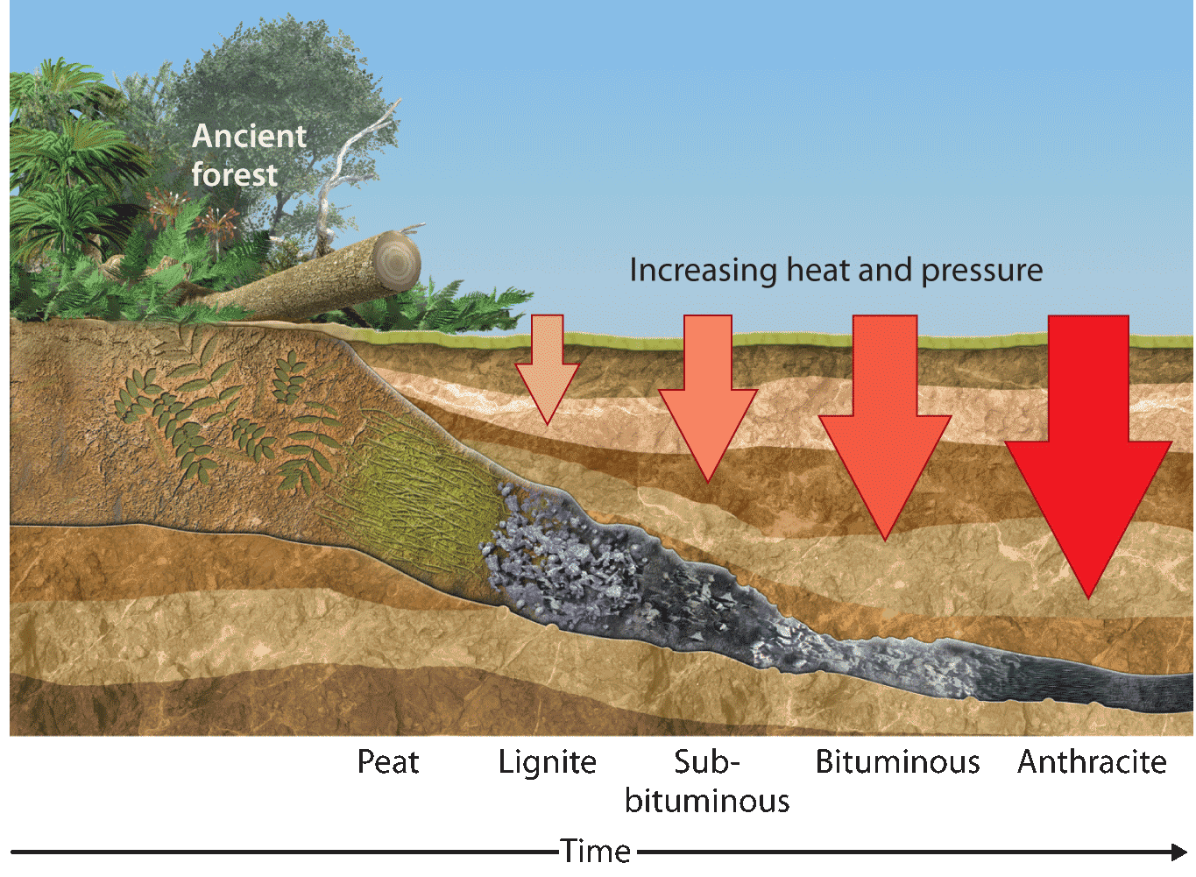

Slide 10
How Deposits are Formed
http://www.youtube.com/watch?v=_RARgmEh-LE

Slide 11
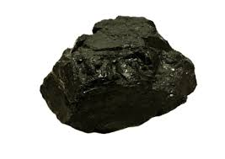
1. Coal
Formed from plant remains subjected to high heat and pressures over millions of years
Provides 1/4 of the world’s energy
Relatively cheap, easy to process and transport

Slide 12
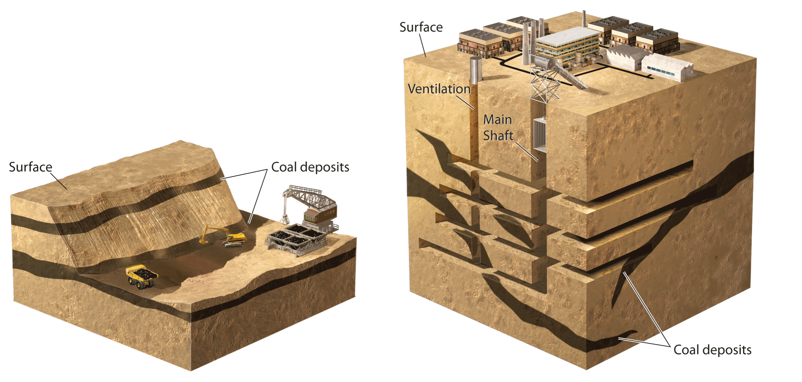
Coal Mining
Strip mining: Overlying rock and soil are removed to access coal (safer for miners).
Subsurface mining: Underground shafts are dug to access coal under Earth’s surface.

Slide 13
Coal Mining
http://www.youtube.com/watch?v=Bk-jrbCi7Sc

Slide 14

2. Oil (Petroleum)
Dark, liquid fossil fuel made up mostly of hydrocarbons
Formed from the remains of ancient marine organisms and found in underground deposits
Used in fuel for cars, trucks, planes, ships

Slide 15
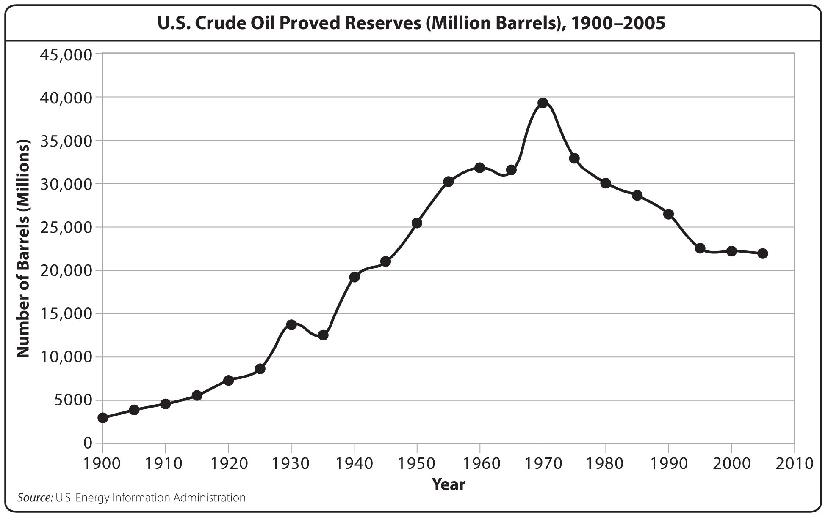

Slide 16
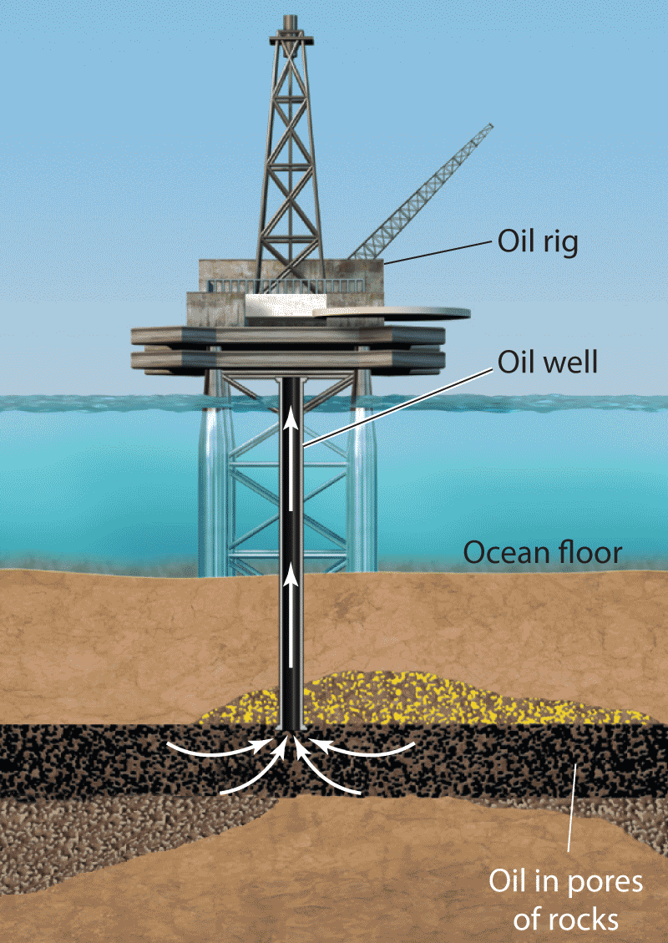
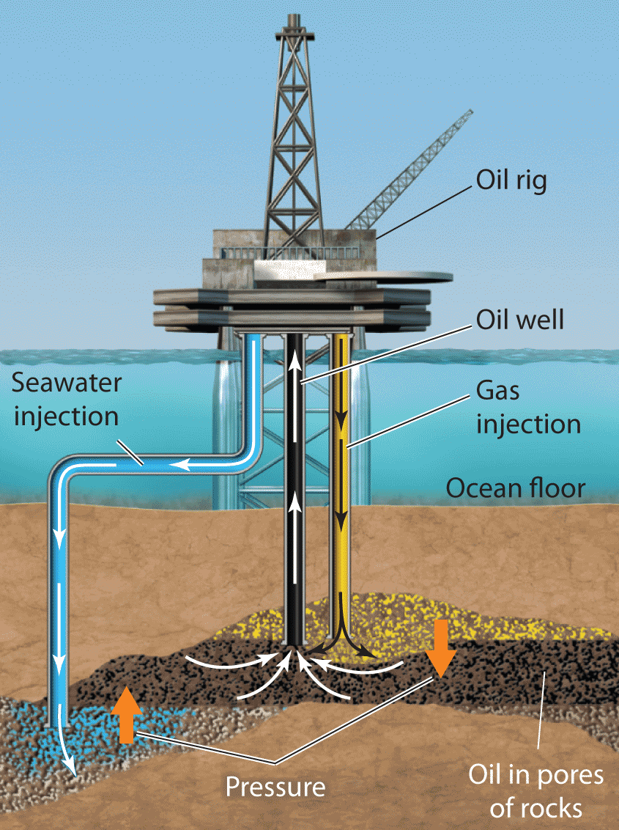
Drilling and Refining Oil
After crude oil is extracted from the ground, it is separated into different fuels in a refinery.
Primary extraction:
Oil flows out of the well, because it is already under pressure.
Secondary extraction: Increased pressure or injections needed to remove oil

Slide 17
Oil Well
http://www.youtube.com/watch?v=0SmSNRTU1Vw

Slide 18
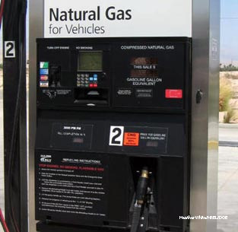
3. Natural Gas
Natural gas consists of methane gas mixed in with small amounts of other gases.
Often found above oil or coal
deposits
Much less polluting than coal or oil and releases more energy when combusted
Used for heating, appliances (stoves, dryers),
and making electricity

Slide 19
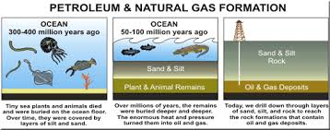

Slide 20
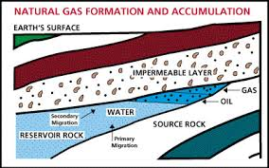

Slide 21
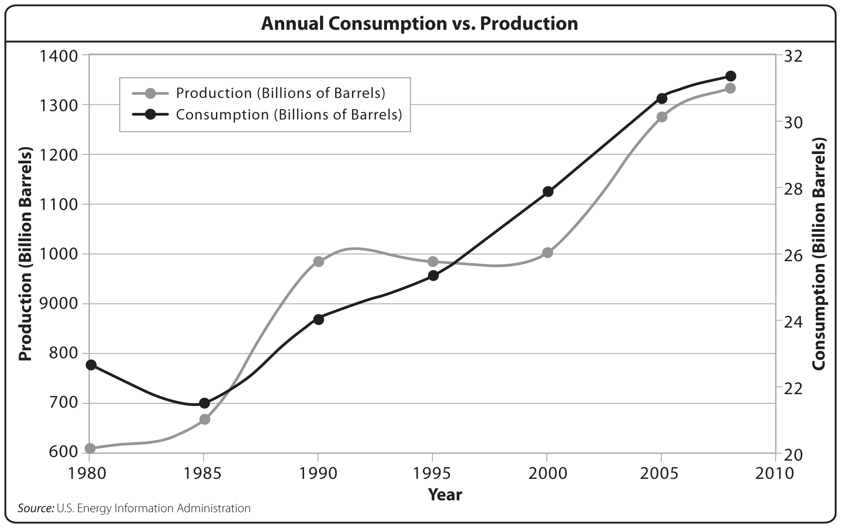

Slide 22
Fossil Fuel Supply
Consumption is still rising, but new fossil fuels do not form on a human timescale.
New oil sources—oil sands, oil shale, methane hydrates—
are expensive,
energy-intensive,
and can be
hazardous to obtain.
Coal sources are still
relatively abundant,
but not infinite.
Did You Know? Some studies suggest we have extracted nearly half Earth’s oil, and that U.S. coal supplies may last just 130 years.

Slide 23
During Classwork Time
Stay focused on the assignments you are given.
Do the questions INDEPENDENTLY (on your own).
Keep the noise level down.
Ask THREE before you ask ME.
You may put earphones on and listen to music quietly as you do your work. (Pick a playlist and stick with it!)
You must finish a certain number of questions (depends on the person) by the end of the period.
TASK:
Chapter 17 Packet (DO DEFINITIONS FOR HW)

Slide 24
Socrative Exit Slip
Go to http://m.socrative.com
Join room #66355
Wait for instructions.
Answer the following questions in the space provided:
  How do fossil fuels form?
  Explain the differences between coal, oil, and natural gas.

Slide 25

REMINDERS
  DON’T FORGET YOUR PACKET STAMPS!
  Benchmark dates – June 10 and June 11.
  Quiz on Energy on Monday
  P6: Climate Change Outlines???
  P10: Koshland WebQuest and Infographic – Monday, June 2.

