Slide 1
Catalyst 5/23/13
Consider the burning of glucose, a type of sugar we desperately need to survive:
C₆H₁₂O₆ + 6O₂ → CO₂ + H₂O
How many grams of water will be produced from 2.5 moles of C₆H₁₂O₆?
Express 5.3 atm in Torr.

Slide 2
Consider the burning of glucose, a type of sugar we desperately need to survive:
C₆H₁₂O₆ + 6O₂ → CO₂ + H₂O
How many grams of water will be produced from 2.5 moles of C₆H₁₂O₆?

Slide 3
Express 5.3 atm in Torr.

Slide 4
Agenda 5/23/13
Catalyst
Gay-Lussac’s Law Discussion
Class Practice
Gas Laws Review
Exit Slip/Self-Assessment

Slide 5
Class Points
Your class can earn class points if everyone in class:
Comes to class quietly and on time
Stays focused and on task during class
Leaves classroom neat and organized
Students are teaching other students
Majority of class participates
Follows all classroom expectations and procedures
And more…
P3: 16 (focused)
P4: 20 (on time, neat room, focused)
P6: 24 (on time, neat room, focused, ready before me)

Slide 6




Objective 5/23/13
We will be able to
We will be able to use Gay-Lussac’s Law to calculate pressure-temperature changes at constant volume.



Slide 7
Gas Laws We’ve Covered
Boyle’s Law
Charles’ Law

Slide 8
Gas Laws We’ve Covered
Boyle’s Law: Pressure and volume are inversely proportional at constant temperature
Charles’ Law: Volume and temperature are directly proportional at constant pressure.

Slide 9
Gay-Lussac’s Law
Gay-Lussac’s Law states that the pressure of a gas is directly proportional to the temperature of a gas at constant volume.
In other words, as pressure increases, temperature increases or as pressure decreases, temperature decreases.

Slide 10
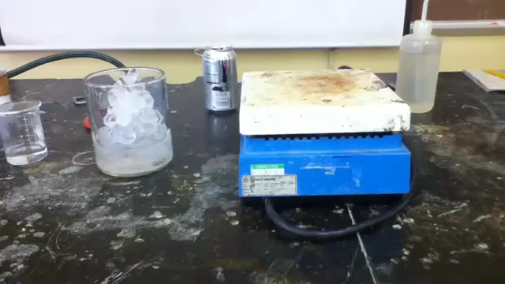
What do you think will happen to the can?

Slide 11
Gay-Lussac’s Law
Looks familiar?

Slide 12
Gay-Lussac’s Law Formula
Mathematically:

Slide 13
Time for some algebra…
Gas Laws calculations will be the only chapter that I will allow you to “cross multiply.”
When are you allowed to cross multiply?

Slide 14
Gay-Lussac’s Law Calculations

Slide 15
Example#1. The gas in a container is at a pressure of 3.00 atm at 25 degrees Celsius. Directions on the container warn the user not to keep it in a place where the temperature exceeds 52 degrees Celsius. What would the gas pressure in the container be at 52 degrees Celsius?

Slide 16
Gay-Lussac’s Law Calculations
Example#2. A sample of helium gas has a pressure of 1.20 atm at 22 degrees Celsius. At what Celsius temperature, will the helium reach a pressure of 2.00 atm, assuming constant volume? (Because this asks for temperature in Celsius, you do not need to convert the given temperature to Kelvin.)
What’s written in parentheses is NOT correct. Please cross it out!!!
IMPORTANT: When doing calculations using ANY of the gas laws, you must use Kelvin as your unit for temperature!!!

Slide 17
Example#2. A sample of helium gas has a pressure of 1.20 atm at 22 degrees Celsius. At what Celsius temperature, will the helium reach a pressure of 2.00 atm, assuming constant volume?

Slide 19
Study Buddy
Choose a partner next to you
Create at least 3 questions from the material we have covered in this unit on Notability (or piece of paper). Try to stump your partner!
Swap questions and do your best to answer them.

Slide 20
Summary of Gas Laws
Boyle’s Law
Charles’ Law
Gay-Lussac’s Law

Slide 21
During Classwork Time
Stay focused on the assignments you are given.
Do the questions INDEPENDENTLY (on your own).
Keep the noise level down.
Ask THREE before you ask ME.
You may put earphones on and listen to music quietly as you do your work.
You must finish a certain number of questions (depends on the person) by the end of the period.
DO NOT FORGET YOUR STAMPS! You cannot get them once you leave the class.

Slide 22
Exit Slip
QUIETLY and INDEPENDENTLY answer the following on Notability and email it to gutierrezbr@elizabeth.k12.nj.us with “p6 ES 5/20” on the subject line. I must receive it by the end of the period. If you are talking or copying, you will not receive credit.*Each E.S. worth 20 pts.
At 120 degrees Celsius, the pressure of a sample of nitrogen is 1.07 atm. What will the pressure be at 205 degrees Celsius, assuming constant volume?

