Slide 1

Environmental Science – Wednesday, Catalyst 11/20/13
1. Visit the class website (http://aofscience.weebly.com) and scroll until you see “CATALYSTS!”
2. Answer the questions and click “Submit” when you are done. (You should see: “your response has been recorded.” after you hit submit.)
QUESTION(s):
What affects the growth rate of a population?
What does a “pyramid-shaped” age structure diagram tell you? (Hint is on the next slide.)
* If you do not have a laptop for whatever reason, grab a Catalyst sheet in the back and answer it on the paper.

Slide 2
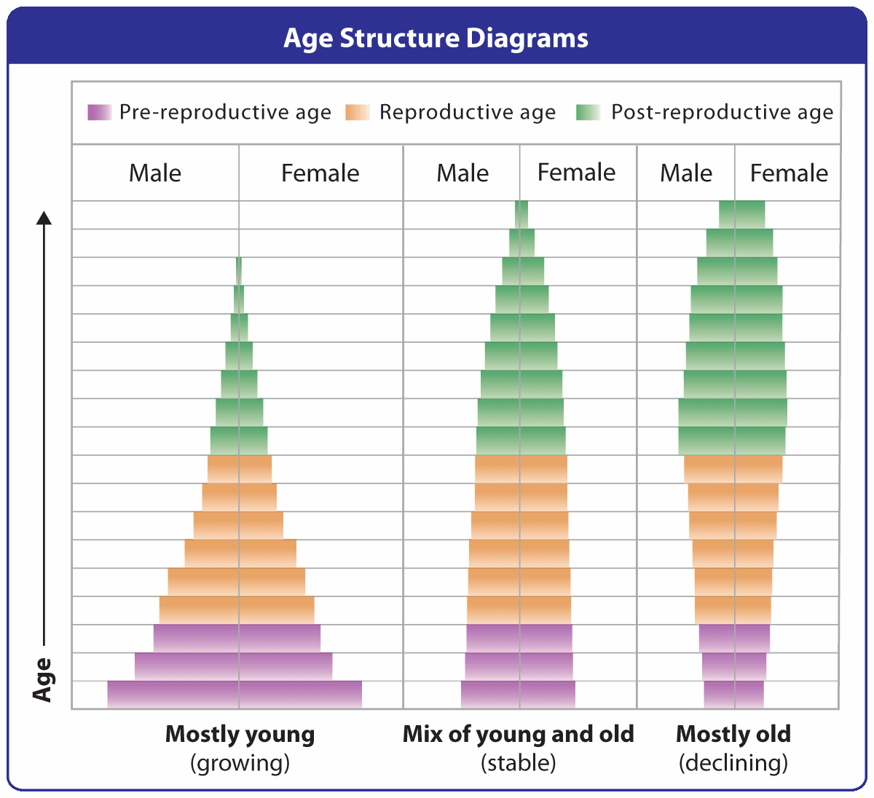

Slide 3
Agenda 11/20/13
Catalyst
Announcements
  I will be out tomorrow and Friday. Thursday/Friday Assignments will be posted on class website and edmodo. You are responsible for submitting the work by the specified deadline. DO NOT give the sub a hard time. If I hear about it, your discussion grade will be affected.
Growth of Populations
Lesson 3 Assessment

Slide 4
Gpoints
Your class can earn class points if:
everyone in class:
Comes to class quietly and on time
Stays focused and on task during class
Leaves classroom neat and organized
Students are teaching other students
Majority of class participates
Follows all classroom expectations and procedures
And more…
P6: 71 pts (on time)
P10: 74 pts (on time, neat room, focused, quiet, productive)

Slide 5






Objectives 11/20/13
We will be able to
Describe the factors that influence a population’s growth rate.
Calculate population growth rate.
Explain exponential growth and logistic growth.


Slide 6
Factors that Determine Population Growth: Birth and Death Rates
  The rate at which individuals within a population are born is called natality.
  The rate at which individuals die is called mortality.

Slide 7
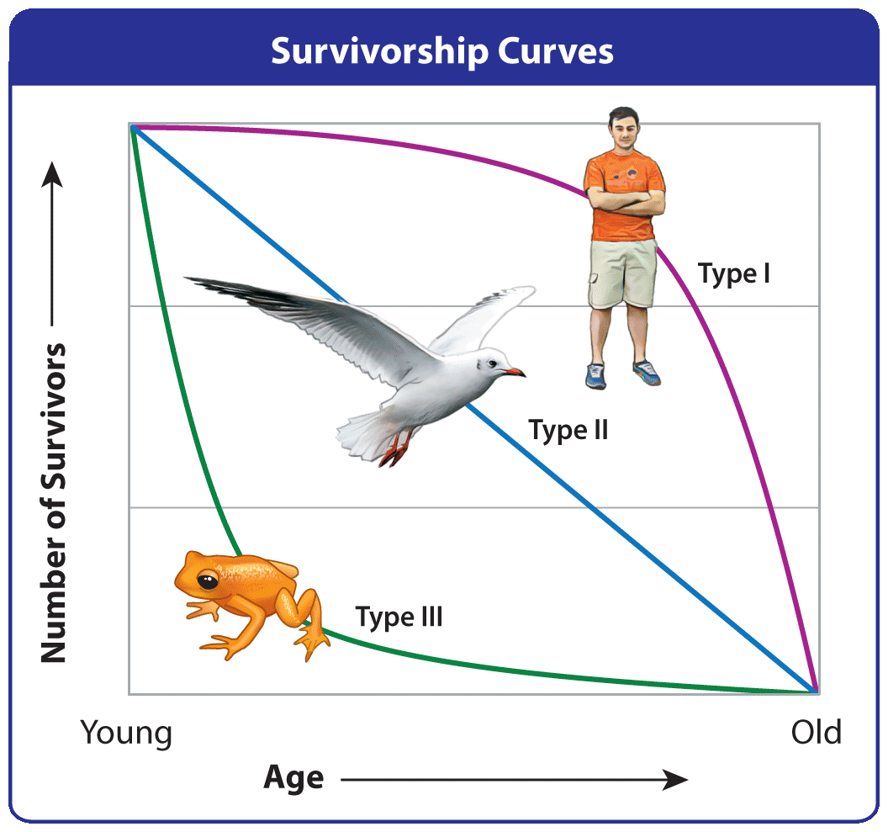

Slide 8
Survivorship Curves
Type I Curve: Organisms with a Type I curve have higher mortality at older ages. (ex: humans)
Type II Curve: Organisms with a Type II curve have a population with equal mortality at all ages. (ex: birds)
Type III Curve: Organisms with a Type III curve have high mortality rates at younger ages. (ex: golden toads)

Slide 9
Factors that Determine Population Growth: Immigration and Emigration
  Immigration is the arrival of individuals from outside a given area (Coming in)
  Emigration is the departure of individuals from a given area. (Leaving)
  Migration is when certain organisms make brief movements into and out of an area during certain seasons. (Relocating for a while)

Slide 10
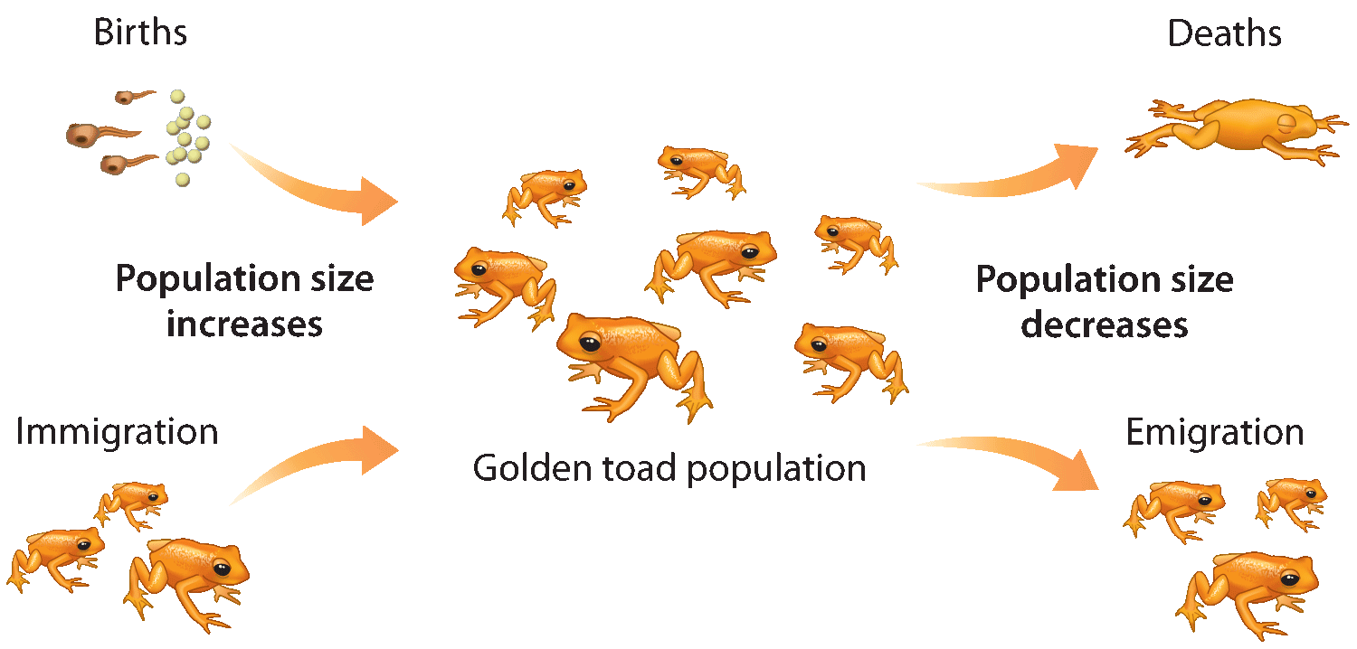

Slide 11
Population Growth Rate
Can you come up with a mathematical formula on how to calculate population growth rate?

Slide 12
Population Growth Rate Calculation
The formula for population growth rate is:
Growth rate = (birthrate + immigration rate) – (death rate + emigration rate)

Slide 13
Population Growth Rate Calculation
You can calculate how fast a population grows. For example, let’s say a population’s annual birthrate is 18 per 1000 and is annual death rate is 10 per 1000. It’s annual immigration rate is 5 per 1000 and and its annual emigration rate is 7 per 1000.

Slide 14
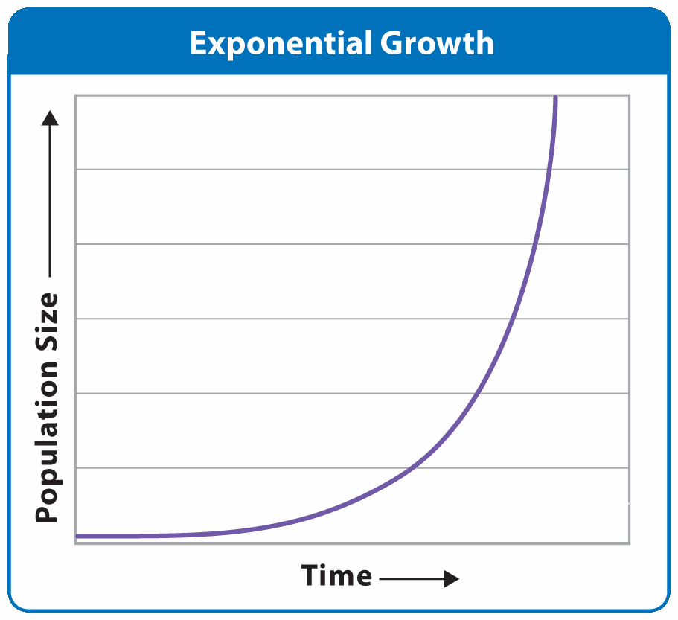
Exponential Growth
Population increases by
a fixed percentage
every year.
Normally occurs only when small populations are introduced to an
area with ideal environmental conditions
Rarely lasts long

Slide 16
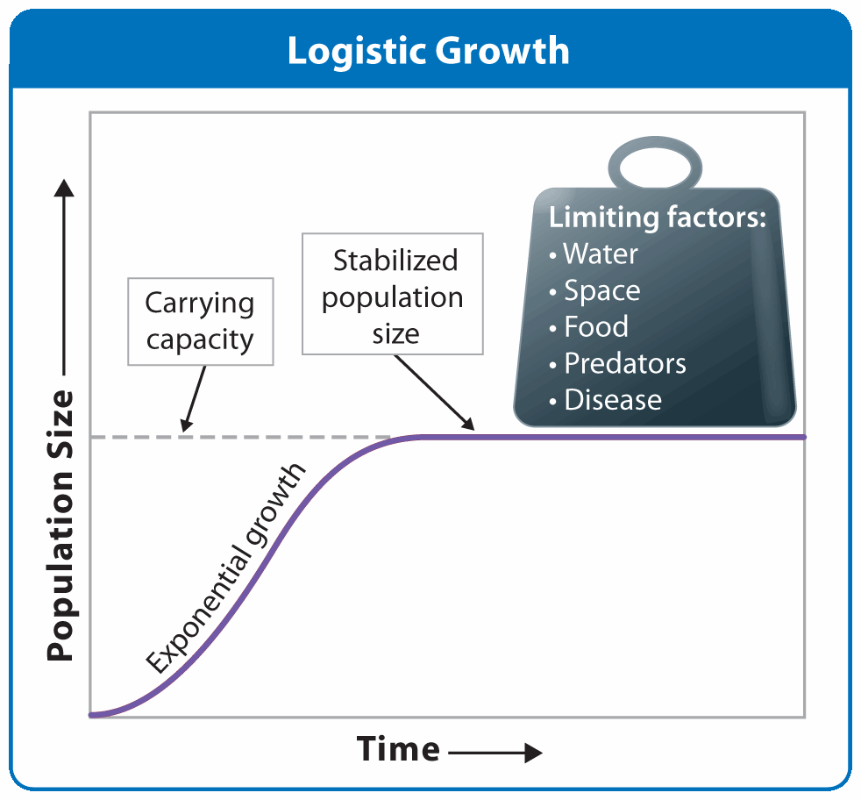
Logistic Growth
Carrying capacity – largest population size a given environment can sustainably support
Growth almost always slows and stops due to limiting factors.

Slide 18
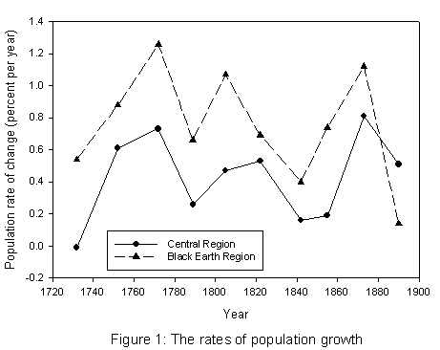
Fluctuating Growth
Limiting factors change over time

Slide 19

Rise and Crash Growth
What might cause this to happen?

Slide 20
Rise and Crash Growth
Some populations grow rapidly and consume their resources too quickly

Slide 21
Chapter 4 Lesson 3 Assessment
Re-read your notes and refer to Chapter 4, Lesson 3 as needed. Complete questions 1and 2 on page 117 in Microsoft Word. Save your work often. When you are finished, EMAIL your responses to gutierrezbr@elizabeth.k12.nj.us. Be sure to include p6 Ch.4 Lesson 3 in the SUBJECT line. (p10 Ch.4 Lesson 2 if you’re in my period 10.)
  If your computer does not work, complete the assignment on a separate sheet of paper.

Slide 22
Limiting Factors
What are the factors that regulate or influence a population’s growth?
Limiting factors are environmental characteristics slow population growth and determine carrying capacity

Slide 23
Limiting Factors: Two Types
Density-dependent
Density-independent
Influence changes with
population density.
Higher population density will decrease availability of resources.
What are some resources that might be limited because of high population density?
  Influence does not change with population density
Natural disasters or catastrophes such as floods, fire, and avalanches are examples of density-independent factors.

