Slide 1
Catalyst 5/29/13
2NaOH + H₂SO₄ → 2H₂O + Na₂SO₄
1. How many moles of water will be produced if you use 200 grams of H₂SO₄ (sulfuric acid)?
2. The temperature of a sample of helium gas is a measure of its
a. kinetic and potential energy.
b. average potential energy.
c. average kinetic energy.
d. total potential energy.

Slide 2
2NaOH + H₂SO₄ → 2H₂O + Na₂SO₄ 1. How many moles of water will be produced if you use 200 grams of H₂SO₄ (sulfuric acid)?

Slide 3
Catalyst 5/29/13
2. The temperature of a sample of helium gas is a measure of its
a. kinetic and potential energy.
b. average potential energy.
c. average kinetic energy.
d. total potential energy.

Slide 4
Agenda 5/29/13
Catalyst
Announcements
Standard Molar Volume
Guided Practice
Ideal Gas Law
Class Practice
CheckPoint

Slide 5
Class Points
Your class can earn class points if everyone in class:
Comes to class quietly and on time
Stays focused and on task during class
Leaves classroom neat and organized
Students are teaching other students
Majority of class participates
Follows all classroom expectations and procedures
And more…
P3: 21 (focused, on time, respectful during lessons)
P4: 26 (on time, neat room, focused)
P6: 30 (on time, neat room, focused)

Slide 6
Objective 5/29/13
We will be able to
Define standard molar volume and perform conversions using the conversion unit for standard molar volume.



Slide 7
Standard Molar Volume
The standard molar volume of a gas is known as the volume that a gas occupies at standard temperature and pressure.
STP stands for standard temperature and pressure. (1 atm and 0 degrees Celsius)
The value of the standard molar volume is equal to 22.4 L/mol.

Slide 8
IMPORTANT
Standard molar volume can ONLY be used when the gas is at STP (standard temperature and pressure).

Slide 9
Standard Molar Volume Calculations
Example#1. What volume does 0.0685 mol of gas occupy at STP?

Slide 10
You try!
At STP, what is the volume of 7.08 mol of nitrogen gas (N₂)?
Write answer on Notability and raise up your iPad in 60 seconds.

Slide 11
You try!
At STP, what is the volume of 7.08 mol of nitrogen gas (N₂)?
158.59 L

Slide 12
Standard Molar Volume Calculations
Example#2. What quantity of gas in moles is contained in 2.21 L at STP?

Slide 13
You try!
A sample of hydrogen gas occupies 14.1 L at STP. How many moles of the gas are present?
Write answer on Notability and raise up your iPad in 60 seconds.

Slide 14
You try! (#2 on page 33)
A sample of hydrogen gas occupies 14.1 L at STP. How many moles of the gas are present?
0.63 moles

Slide 15
Ideal Gas Law

Slide 16
Objective 5/29/13
We will be able to
Use the Ideal Gas Law equation to calculate pressure, temperature, number of moles, or volume when three of the four quantities are given.



Slide 17
Ideal Gas Law Kinetic Molecular Theory Review
According to the KMT, Ideal Gases:
Are made of tiny particles that are always moving.
Colliding with each other
Temperature increase the velocity and therefore, the kinetic energy or gas particles
Gases are in constant, random motion
Gas particles are not attracted or repulsed by each other

Slide 18
Gases are most likely to deviate (get away from) being ideal when temperature is low and pressure is high

Slide 19
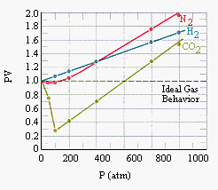
Gases Deviate from the Ideal

Slide 20
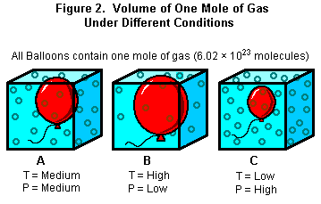

Slide 21
Ideal Gas Law Equation
A constant is a quantity that does not change in value.
The Gas Constant R, has a value of
0.0821

Slide 22
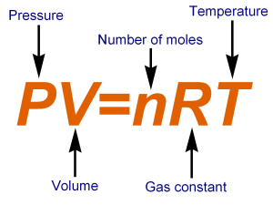
PV = nRT

Slide 23
Ideal Gas Law Calculations

Slide 24
Example#1. What is the pressure in atmospheres exerted by a 0.500 mol sample of Nitrogen gas in a 10.0 L container at 298 K?

Slide 25
Example#2. A gas occupies 8.77 L at 20 degrees Celsius. How many moles of gas are present if pressure was measured to be at 0.953 atm?

Slide 26
Example#3. A sample of nitrogen gas occupies 7.73 L at 20 degrees Celsius. How many moles of Nitrogen gas (N₂) are present if pressure was measured to be at 0.876 atm?

Slide 27
YOU TRY! (Use Notability)
An unknown gas occupies 32.3 L at 10 degrees Celsius. If the pressure was measured to be 0.833 atm and the mass of the gas was determined to be 27 grams, what is the molar mass of this compound?
(HINT: n = given mass/molar mass)

Slide 28
Ideal Gas Law Calculations
Example#4. An unknown gas occupies 24.3 L at 50 degrees Celsius. If the pressure was measured to be 0.932 atm and the mass of the gas was determined to be 12 grams, what is the molar mass of this compound?
(HINT: n = given mass/molar mass)

Slide 29
YOU TRY! (Use Notability)
An unknown gas occupies 0.4 L at 15 degrees Celsius. If the pressure was measured to be 0.840 atm and the mass of the gas was determined to be 40 grams, what is the molar mass of this compound?
(HINT: n = given mass/molar mass)

Slide 30
During Classwork Time
Stay focused on the assignments you are given.
Do the questions INDEPENDENTLY (on your own).
Keep the noise level down.
Ask THREE before you ask ME.
You may put earphones on and listen to music quietly as you do your work.
You must finish a certain number of questions (depends on the person) by the end of the period.
DO NOT FORGET YOUR STAMPS! You cannot get them once you leave the class.

Slide 31
Challenge?
What happens to the temperature of an ideal gas if the volume is doubled?
Temperature decreases by a factor of 4
Temperature increases by a factor of 4
Temperature decreases by a factor of 2
Temperature increases by a factor of 2

Slide 32
Challenge?
How is the final pressure of a gas affected if the original volume and original temperature are doubled?
The final pressure doubles
The final pressure decreases by a factor of 2
The final pressure increases by a factor of 2
The final pressure is not affected

Slide 33
Exit Slip
1. What is the numerical value of standard molar volume?
2. What is STP?
3. At 120 degrees Celsius, the pressure of a sample of nitrogen is 1.07 atm with a volume of 200 mL. How many moles of nitrogen gas are present?
Use Notability to answer the questions above. Email to gutierrezbr@elizabeth.k12.nj.us with p9 (or p10 if you’re in period 10) in the subject line.

