Slide 1
Catalyst 11/7/12
When a proton (a hydrogen atom) is removed from a water molecule, what compound remains?
What intermolecular forces causes water to have a high boiling point?
The atomic number tells you the number of _______.
When two hydrogen atoms and an oxygen atom combine to form water, electrons are:
A) Transferred to form an ionic bond
B) Transferred to form a covalent bond
C) Shared to form an ionic bond
D) Shared to form a covalent bond

Slide 2
Agenda 11/7/12
Catalyst
Basic Chemistry Review
Announcements
Both Packets DUE Friday, November 9, 2012.
Introduction to Ecology
Class Practice
Exit Slip

Slide 3
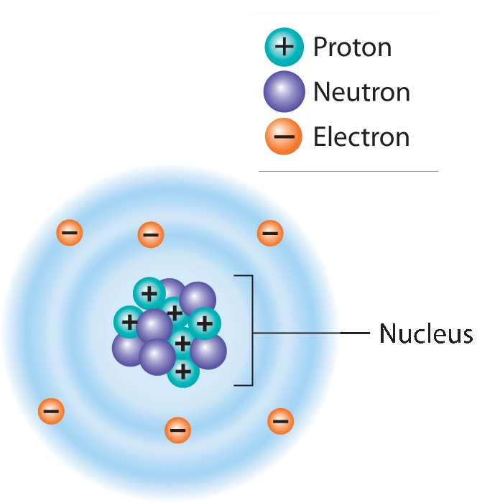
Atoms and Elements
Lesson 3.1 Matter and the Environment
Atoms are the basic unit of matter.
Nucleus: Contains protons and neutrons
Electrons: Move around the nucleus
An element is a substance that cannot be broken down into other substances.
Did You Know? There are 92 elements that occur naturally, and scientists have created about 20 others in labs.

Slide 4
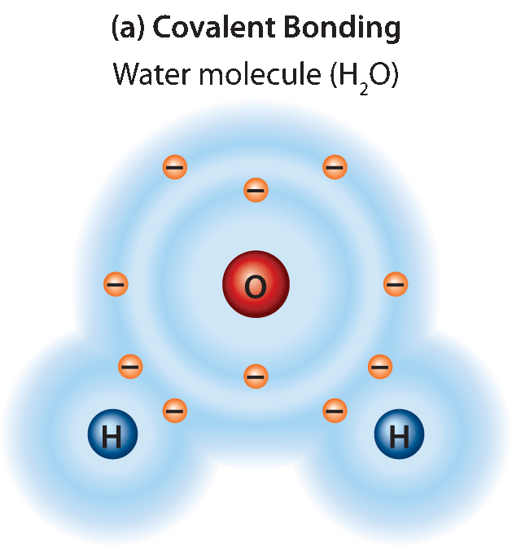
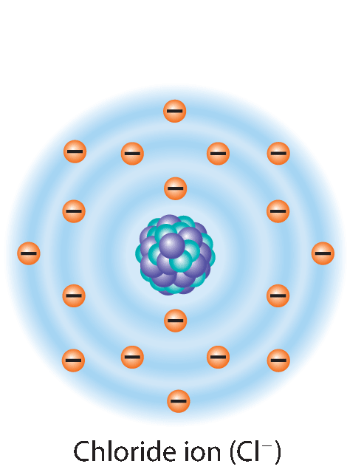
Bonding
Lesson 3.1 Matter and the Environment
Atoms combine by bonding:
Covalent bonds: Electrons are shared.
Ionic bonds: Electrons are transferred.
Molecule: Two or more atoms joined by covalent bonds
Compound: Substance composed of atoms of two or more different elements
Covalent bonding
Ionic bonding

Slide 6
OBJECTIVES
We will be able to:
Describe the major levels of ecological organization
Differentiate between biotic and abiotic factors
Define an organism’s habitat

Slide 7
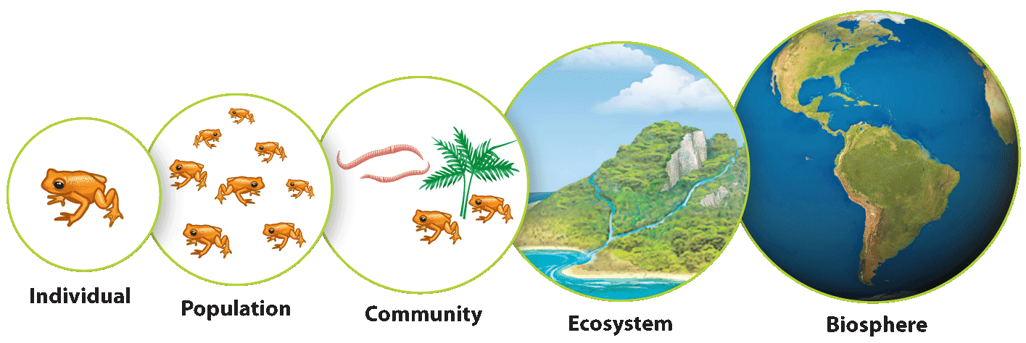
Levels of Ecological Organization
Lesson 4.1 Studying Ecology
Ecology: the study of how organisms interact with each other and with their environments
Scientists study ecology at various levels of organization.

Slide 8
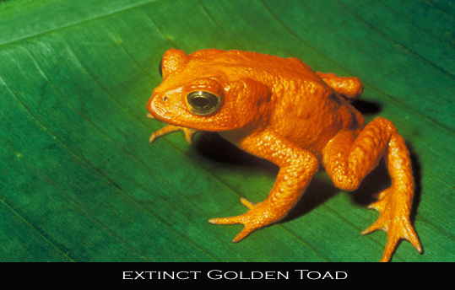
Individual
Most basic level an ecologist studies
This level focuses on the relationship between individual organisms and their physical environments.
Golden Toad (Bufo periglenes) from Monteverde, Costa Rica

Slide 9
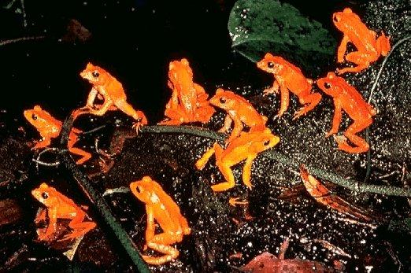
Population
Individuals in a group that are genetically similar and can produce offspring with each other are classified into species. A population is made up of members of a species that live in the same area at the same time.
Population ecology focuses on how individuals within a population interact with each other.

Slide 10
Community
All of the populations in a particular area make up a community. Example: a population of golden toads together with all of the plant, animal, fungal, and microbial populations within the Monteverde Cloud Forest Reserve made up a single community.

Slide 11
Community = ALL POPULATIONS (living things only)

Slide 12
Ecosystem
Ecosystems include both living things and nonliving things in a particular area. Example: Monteverde’s cloud-forest ecosystem includes all the organisms that live there plus the air, water, and nutrients they use.

Slide 13
Ecosystem = ALL LIVING AND NONLIVING THINGS

Slide 14
Biosphere
Biosphere includes all parts of the Earth that host life, with all of its organisms and environments (both living and nonliving)

Slide 15
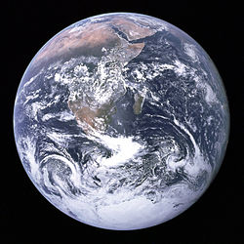
Biosphere
Biosphere includes all parts of the Earth that host life, with all of its organisms and environments (both living and nonliving)

Slide 16
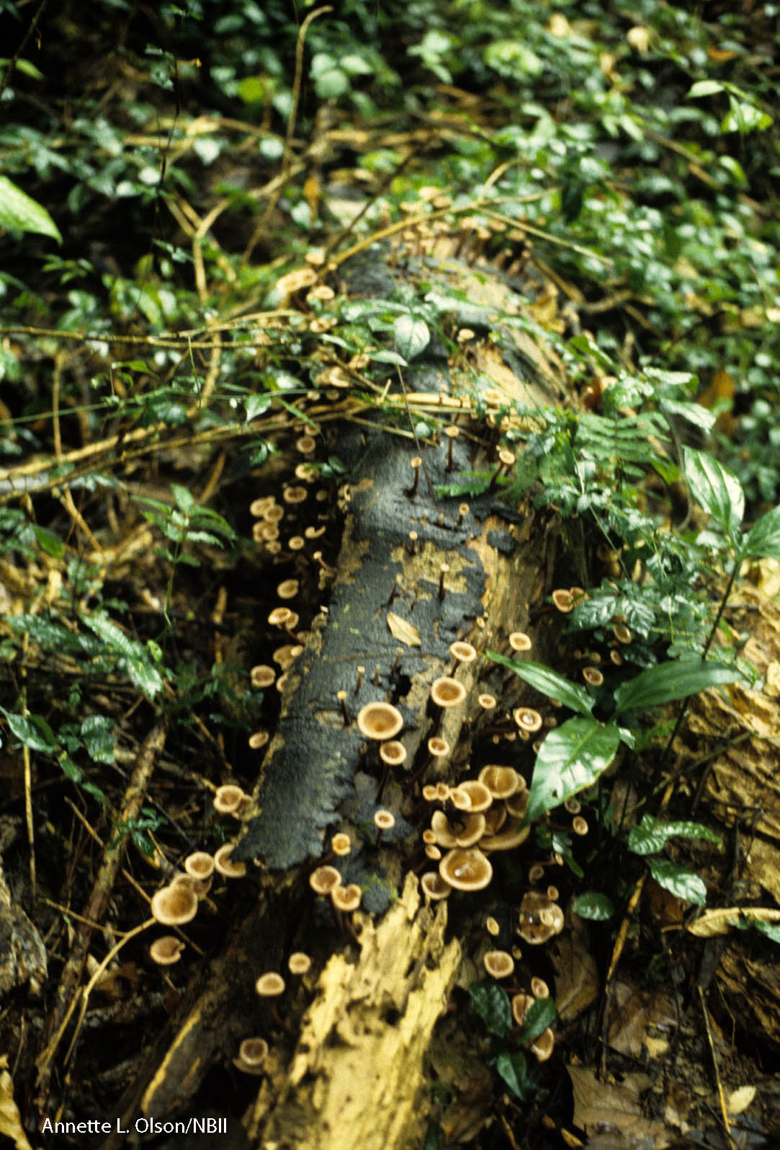
Biotic and Abiotic Factors
Lesson 4.1 Studying Ecology
Biotic factors: Parts of an ecosystem that are living or used to be living
Abiotic factors: Parts of an ecosystem that have never been living

Slide 18
Habitat
Lesson 4.1 Studying Ecology
A habitat is the specific environment in which an organism lives in. A species’ habitat consists of the biotic and abiotic components around it.
A habitat provides an organisms with its resources, which is anything that an organisms needs, including nutrients, shelter, breeding sites, and mates.

Slide 19
Habitat
For example, the golden toad lives in a habitat of cloud forest. The forest’s soil, rocks, leaf litter, humidity, plant life, and seasonal pools of water are all part of the toad’s habitat.
Unlike an ecosystem, the boundaries of habitats are defined by the particular organism that lives in it.

Slide 20
Exit Slip 11/7/12
Describe your habitat.
Identify all the abiotic and biotic factors in the room. Create a t-chart for your answer.

