Slide 1
Catalyst 1/12/12
Last chance to hand in homework from Tuesday. Place it in homework bin.
Name the following compound: V₃(PO₄)₂
Draw the Lewis dot structure of CO₂.
Name the compound from #2.
What type of bonding (ionic or covalent) is demonstrated in #2? How do you know?
You should be done with the catalyst when the music is done playing.

Slide 2
Agenda 1/12/12
Catalyst
Announcements
Verbal Drill
Comparing Ionic vs. Covalent Bonding
Class Practice
Exit Slip

Slide 3
Announcements
Quiz on chemical bonding/naming compounds on Tuesday, 1/17/12.

Slide 4
Verbal Drill (2 minutes)
One person speaking at a time (so everyone can hear the question and answer!)
You may only go once.
DO NOT CALL OUT IF IT’S NOT YOUR TURN.
If you don’t know the answer, have a classmate help you. You still need to say the answer if its your turn!
Points will NOT COUNT if you do not follow the rules above.
Class with the most Verbal Drill points will receive 5 points on the next exam. 2nd Place will receive 2 points.
P4: 137 pts P5: 119 pts P8: 121 pts P9: 73 pts
P10: 106 pts

Slide 5
Objective
SWBAT explain why atoms form bonds and state the Octet Rule in the context of ionic bonding.

Slide 6
Types of Chemical Bonding
Covalent Bonding results from the sharing of electron pairs between two atoms.
Ionic Bonding results from the attraction between cations and anions. Electrons are transferred. ←

Slide 7
Ionic Bonding
Ionic bonding is chemical bonding that results from the electrical attraction between cations and anions. Electrons are TRANSFERRED between atoms.
According to the Octet Rule, atoms will GAIN or LOSE electrons to have 8 valence electrons. (exceptions: Hydrogen, Lithium, and Beryllium)

Slide 8
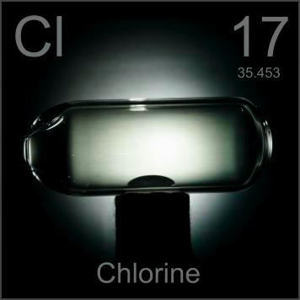
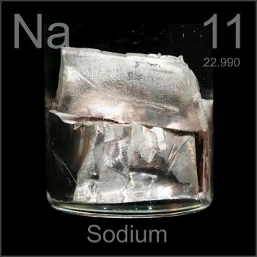
“I just need ONE MORE!!!!”
“You know what I want and I got what you need, Chlorine!”

Slide 9
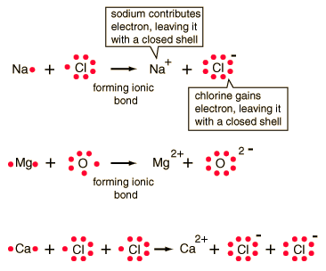

Slide 10
Objective
SWBAT compare and contrast the properties of ionic and covalent compounds.

Slide 11
Ionic vs. Covalent - Forces
Ionic
Covalent
Atoms involved in ionic bonding experiences STRONGER forces due to the positive and negative attraction
Atoms involved in covalent bonding experience WEAKER forces

Slide 12
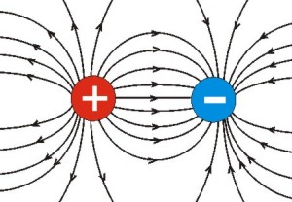
Ionic Bonding
When atoms form ionic bonds, the positively charged atom is attracted to the negatively charged atom.

Slide 13
Ionic vs. Covalent – Boiling and Melting Point
Ionic
Covalent
Ionic compounds have higher boiling and melting points as a result of the stronger forces
Ionic compounds have lower boiling and melting points as a result of the weaker forces

Slide 14
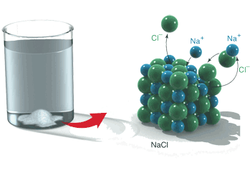
Ionic vs. Covalent – Electrical Conductivity
Ionic
Covalent
High electrical conductivity when dissolved in water
Low electrical conductivity

Slide 15
Ionic vs. Covalent – Other Properties
Ionic
Covalent
Harder
Softer

Slide 16
Check For Understanding
Which has a higher boiling point: NaCl or CO₂ ?
Why?

Slide 17
Check for Understanding
Which has can conduct electricity better when dissolved in water MgCl₂ or PBr₃?
Why?

Slide 18
Exit Slip
Please neatly complete the following on a whole sheet of paper.
Draw the Lewis dot structure of SiO₂.
Draw the Lewis dot structure of PBr₃.

Slide 19
Exit Slip
Explain the difference between ionic bonding and covalent bonding. (Do NOT say ionic involves metals and covalent doesn’t. Think about the electrons.)
What are the two ions that KBr comes from? Write the electron configuration for each ion.
Draw the Lewis dot structure of PBr₃

Slide 20
Extra Practice
How many pi bonds are there in C₂H₂?
How many pi bonds are there in O₃?
Draw the Lewis dot structure of CH₃CH₂OH.
Write the Lewis dot structure of C₂H_{4.}
5. Draw the Lewis dot structure of the Phosphate Ion. (**Wait for further instructions for polyatomic ions.)
6. Draw the Lewis dot structure of the Sulfate Ion.**
7. Draw the Lewis dot structure of the Nitrate Ion.**
8. How many resonance structures does the structure in number 5 have?

