Slide 1

Environmental Science Catalyst 4/15/14
Go to class website: http://aofscience.weebly.com and scroll down to Catalysts. Complete the questions and press submit.
Question:
Summarize the rock cycle.
Explain the difference between the three types of rocks.

Slide 2
Environmental Science Agenda 4/15/14
Catalyst
Announcements
  Quiz tomorrow
Mining Methods
Classwork Time
Check For Understanding
Reminders

Slide 3






Objective(s)
We will be able to
Describe the different methods used for mining.


Slide 4
How do you think we extract minerals from the Earth?

Slide 5
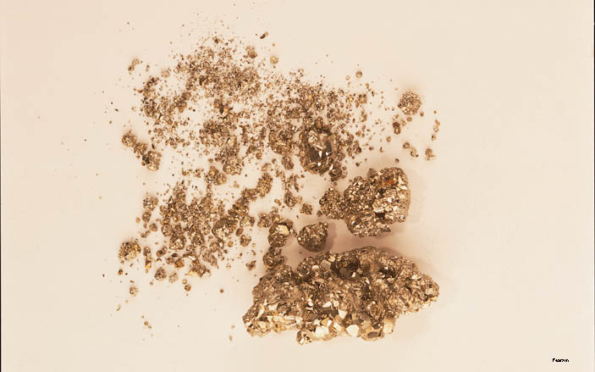
Lesson 13.2 Mining
More than a ton of waste may remain after extracting just a few hundredths of an ounce of gold.

Slide 6
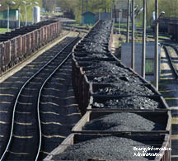
What Is Mined?
Ores: Groups of minerals that are mined so metal or metals can be removed
Nonmetallic minerals: Minerals, including gemstones, that as a whole have valuable properties
Fuels: Minerals that can be used to generate energy
Did You Know? About 100 minerals are considered gemstones, including diamond, topaz, and jade.

Slide 7
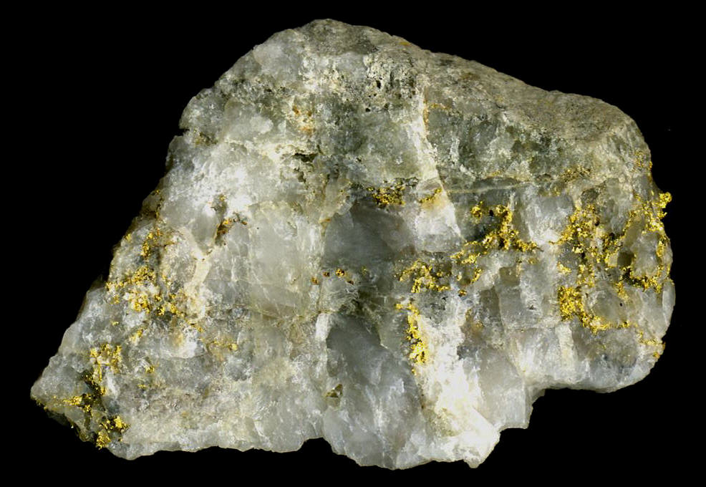
Gold Ore

Slide 8
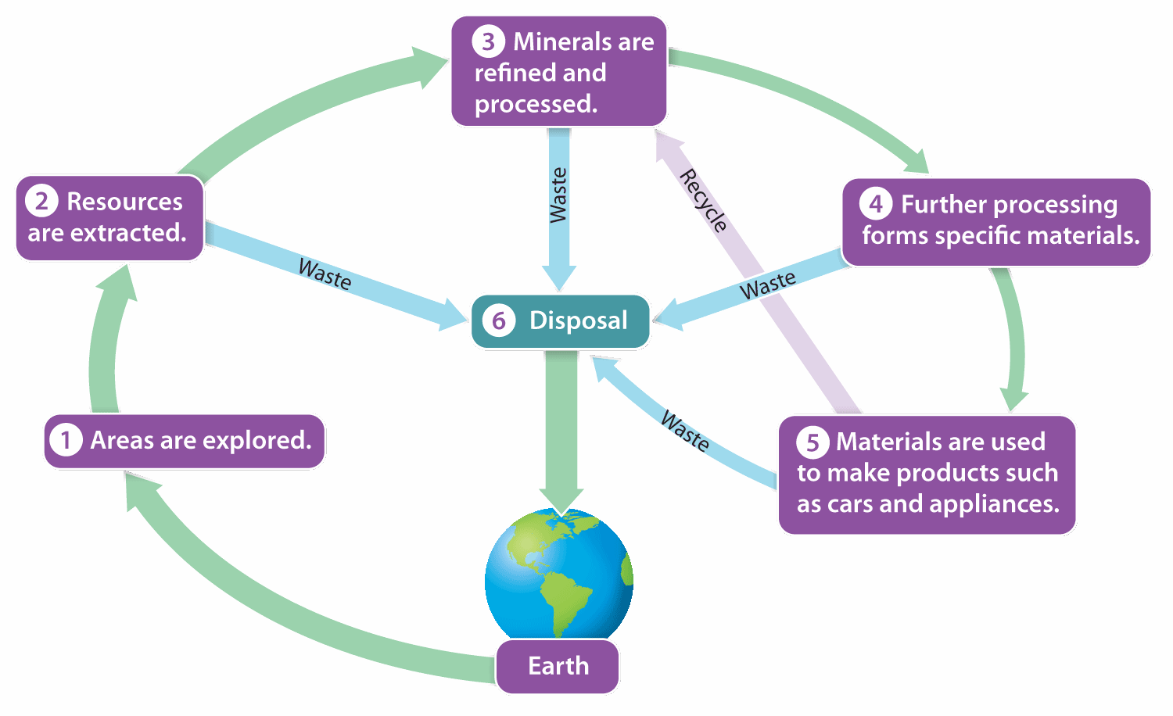
Process of Mining and Mineral Use
From initial exploration to disposal, mining and mineral use involve many steps.

Slide 9
Mining Methods
Strip mining (remove layer of rock and soil)
Subsurface mining (underground tunnels)
Open pit mining
Mountaintop removal
Solution mining
Placer mining (sift through material in riverbied deposits)
Undersea mining

Slide 10
Strip Mining
Layers of surface soil and rock are removed from large areas to expose the resource
Used to mine coal, sand, and gravel

Slide 11
Subsurface Mining
Vertical shafts are dug deep into the ground, and networks of horizontal tunnels are dug or blasted out to follow deposits of the resource
Used for metals such as zinc, lead, nickel, tin, gold, copper, and uranium and for nonmetallic minerals such as diamonds, phosphate, and salt.

Slide 12
Open Pit Mining
When a mineral is distributed widely and evenly throughout a rock formation
Involves digging a large hole and removing the ore and unwanted rock that surrounds the ore.

Slide 13
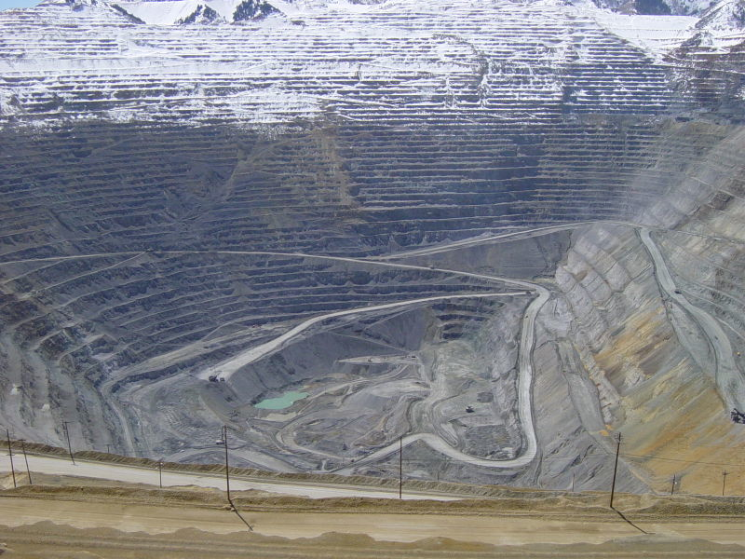
Open Pit Mining
http://www.youtube.com/watch?v=4WbaONJEbRE

Slide 14
Mountaintop Removal
First, forests are clear-cut and the timber is sold and burned.
Then, the topsoil is removed and rock is blasted away to expose the resource.

Slide 15
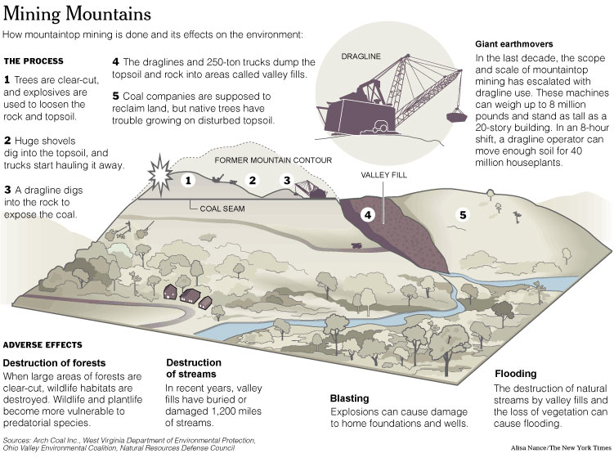

Slide 16
Solution Mining
Rather than removing ore from the ground, miners sometimes pump a chemical solution into a mine to leach the desired resource from the ore.
Once the solution has reacted with the ore, the liquid is removed from the mine, taking the resource with it.

Slide 17
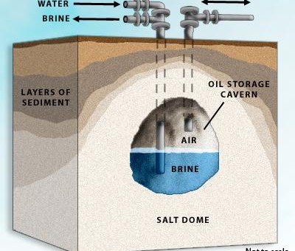
Solution Mining
http://videos.howstuffworks.com/discovery/35567-howstuffworks-show-episode-9-solution-mining-video.htm

Slide 18
Placer and Undersea Mining
TEXTBOOK FUN FOR YOU!
Turn to page 402 and write brief summaries of Placer Mining and Undersea Mining

Slide 19
During Classwork Time
Stay focused on the assignments you are given.
Do the questions INDEPENDENTLY (on your own).
Keep the noise level down.
Ask THREE before you ask ME.
You may put earphones on and listen to music quietly as you do your work. (Pick a playlist and stick with it!)
You must finish a certain number of questions (depends on the person) by the end of the period.
TASK:
13.1 Questions

Slide 20
Partner Check
Explain the first five mining methods of mining to a partner next to you.
Switch roles once you are done.

Slide 21
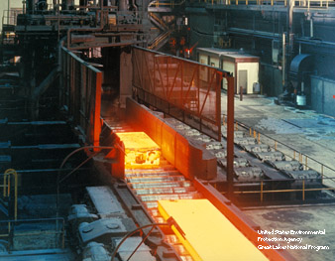
Processing Ore
Ores must be processed to gain access to the metals they contain:
  Ore is crushed and ground.
  Crushed ore is separated
  into metals and tailings.
  Concentrated metals
  are further processed,
  often by smelting.

Slide 22
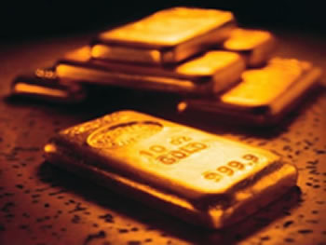
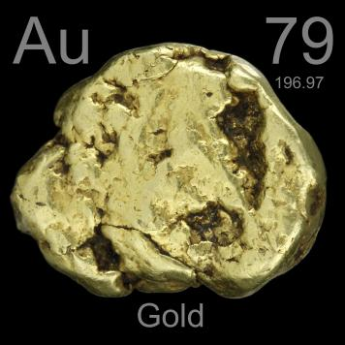
Mining for Gold
http://www.youtube.com/watch?v=nCDCQtcPeGU

Slide 23
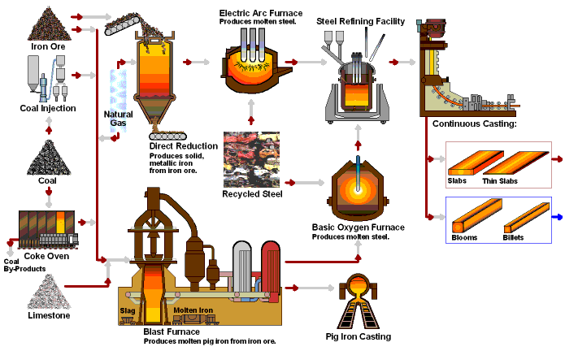
Steel Making
http://www.youtube.com/watch?v=9l7JqonyoKA

Slide 24
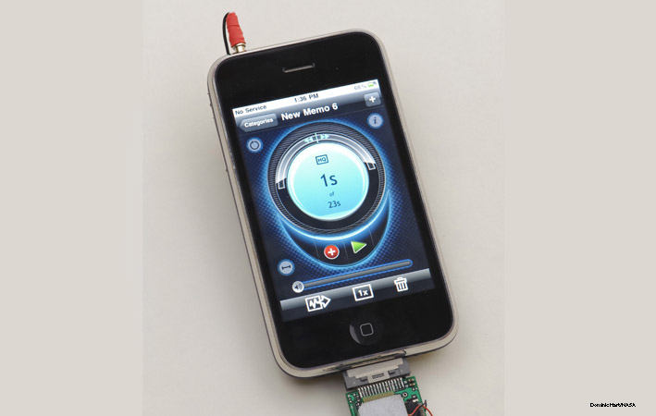
Lesson 13.3 Mining Impacts and Regulation
There are about $314 million worth of metals contained in unused cell phones in the United States alone.

Slide 25
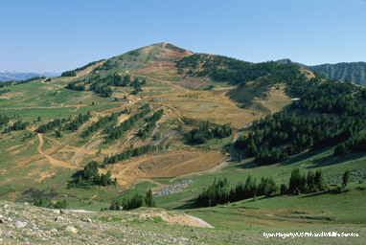
Environmental Impacts of Mining
Increased erosion
Sediment and debris clog waterways.
Acid drainage and other forms of water pollution
Air pollution
Disruption of ocean ecosystems (undersea mining)
Mine Remediation Mitigation of damage caused to the hillside by strip mining

Slide 26
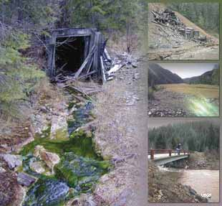
Social Impacts of Mining
Property damage caused by mountaintop removal or mine collapse
Although mining can bring
money and jobs to poor areas
of the world, conflicts can
arise over mineral rights.
Mining can be hazardous to
the health of the miners.
Did You Know? Around 650 miners or former miners died from complications related to black lung disease in 2005.
Several damaged areas in the Northern Coeur d’Alene Mining District, in Idaho

Slide 27
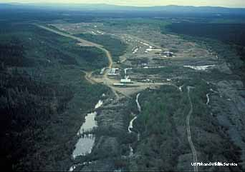
General Mining Law of 1872
Created rules to manage mining activity, but also promoted mining
Public land can be claimed and leased from the government for mining.
Claim owners can file to
patent, or own, the land
for $5 per acre.
Amendments are
currently being
considered
Placer mine on the Hog River, in Alaska

Slide 28
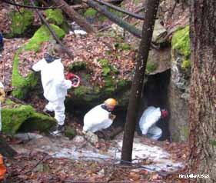
Additional Mining Regulations
Lesson 13.3 Mining Impacts and Regulation
Mineral Leasing Act of 1920 governs leasing of public lands for fossil fuel, phosphate, sodium, and sulfur mining.
Surface Mining Control and Reclamation Act (1977) requires that coal-mining companies restore land after mining is complete.
An abandoned mine in New York state, now home to hibernating bats

Slide 29
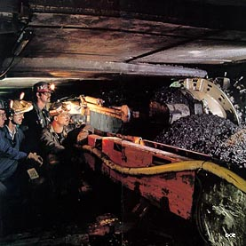
Mine Safety
First law, passed in 1891, established ventilation requirements for coal mines and prohibited miners under 12.
Today, the Federal Mine Safety and Health Act of 1977 regulates mine safety.
In 2010, an underground explosion in a West Virginia mine killed 29 miners.

Slide 30
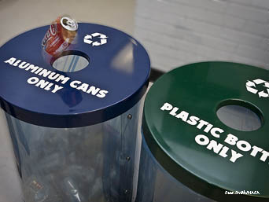
Responsible Mineral Use
Minerals are nonrenewable resources.
Reducing use, reusing, and recycling minerals can help minimize the negative impacts of mining and address limited supplies.
Did You Know? Extracting aluminum ore takes 20 times more energy than obtaining it from recycled sources.

Slide 31
Enviro-Blogging!
Write a blog entry to encourage responsible mineral use. Specify your audience (mining companies, customers, law makers, and etc.) In your blog entry, be sure to discuss the negative impacts of mining on the environment and society. Give specific examples of how people can mine responsibly.

Slide 32
Closing Discussion
BIG Question:
At what point do the costs of mining outweigh the benefits?

