Slide 1
Catalyst Friday, 10/19/12
A. How can you distinguish between a physical and chemical change?
B. Is painting a wall a chemical or physical change?
2. *Honors: List one example of a homogenous mixture in the room right now and one example of a heterogenous mixture. How can you tell the difference?

Slide 2
Agenda Friday 10/19/12
Catalyst (5 minutes)
Announcements
  HW: Page 60, #35 - #51. (On sheet of paper)
  Have packet ready to go once you sit down
Types of Mixtures Lesson (10 minutes)
Class Practice (25 minutes)
Exit Quiz (5 minutes)
Periodic Table Introduction (Honors*)

Slide 3
Class Points
Your class can earn class points if:
everyone in class:
Comes to class quietly and on time
Stays focused and on task during class
Leaves classroom neat and organized
Students are teaching other students
Majority of class participates
Follows all classroom expectations and procedures
And more…
P3: 6pts
(staying focused and on time)
P4: 5pts (staying focused)
P6: 7pts (staying focused, on time, and leaving the room neat)

Slide 4
Objective
We will be able to:
Classify a mixture as either a homogenous mixture, heterogenous mixture, or pure substance.
Describe different methods of physical separation.

Slide 5
Mixtures vs. Pure Substances
There are two main types of matter: mixtures and pure substances.

Slide 6
Mixtures
If it can be physically separated by the following methods:
filtering
distillation
hand separation
Then it is a mixture. A mixture is a blend of two or more kinds of matter, each retaining its identity and properties. The two types of mixtures are:
Homogenous Mixtures
Heterogenous Mixtures

Slide 7
Homogenous vs. Heterogenous
Heterogenous Mixture: Mixtures that are NOT the same throughout
Homogenous Mixture: Mixtures that are the same throughout. Homogenous mixtures are also called solutions.

Slide 8
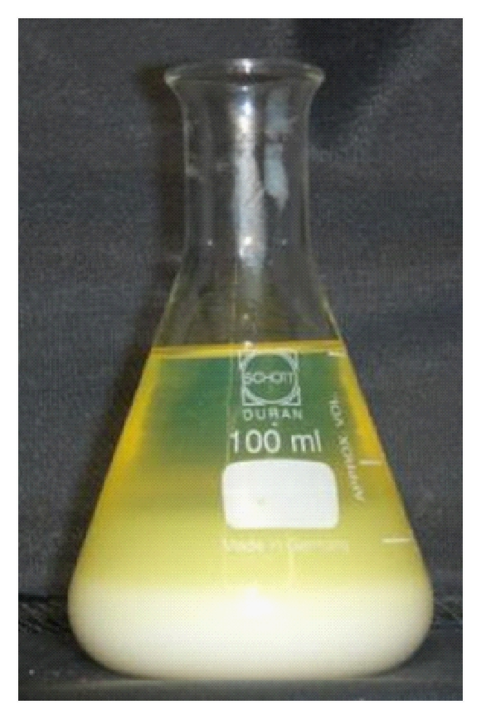
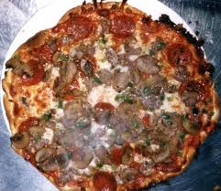
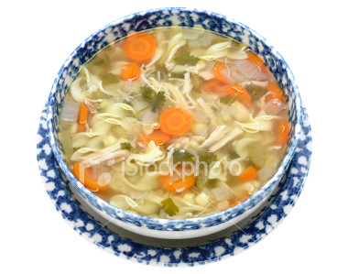
Heterogenous Mixtures

Slide 9
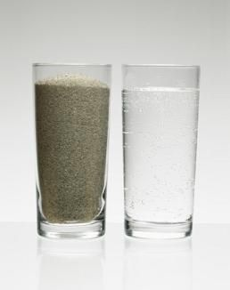

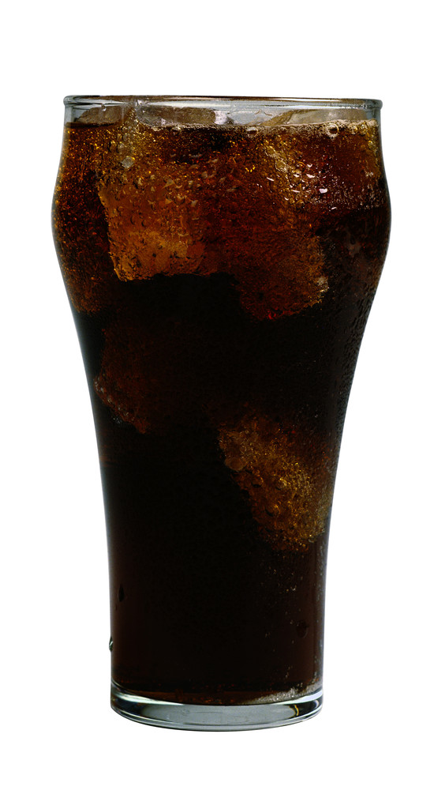
Homogenous Mixtures

Slide 10
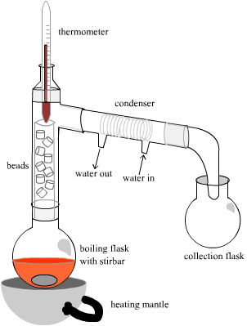
Separating Mixtures: Distillation
Uses the differences in boiling points to separate out different substances

Slide 11
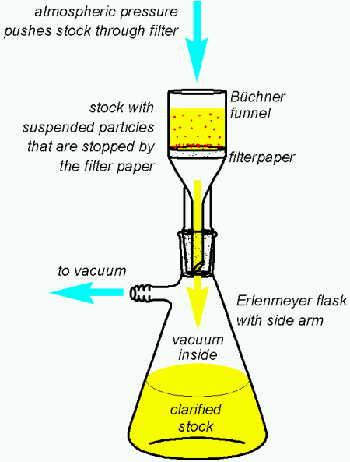
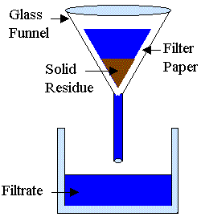
Separation of Mixtures: Filtering

Slide 12
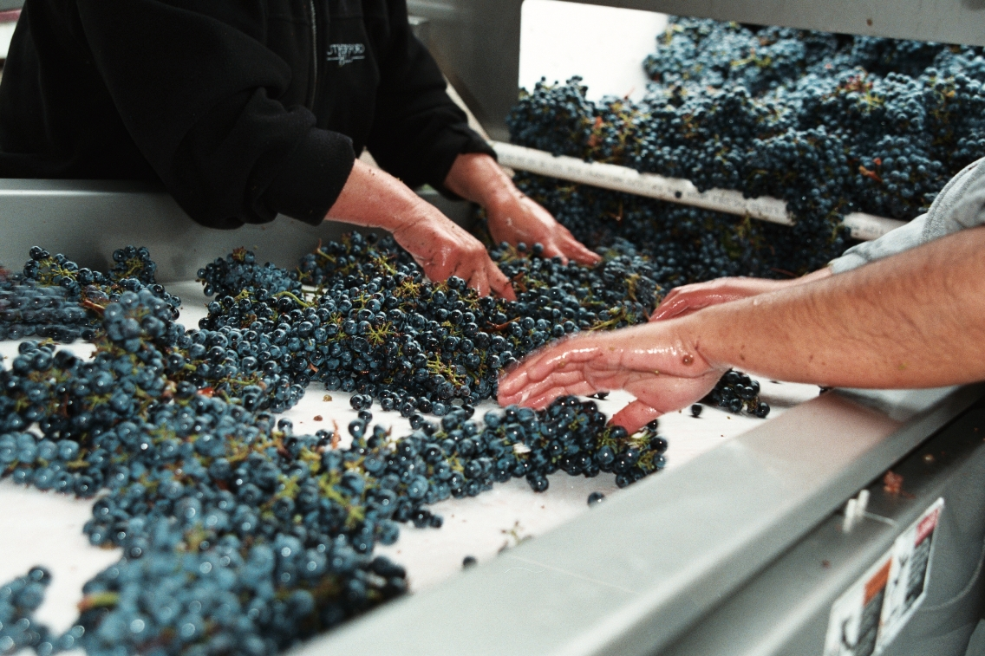
Separation Of Mixtures: Hand Sorting

Slide 13
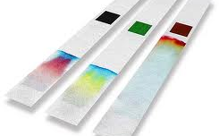
*Honors: Separation of Mixtures - Chromatography
Mixtures are separated by different properties such as polarity and charge.

Slide 14
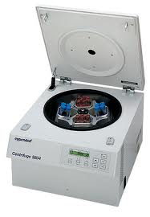
*Honors: Separation of Mixtures: Chromatography
The centripetal acceleration causes denser substances to separate towards the bottom. Less dense objects will tend to stay on the top.
This is commonly used for blood tests.

Slide 15
Pure Substance
If it CANNOT be physically separated by the methods mentioned above, then it is a pure substance. A pure substance is a substance that is made up of only one component. Every sample of a given pure substance has the same the same characteristics. There are two types of pure substances:
Compounds: A substance made up of two or more atoms that are chemically bonded. Can be broken down chemically into elements.
Elements:
Pure substance that cannot be broken down into simpler, stable substances.

Slide 16

Element
Compound
Water (H₂O)
Lithium Oxide (Li₂O)
Hydrogen = H
Oxygen = O
Lithium = Li
Molybdenum = Mo

Slide 17
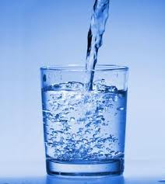
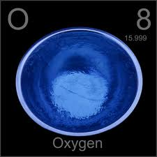
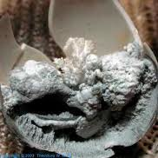

Slide 18

CAUTION!
DO NOT CONFUSE HOMOGENOUS MIXTURES WITH PURE SUBSTANCES!
Homogenous mixtures can be simply separated using physical methods (filtering, hand sorting, magnets, etc.)
Pure substances can only be separated using chemical methods. (electrolysis, chemical reactions, etc.)

Slide 20
Let’s Practice!
Classify the following substances as either a homogenous mixture, heterogenous mixture, or pure substance (element or compound)

Slide 21
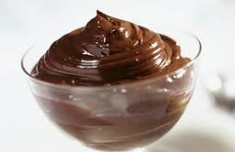
Chocolate Pudding

Slide 22
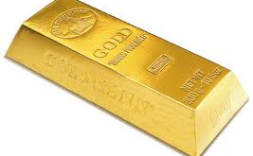
Brick of Gold

Slide 23

Iced Tea

Slide 24
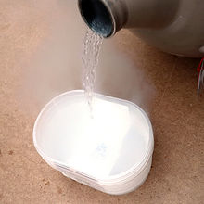
Liquid Nitrogen

Slide 25
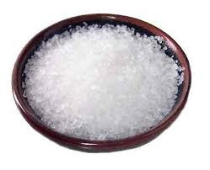
Salt

Slide 26
During Classwork Time
Stay focused on the assignments you are given.
Do the questions INDEPENDENTLY (on your own).
Keep the noise level down.
Ask THREE before you ask ME.
You may put earphones on and listen to music quietly as you do your work.
You must finish a certain number of questions (depends on the person) by the end of the period.
DO NOT FORGET YOUR STAMPS! You cannot get them once you leave the class.

Slide 27
Exit Quiz
Go to http://m.socrative.com
Join room 66355
Make sure to type in your name when asked.
Answer the questions INDEPENDENTLY and QUIETLY. (Otherwise it is a zero.)
HW: Page 60, #35 - #51. Due Tuesday, October 23.

