Slide 1
Catalyst 4/19/12
Given the balanced equation:
8Ca + S₈ → 8CaS
a) What is the mole ratio of S₈ to CaS?
b) How many moles of CaS do you have in 5 moles of S₈?

Slide 3
Agenda
Catalyst
Element of the Day
Stoichiometry Class Practice
Exit Slip

Slide 4
Class Points
Your class can earn class points if:
everyone in class:
Comes to class on time
Stays focused and on task during class
Leaves classroom neat and organized
Students are teaching other students
And more…
P4: 10
P5: 14 (+3 everyone on task and on time)
P8: 17 (+2 everyone paying attention and on task)
P9: 10
P10: 13 (+2 everyone being engaged and on task)

Slide 5
39

Slide 6
Announcements
All Element Facebook Profile Projects may be handed in by next Friday, April 27. (If you’re having trouble accessing a computer, feel free to use the computers in this room.)

Slide 7
Review of Classroom Expectations
Do not speak or make any noise while I am giving directions, announcements, or explanations.
Do not randomly get up or throw objects across the room during a lesson.
Avoid asking to leave the class during the lesson.
4. If I ask for a specific person to answer a question, don’t call out the right answer. (You will get one warning, after that points will be deducted.)
5. Be prepared with a periodic table, your packet, and a pen/pencil every day!

Slide 8
During a lesson…
Do not speak to anyone else while I am teaching.
Let me finish before asking a question.
Me pausing does not give you an excuse to start talking.
Look at the board!

Slide 9
Objective
I will be able to write a mole ratio using the coefficients of chemical formulas.
I will be able to convert moles of one compound to moles of another compound using mole ratios as a conversion factor.

Slide 10
Class Practice Time
Work on packet questions.
Work on Element Facebook Profile Project. (only half of class can work on Facebook profile.)

Slide 11
Stoichiometry

Slide 12
Why is a recipe important?
• 2 cups all purpose flour
• 2 cups sugar
• 1/2 teaspoon baking powder
• 1 teaspoon salt
• 1 teaspoon baking soda
• 1/2 cup shortening
• 3/4 cup water
• 2 large eggs
• 3/4 cup milk
• 1 teaspoon vanilla
• 4 ounces melted unsweetened baking chocolate

Slide 13
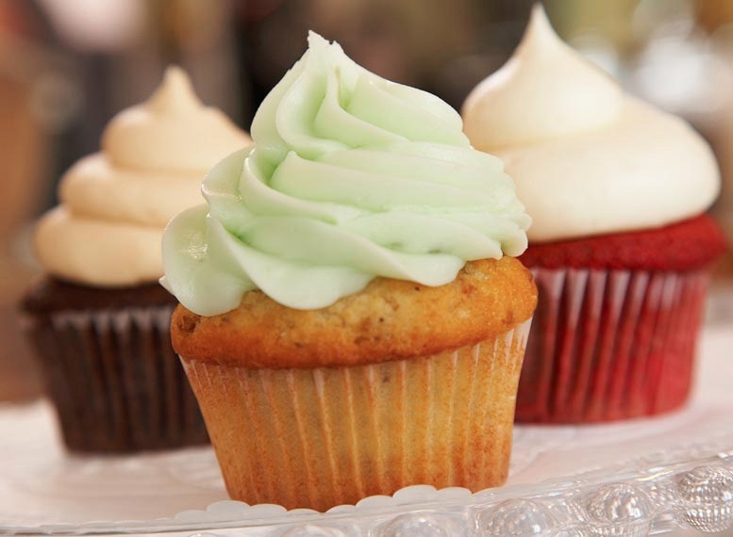

Slide 14
Stoichiometry
Stoichiometry is the branch of chemistry that deals with the mass relationships of elements in compounds and the mass relationships between reactants and products in a chemical reaction.
In less words: Stoichiometry is the study of the amounts of reactants and products used in a chemical reaction. (“cooking in chemistry”)

Slide 15
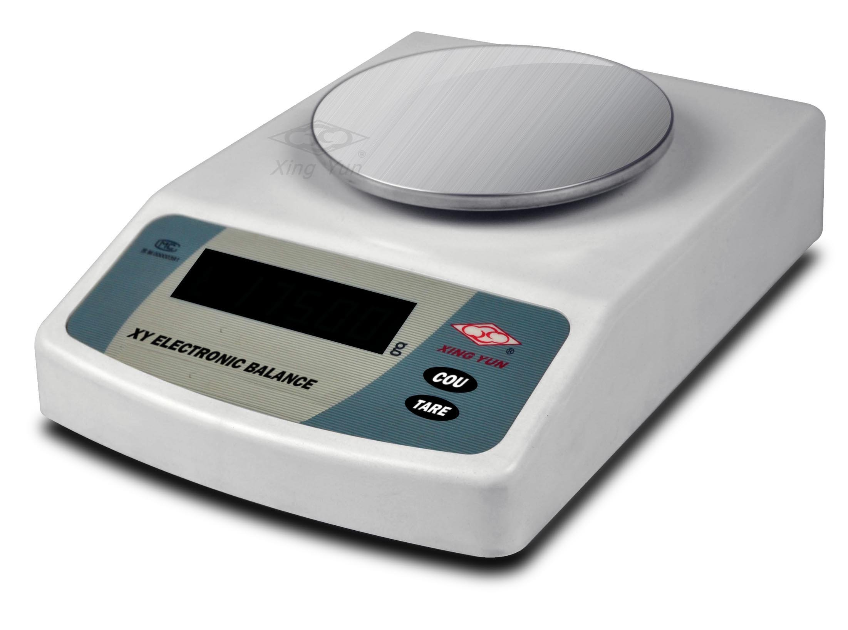
Why is this study important?
Chemists need to know how much reactant they need to add to a reaction to create a product.
Conversion from moles to grams and vice versa is needed because we can’t measure out a compound in moles when we’re using a scale. The scale only measures the compound in grams!

Slide 16
Plan for Today
Part I: Writing Mole Ratios
Part II: Using Mole Ratios as a Conversion factor

Slide 17
PART I: WRITING MOLE RATIOS

Slide 18
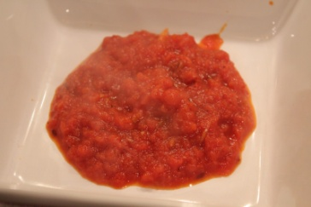
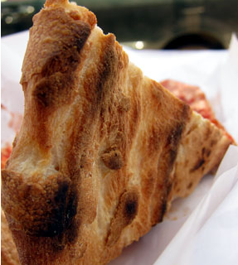
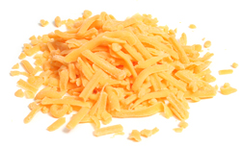
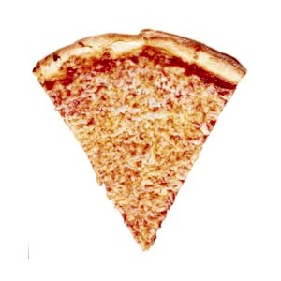
Goal of this week and next week
Given a chemical “recipe”, how much product can we make? How much reactant (ingredient) do we need?
+
+
→

Slide 19
Mole ratios!
Look at this recipe. How many crusts are represented? Cheese units? Tomato sauce units?
What is the ratio of pizza slices:crust?
+
+
→

Slide 20
Pizza
+
+
→
For the recipe
Crust + 2 cheese + 3 tomato sauce → 1 slice pizza
# of crusts | 1
# of cheese | 2
# of tomato sauce | 3
# of pizza slices | 1

Slide 21
Pizza
For the recipe
Crust + 2 cheese + 3 tomato sauce → 1 slice pizza
+
+
→

Slide 22
Pizza
+
+
→
For the recipe
Crust + 2 cheese + 3 tomato sauce → 1 slice pizza
Ratio of crusts to pizza slices
Ratio of cheese to tomato sauce
Ratio of cheese to slices of pizza

Slide 23
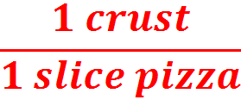
Pizza
+
+
→
For the recipe
Crust + 2 cheese + 3 tomato sauce → 1 slice pizza
Ratio of crusts to pizza slices
Ratio of cheese to tomato sauce
Ratio of cheese to slices of pizza

Slide 24
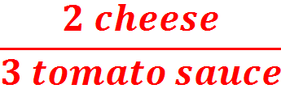
Pizza
+
+
→
For the recipe
Crust + 2 cheese + 3 tomato sauce → 1 slice pizza
Ratio of crusts to pizza slices
Ratio of cheese to tomato sauce
Ratio of cheese to slices of pizza

Slide 25
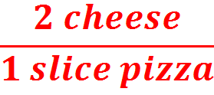
Pizza
+
+
→
For the recipe
Crust + 2 cheese + 3 tomato sauce → 1 slice pizza
Ratio of crusts to pizza slices
Ratio of cheese to tomato sauce
Ratio of cheese to slices of pizza

Slide 26
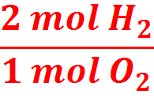
+
→
For the equation
2 H₂(g) + O₂(g) → 2 H₂O (l)
Ratio of H₂:O₂
Ratio of O₂:H₂O
How many moles of H₂O can you get from 2 moles of H₂?

Slide 27
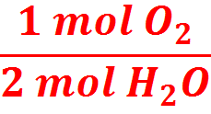
+
→
For the equation
2 H₂(g) + O₂(g) → 2 H₂O (l)
Ratio of H₂:O₂
Ratio of O₂:H₂O
How many moles of H₂O can you get from 2 moles of H₂?

Slide 28
+
→
For the equation
2 H₂(g) + O₂(g) → 2 H₂O (l)
Ratio of H₂:O₂
Ratio of O₂:H₂O
How many moles of H₂O can you get from 2 moles of H₂? | 2 moles!

Slide 29
IMPORTANT: Make sure the chemical equation is balanced before working with it!

Slide 30
YOU TRY!
Consider the following chemical equation:
H₃PO₄ + 5HCl → PCl₅ + 4H₂O
On your whiteboards, write:
What is the mole ratio of H₃PO₄ to PCl₅?

Slide 31
YOU TRY!
Consider the following chemical equation:
H₃PO₄ + 5HCl → PCl₅ + 4H₂O
On your whiteboards, write:
What is the mole ratio of H₃PO₄ to PCl₅?

Slide 32
YOU TRY!
Consider the following chemical equation:
H₃PO₄ + 5HCl → PCl₅ + 4H₂O
On your whiteboards, write:
What is the mole ratio of HCl to water?

Slide 33
YOU TRY!
Consider the following chemical equation:
H₃PO₄ + 5HCl → PCl₅ + 4H₂O
On your whiteboards, write:
What is the mole ratio of HCl to PCl₅?

Slide 34
PART II: Using Mole Ratios as a Conversion Factor

Slide 35
Given the recipe 1 crust + 2 units cheese + 3 units tomato sauce → 1 slice of pizza, how many slices of pizza could you make from 8 crusts?
+
+
→

Slide 36
Moles A
Moles B
How many slices of pizza could you make from 8 crusts?
Start:
End:
Plan:
MM needed?
Solve:
8 crusts (A)
? Slices (B)
crusts (A) → slices (B)
Nope
1
slice
8 crusts
X
= 8x1/1
1
crusts
= 8
slices

Slide 37
Moles A
Moles B
How many moles of pizza could you make from 100 moles of cheese?
Start:
End:
Sequence:
MM needed?
Solve:
100 cheese - A
? Slices - B
mol cheese (A) → mol slices (B)
Nope
1
slice
100 cheese
X
= 100x1/2
2
cheese
= 50
slices

Slide 38
Moles A
Moles B
How many moles of pizza could you make from 900 moles of tomato sauce?
Start:
End:
Sequence:
MM needed?
Solve:
900 mol tomato sauce (TS) - A
? Slices - B
mol TS (A) → mol slices (B)
Nope
1
slice
900 TS
= 900x1/3
X
3
TS
= 300
slices

Slide 39
Moles A
Moles B
How many moles of NaBr could be produced from 4 moles of Br₂?
Start:
End:
Sequence:
MM needed?
Solve:
4 mol Br₂ (A)
? mol NaBr (B)
mol Br₂ (A) → mol NaBr (B)
Nope
2
mol NaBr
4 mol Br₂
X
= 4x2/1
1
mol Br₂
= 8
mol NaBr

Slide 40
Grams A
Moles A
Moles B
Grams B
How many moles of SO₂ would be needed to produce 2 moles of SO₃?
Start:
End:
Sequence:
MM needed?
Solve:
2 mol SO₃ (A)
? mol SO₂ (B)
mol SO₃ (A) → mol SO₂ (B)
Nope
2
mol SO₂
2 mol SO₃
X
= 2x2/2
2
mol SO₃
= 2
mol SO₂

Slide 41
Grams A
Moles A
Moles B
Grams B
How many moles of oxygen (O₂) would be needed to produce 79.60 moles of SO₃?
Start:
End:
Sequence:
MM needed?
Solve:
79.60 mol SO₃ (A)
? mol O₂ (B)
mol SO₃ (A) → mol O₂ (B)
Nope
1
mol O₂
79.60 mol SO₃
X
= 79.6x1/2
2
mol SO₃
= 39.8
mol O₂

Slide 42
Exit Slip
On a half a slip of paper, answer the following:
Consider the following chemical equation,
K + Cl₂ → KCl
Balance the equation
What is the mole ratio of potassium to potassium chloride?
How many moles of potassium chloride will be produced if you add 4 moles of potassium to the reaction?

