Slide 1
Catalyst 10/24/12
Describe the movement of water particles when the temperature is changed from 300 K to 400 K.
Multiply. Express your answer using the correct number of significant figures. 98.30 m x 13 m = ?
*Honors: Using the equation E = mc², calculate the mass of a piece of matter if the energy released by this object is 3945 J. (c = 3 x 10⁸ m/s)

Slide 2
Agenda 10/24/12
Catalyst
Announcements
Benchmark Exam#1 – November 13th
Introduction to Periodic Table
Class Practice
Exit Slip
Student Job Assignments
Metals, Nonmetals, and Metalloids
Class Practice
Exit Slip

Slide 3
Objective
We will be able to use a periodic table to name elements and write their symbols.

Slide 4
The Periodic Table
What is an element?

Slide 5
Periodic Table Video

Slide 6
The Periodic Table
An element is a pure substance that cannot be broken down into a simpler, stable substance. (You already have this definition.)

Slide 7
The Periodic Table
All known elements are arranged in the Periodic Table of Elements.
Elements are arranged based on their chemical and physical properties.
Similar elements were placed near each other in the Periodic Table.

Slide 8
The Periodic Table
Each square on the periodic table contains the following information:
Atomic Number (tells you the number of protons)
Symbol (most are related to their English names, but some are related to their Latin or German names)
Average Atomic Mass Number

Slide 9
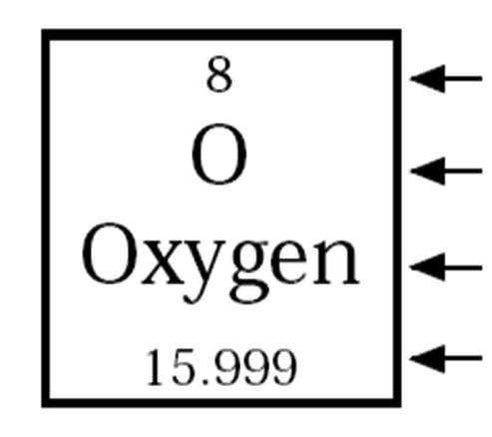

Slide 10
Arrangement of the Periodic Table
The vertical columns are called the groups.
The horizontal rows are called the periods.

Slide 11
Element Match Up (Honors)
Take 2 minutes and write as many pairs of element symbols with atomic numbers and element names.
Your group will be assigned a group number on the periodic table.

Slide 12
Element Match Up
Take a card, which will either have a symbol and atomic number or the name of an element.
Find your match in the room and stand next to them.

Slide 13
Guided Practice
Which of the following elements will most likely react the same way as Potassium?
Germanium
Silicon
Sodium
Nitrogen

Slide 14
Guided Practice
Write the answers to the following on your whiteboard app.
Which element is located in Period 4, Group 2?
What is the atomic number of this element?
What is the average atomic mass number?

Slide 15
During Classwork Time
Stay focused on the assignments you are given.
Do the questions INDEPENDENTLY (on your own).
Keep the noise level down.
Ask THREE before you ask ME.
You may put earphones on and listen to music quietly as you do your work.
You must finish a certain number of questions (depends on the person) by the end of the period.
DO NOT FORGET YOUR STAMPS! You cannot get them once you leave the class.

Slide 16
Exit Slip 10/24/12
QUIETLY and INDEPENDENTLY answer the following on the email app and email it to gutierrezbr@elizabeth.k12.nj.us with “p6 ES 10/24” on the subject line. I must receive it by the end of the period. If you are talking or copying, you will not receive credit.
The vertical columns in the periodic table are called the_________.
What element is located on Group 12, period 5? What is the atomic number? What is the average atomic mass?
Why are the elements arranged the way they are on the periodic table?

