Slide 1
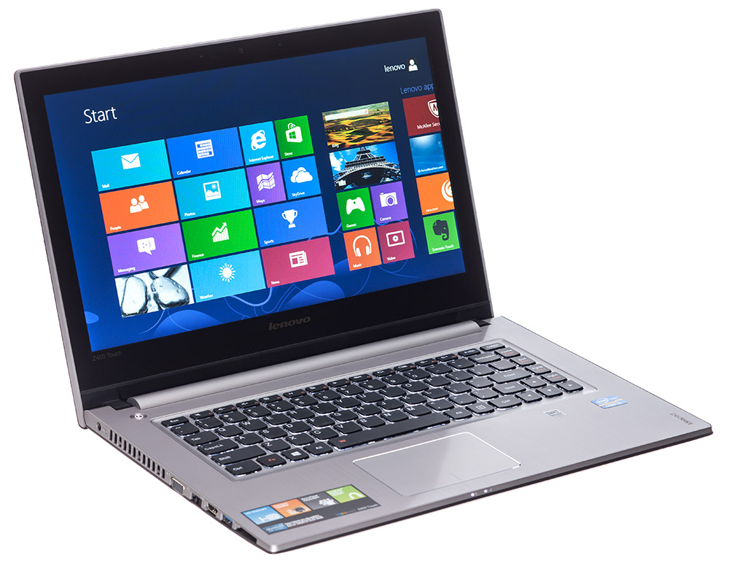
Biology Catalyst 4/11/14
Go to class website: http://aofscience.weebly.com and scroll down to Catalysts. Answer the question(s) and press submit.
QUESTION(S)
Pretend you are Mama/Papa Plant! You've been spending time with your offspring and are telling them a bedtime story about photosynthesis. Write a short bedtime story describing what happens in the light-dependent and light-independent reaction in photosynthesis.

Slide 2
biology agenda 4/11/14
Catalyst
Announcements
Photosynthesis – Light and Dark Reaction Review*
Photosynthesis Verbal Review
Human Body Model Work Time

Slide 3
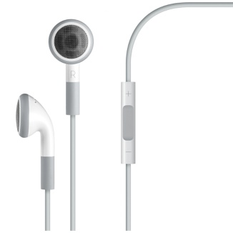




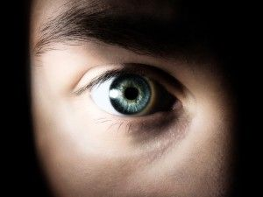
Objectives
We will be able to
Explain the process of photosynthesis.
Describe what occurs in the light-independent and light-dependent reactions of photosynthesis.


Slide 4
Producers (autotrophs)
Organisms that create their own food.
Photosynthesis is the process by which producers use energy from sunlight to convert water and carbon dioxide into sugar, releasing oxygen as a byproduct.

Slide 5
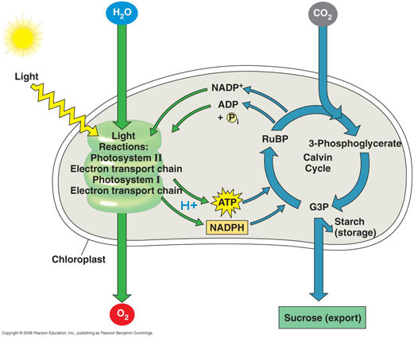
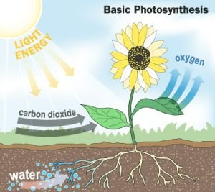
Photosynthesis

Slide 6
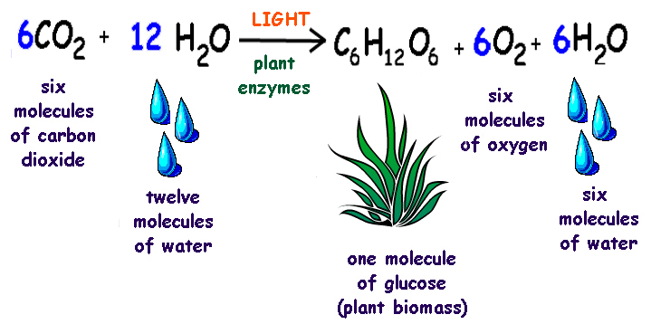
Photosynthesis

Slide 7
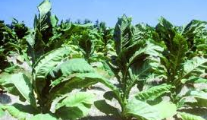
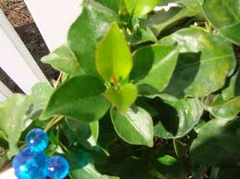
Producers examples

Slide 8
Photosynthesis Animation
TAKE NOTES
https://www.youtube.com/watch?v=3pD68uxRLkM
Honors:
https://www.youtube.com/watch?v=mYbMPwmwx88

Slide 9
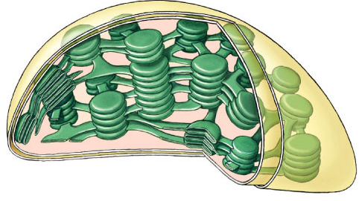
Photosynthesis:
Life from Light and Air

Slide 10
Plants are energy producers
Like animals, plants need energy to live
  unlike animals, plants don’t need to eat food to make that energy
Plants make both FOOD & ENERGY
  animals are consumers
  plants are producers

Slide 11
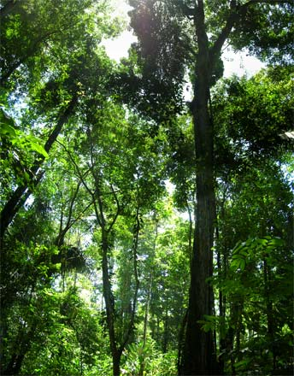
How do plants make energy & food?
Plants use the energy from the sun
  to make ATP energy
  to make sugars
    glucose, sucrose, cellulose, starch, & more
sun
ATP
sugars

Slide 12
What do plants need to grow?
The “factory” for making
energy & sugars
  chloroplast
Fuels
  sunlight
  carbon dioxide
  water
The Helpers
  enzymes
sun
CO₂
ATP
enzymes
H₂O
sugars

Slide 13
TWO SEPARATE PROCESSES OF PHOTOSYNTHESIS
  ENERGY building reactions
    collect sun energy
    use it to make ATP
  SUGAR building reactions
    take the ATP energy
    collect CO₂ from air & H₂O from ground
    use all to build sugars

Slide 14

Photosynthesis
sun
ENERGY
building
reactions
ADP
ATP
SUGAR
building
reactions
used immediately
to synthesize sugars
H₂O
sugar
CO₂

Slide 15
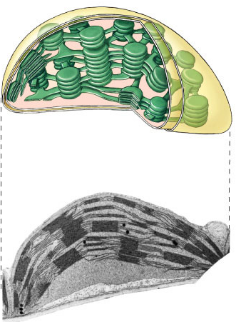
Plant structure
Chloroplasts
  double membrane
  stroma
    fluid-filled interior
  thylakoid sacs
  grana stacks
Thylakoid membrane contains
  chlorophyll molecules
  electron transport chain
  ATP synthase
outer membrane
inner membrane
stroma
thylakoid
granum
Notes:
A typical mesophyll cell has 30-40 chloroplasts, each about 2-4 microns by 4-7 microns long.
Each chloroplast has two membranes around a central aqueous space, the stroma.
In the stroma are membranous sacs, the thylakoids.
These have an internal aqueous space, the thylakoid lumen or thylakoid space.
Thylakoids may be stacked into columns called grana.

Slide 16
Plant structure
outer membrane
inner membrane
stroma
thylakoid
granum
Notes:
A typical mesophyll cell has 30-40 chloroplasts, each about 2-4 microns by 4-7 microns long.
Each chloroplast has two membranes around a central aqueous space, the stroma.
In the stroma are membranous sacs, the thylakoids.
These have an internal aqueous space, the thylakoid lumen or thylakoid space.
Thylakoids may be stacked into columns called grana.

Slide 17
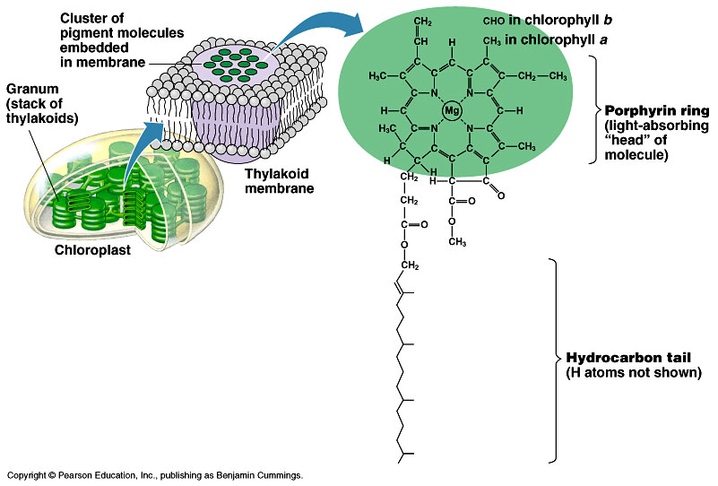
Pigments of photosynthesis
Chlorophylls & other pigments
  embedded in thylakoid membrane
  arranged in a “photosystem”
    Collection of pigment molecules
    embedded in a protein

Slide 18
Two Processes of photosynthesis
Calvin cycle
  light-independent reactions
  sugar building reactions
    uses chemical energy (ATP & NADPH) to reduce CO₂ & synthesize C₆H₁₂O₆
Light reactions
  light-dependent reactions
  energy conversion reactions
    convert solar energy to chemical energy
    ATP & NADPH

Slide 19
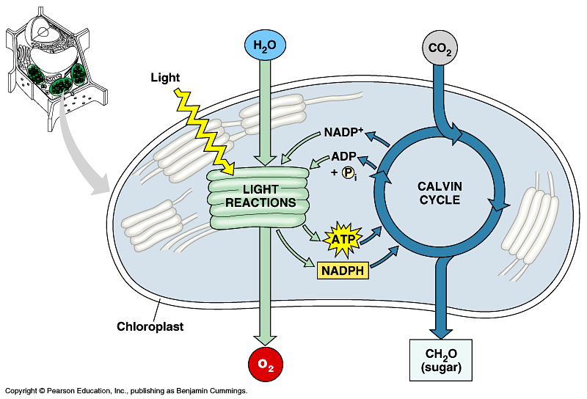

TWO PROCESS OF Photosynthesis

Slide 20
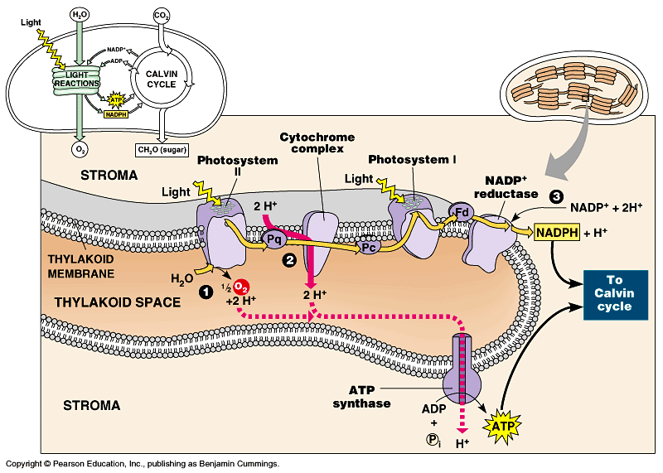
Light Reactions of Photosynthesis
Photosystem II
Photosystem I
Notes:
Two places where light comes in.
Remember photosynthesis is endergonic -- the electron transport chain is driven by light energy.
Need to look at that in more detail on next slide

Slide 21
ETC of Photosynthesis
ETC uses light energy to produce
  ATP & NADPH
    go to Calvin cycle

Slide 22
Light Reaction
PS II absorbs light
  excited electron passes from chlorophyll to “primary electron acceptor”
  need to replace electron in chlorophyll
  enzyme extracts electrons from H₂O & supplies them to chlorophyll
    splits H₂O
    O combines with another O to form O₂
    O₂ released to atmosphere
    and we breathe easier!

Slide 23
ETC of Photosynthesis
PS II absorbs light
  excited electron passes from chlorophyll to “primary electron acceptor”
  Electron passes down ETC
  Each time electron is passed, releases a little E
  E is used to pump H⁺ from stroma into thylakoid
  H⁺ diffuse down conc. gradient back into stroma
  Pass through ATP Synthase, allowing it to make ATP

Slide 24
ETC of Photosynthesis
PS I absorbs light
  excited electron passes from chlorophyll to “primary electron acceptor”
  need to replace electron in chlorophyll
  Electron comes from ETC of PSII
  Excited electron passes to electron carrier molecule
    NADPH
    Sent to Calvin Cycle in the stroma

Slide 25

Light Reactions of Photosynthesis
sun
sun
e
e
e
e
H⁺
H⁺
H⁺
O
H⁺
H⁺
H⁺
H⁺
H⁺
to Calvin Cycle
H⁺
H⁺
H⁺
split H₂O
ATP
Notes:
Two places where light comes in.
Remember photosynthesis is endergonic -- the electron transport chain is driven by light energy.
Need to look at that in more detail on next slide

Slide 26
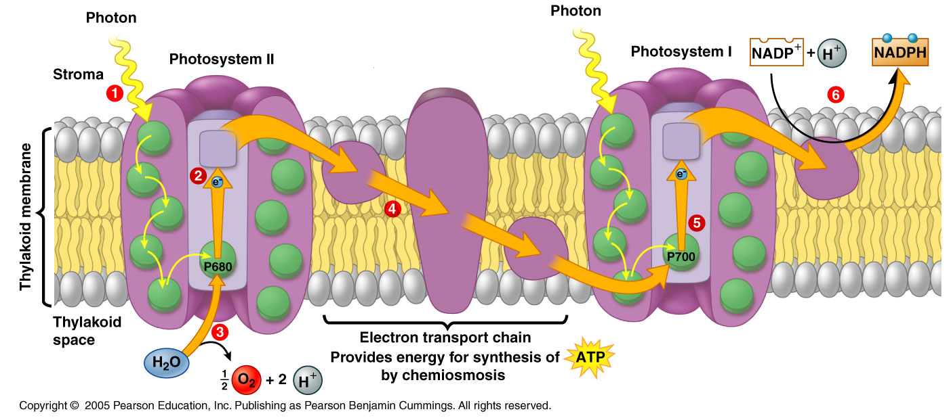

Slide 27
LIGHT-DEPENDENT REACTION ANIMATION
https://www.youtube.com/watch?v=BK_cjd6Evcw

Slide 28
From Light reactions to Calvin cycle
Calvin cycle
  chloroplast stroma
Need products of light reactions to drive synthesis reactions
  ATP
  NADPH
stroma
thylakoid

Slide 29
Calvin Cycle
C
C
C
C
C
C
C
C
1C
CO₂
C
C
C
C
C
1. Carbon fixation
3. Regeneration
of RuBP
C
C
C
C
C
5C
C
C
C
C
C
C
RuBP
RuBisCo
ribulose bisphosphate
C
C
C
C
C
C
starch,
sucrose,
cellulose
& more
6C
3 ATP
ribulose
bisphosphate
carboxylase
C
C
C
C
C
C
3 ADP
5C
C
C
C
used
to make
glucose
C
C
C
glyceraldehyde-3-P
3C
C
C
C
G3P
PGA
C
C
C
C
C
C
C
C
C
phosphoglycerate
C
C
C
3C
C
C
C
C
C
C
C
C
C
2. G3P Production
6 ATP
C
C
C
C
C
C
6 NADPH
3C
6 ADP
C
C
C
6 NADP
Notes:
1. A five-carbon sugar molecule called ribulose bisphosphate, or RuBP, is the acceptor that binds CO2 dissolved in the stroma. This process, called CO2 fixation, is catalyzed by the enzyme RuBP carboxylase, forming an unstable six-carbon molecule. This molecule quickly breaks down to give two molecules of the three-carbon 3-phosphoglycerate (3PG), also called phosphoglyceric acid (PGA).
2. The two 3PG molecules are converted into glyceraldehyde 3-phosphate (G3P, a.k.a. phosphoglyceraldehyde, PGAL) molecules, a three-carbon sugar phosphate, by adding a high-energy phosphate group from ATP, then breaking the phosphate bond and adding hydrogen from NADH + H+.
3. Three turns of the cycle, using three molecules of CO2, produces six molecules of G3P. However, only one of the six molecules exits the cycle as an output, while the remaining five enter a complex process that regenerates more RuBP to continue the cycle. Two molecules of G3P, produced by a total of six turns of the cycle, combine to form one molecule of glucose.

Slide 30
RuBisCo
Enzyme which fixes carbon from air
  ribulose bisphosphate carboxylase
  the most important enzyme in the world!
    it makes life out of air!
  definitely the most abundant enzyme

Slide 31
Photosynthesis summary
Light reactions
  produced ATP
  produced NADPH
  consumed H₂O
  produced O₂ as byproduct
Calvin cycle
  consumed CO₂
  produced G3P (sugar)
  regenerated ADP
  regenerated NADP

Slide 32
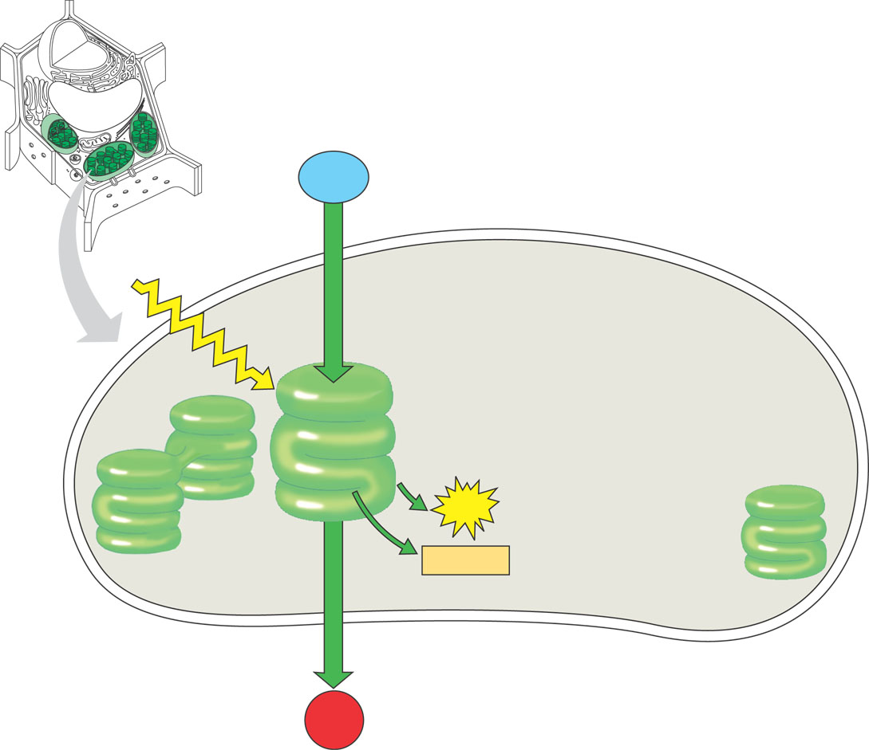
Light Reactions
H₂O
+
light
energy
→
ATP
+
NADPH
+
O₂
H₂O
produces ATP
produces NADPH
releases O₂ as a waste product
sunlight
Energy Building
Reactions
NADPH
ATP
O₂

Slide 33
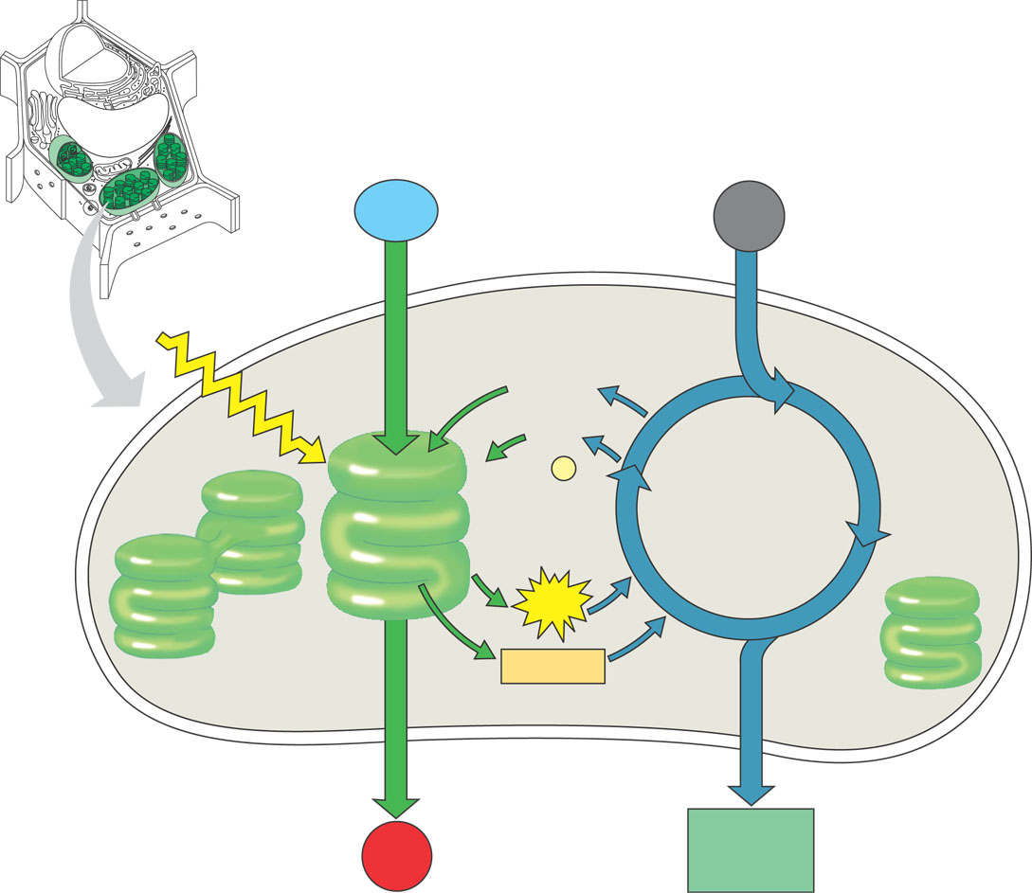
Calvin Cycle
CO₂
+
ATP
+
NADPH
→
C₆H₁₂O₆
+
ADP
+
NADP
CO₂
builds sugars
uses ATP & NADPH
recycles ADP & NADP
  back to make more ATP & NADPH
ADP
NADP
Sugar
Building
Reactions
NADPH
ATP
sugars

Slide 34
Photosynthesis: light and dark reaction Animation
https://www.youtube.com/watch?v=joZ1EsA5_NY

Slide 35
Energy cycle
sun
Photosynthesis
CO₂
+
H₂O
+
light
energy
→
C₆H₁₂O₆
+
O₂
plants
CO₂
H₂O
glucose
O₂
animals, plants
C₆H₁₂O₆
+
O₂
→
ATP
energy
+
CO₂
+
H₂O
Cellular Respiration
ATP

Slide 36

Exit Slip 4/9/14
This must be done independently and quietly.
To access the exit slip, go to the class website: http://aofscience.weebly.com
Navigate to BIOLOGY →Chapter 8 → Scroll down to Exit Slips.
Complete Exit Slip and press submit.

Slide 37
7th Period. Being an Experimental Scientist
Read pages 394 – 397.
Begin the Process and Procedures on page 394 beginning with Part B. (SKIP PART A on page 394.)

