Slide 1
Catalyst 1/22/13
Write the chemical formula of chromium (III) sulfide.
Write the name for SCl₅.
BLAST FROM THE PAST! Convert 50 grams to milligrams.
Honors* Challenge: Draw the Lewis dot structure of O₃.

Slide 2
Agenda 1/22/13
Catalyst
Element of the Day
Announcements
  Packet#7 due THURSDAY, 1/24/13
  HW: QuickStudy sheet using Packet#5,#6,#7 material.
Name and Chemical Formula with Polyatomic Ions
Class Practice
Return Graded Work
Exit Slip

Slide 3
Element of the Day
You can drink me if you have nausea, heartburn, indigestion, upset stomach, diarrhea! This is pretty weird considering my neighbors on the periodic table are extremely toxic and radioactive. I am also known as the very last stable element. (Well, technically none of my isotopes are THAT stable, but they practically are.) Cool me down very slowly when I’m super pure and I will spontaneously form large “hopper” crystals!
Who am I?

Slide 4

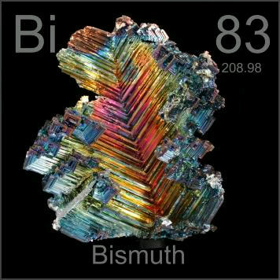
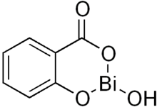
Element of the Day: Bismuth
C₇H₅BiO₄

Slide 5
Class Points
Your class can earn class points if:
everyone in class:
Comes to class quietly and on time
Stays focused and on task during class
Leaves classroom neat and organized
Students are teaching other students
Majority of class participates
Follows all classroom expectations and procedures
And more…
P3: 55 pts (neat room, focused)
P4: 60 pts (focused)
P6: 66 pts (neat room, focused, on time)

Slide 6



Objective 1/22/13
We will be able to
Write the chemical formula of compounds with polyatomic ions
Name compounds with polyatomic ions



Slide 7
POLYATOMIC IONS
Polyatomic ions are made up of covalently bonded atoms with a charge.
(“Poly-“ means many.)
Oxyanions are polyatomic ions with oxygen.

Slide 9
Write the chemical formula of compounds with polyatomic ions

Slide 10
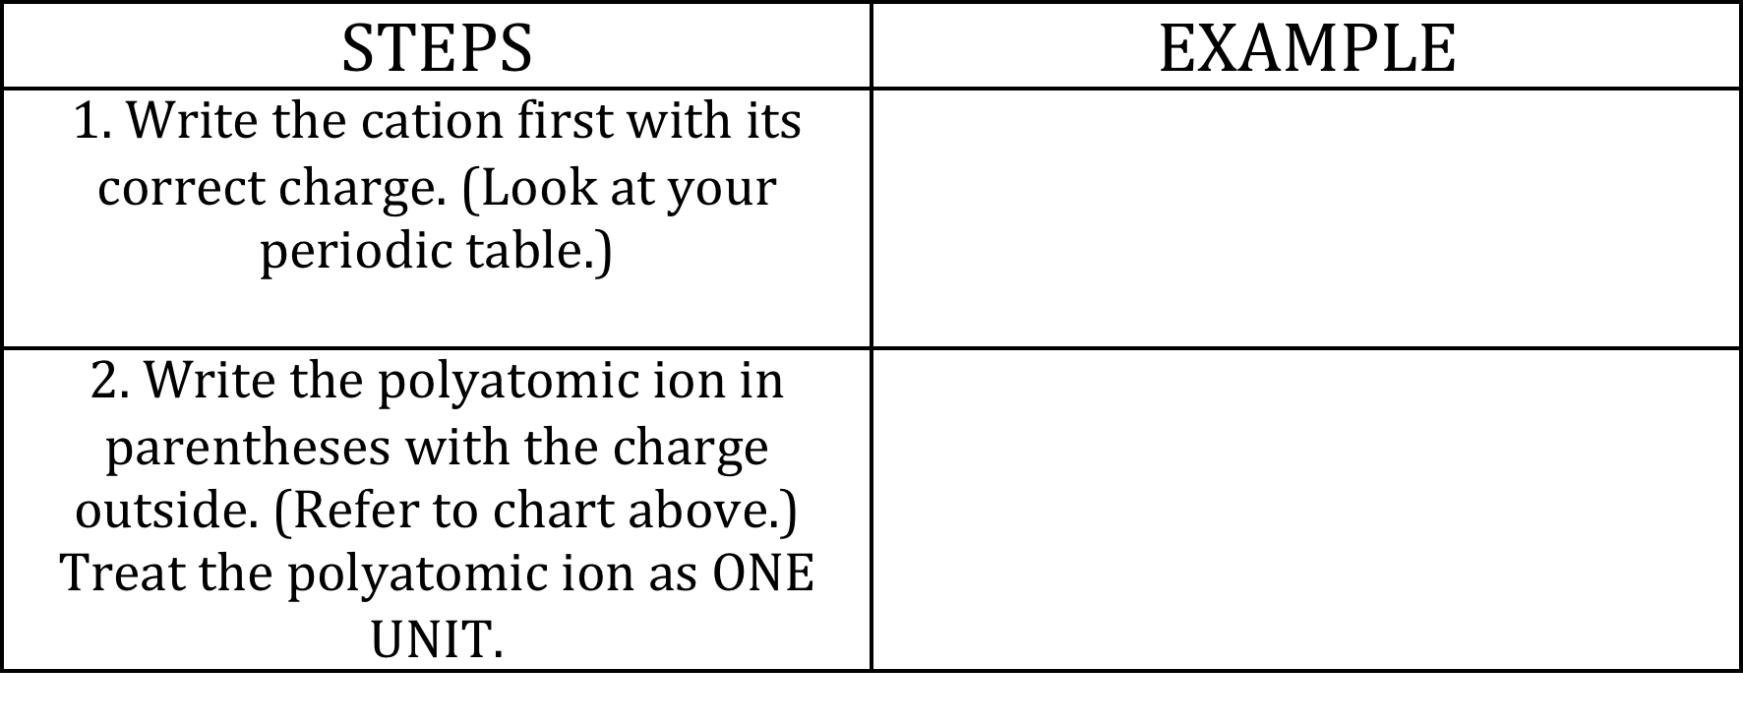
How to Write a Chemical Formula With Polyatomic Ions
Example#1: Potassium Phosphate

Slide 11
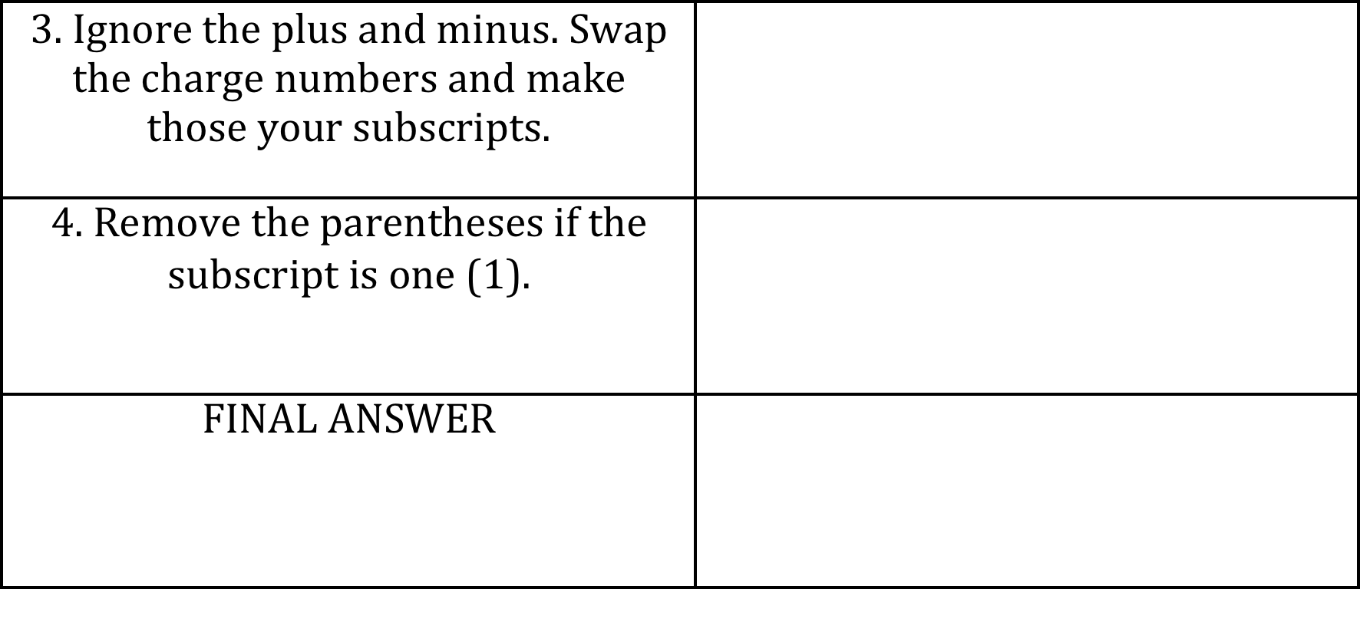
How to Write a Chemical Formula With Polyatomic Ions
Example#1: Potassium Phosphate

Slide 12

WARNING!!!
WARNING!!!! WARNING!!! Do not confuse:
phosphide (P³-) with phosphate (PO₄³-)
sulfide (S²-) with sulfate
nitride (N³-) with nitrate

Slide 13
Example#2
Magnesium nitrate

Slide 14
Example#3
Copper (II) chromate

Slide 15
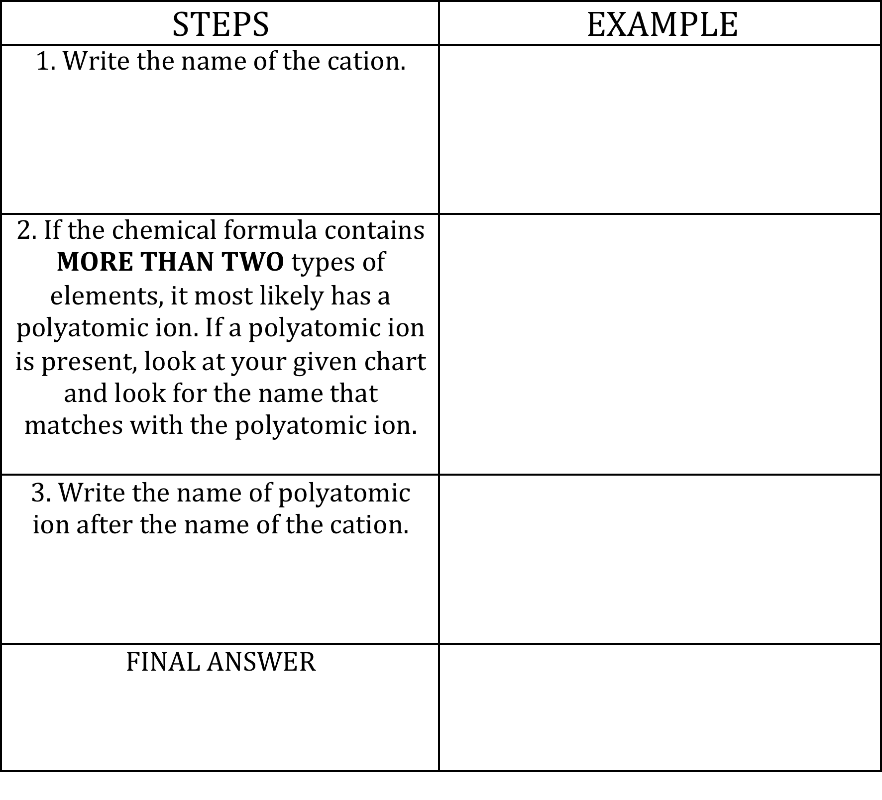
How to Write the Name of Compound with Polyatomic Ions Given the Chemical Formula
Example#1: K₂SO₄

Slide 16
Example#2
Na₃PO₄

Slide 17
Example#3
KCH₃COO

Slide 18
During Classwork Time
Stay focused on the assignments you are given.
Do the questions INDEPENDENTLY (on your own).
Keep the noise level down.
Ask THREE before you ask ME.
You may put earphones on and listen to music quietly as you do your work.
You must finish a certain number of questions (depends on the person) by the end of the period.
DO NOT FORGET YOUR STAMPS! You cannot get them once you leave the class.

Slide 19
Exit Slip
QUIETLY and INDEPENDENTLY answer the following on Notability and email it to gutierrezbr@elizabeth.k12.nj.us with “p4 (or p6) ES 1/22” on the subject line. I must receive it by the end of the period. If you are talking or copying, you will not receive credit.
Write the chemical formula of zinc phosphate
Name the compound: Ni(Cr₂O₇)₂.

