Slide 1
Catalyst 5/17/13
Take a laptop and charger from the counter by the window and quickly have a seat.
Describe what happens to pressure when area increases.
What will happen to the kinetic energy of nitrogen gas if the temperature was changed from 40 degrees Celsius to 60 degrees Celsius?
True or false. According to the kinetic molecular theory, gases are in constant motion and upon collision, become one large mass. (Read this statement carefully.) If false, explain why it is false.

Slide 2
Agenda 5/17/13
Catalyst
Announcements
  Packet#13 DUE Wednesday
Pressure Conversions
Class Practice
Boyle’s Law Virtual Lab

Slide 3
Class Points
Your class can earn class points if everyone in class:
Comes to class quietly and on time
Stays focused and on task during class
Leaves classroom neat and organized
Students are teaching other students
Majority of class participates
Follows all classroom expectations and procedures
And more…
P3: 12 (on time, focused, respectful during lessons)
P4: 11 (on time, focused, neat room)
P6: 9 (on time, neat room,)

Slide 4
Expectations for the Audience
Stay positive at all times. No put downs, teasing, or negative comments.
Don’t like something? Email me privately with the comment, don’t yell it out.
Stay engaged for the lesson. Take notes and pay close attention.
Be engaged and ask/answer questions throughout the lesson.

Slide 5




Objective 5/16/13
We will be able to
We will be able to define pressure and convert from unit of pressure to another.



Slide 6
PRESSURE!!!

Slide 7
Pressure
Pressure is defined as force divided by area.

Slide 8
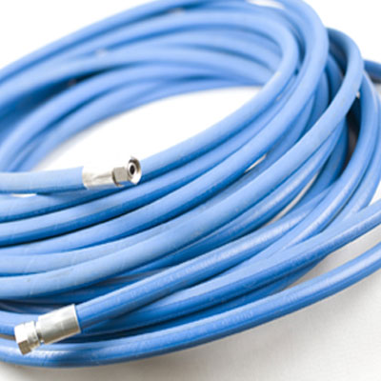
How do you increase “pressure” in a hose?

Slide 9
Units of Pressure
Millimeters of Mercury (mmHg)
Atmosphere (atm)
Torr (Torr)
Pascal (Pa)

Slide 10
Units of Pressure
1 atm = 760 mmHg
1 atm = 760 Torr
1 Torr = 1 mmHg
Standard Temperature and Pressure has been agreed to be 1 atm pressure and 0 degrees Celsius.

Slide 11
Pressure Units Conversion
Example#1
Express 500 atmosphere in millimeters of Mercury.

Slide 12
Pressure Units Conversion
Example#2
Express 876 mmHg in atm.

Slide 13
Pressure Units Conversion
Example#3
How many torr are there in 980 atm?

Slide 14
Exit Slip
QUIETLY and INDEPENDENTLY answer the following on Notability and email it to gutierrezbr@elizabeth.k12.nj.us with “p6 ES 5/14” on the subject line. I must receive it by the end of the period. If you are talking or copying, you will not receive credit.
What happens to the kinetic energy of gas particles as you increase temperature?
Express 500 mmHg in atmospheres. Use a conversion factor and show all your work.

Slide 15
Objective
We will be able to use Boyle’s law to calculate pressure-volume changes at constant temperature.

Slide 16
Quick Review!
What’s pressure?
What are the units of pressure?

Slide 17
Quick Review!
What’s pressure? Force over area.
What are the units of pressure? mmHg, Torr, atm, kPa, Pa, Psi

Slide 18
What’s volume?

Slide 19
What’s volume?
The amount of space something takes. Some units of volume include: mL, cm³, L and m^{3.}

Slide 20
Boyles’ Law Virtual Lab
Open the link posted on Edmodo.
http://www.sciencegeek.net/VirtualLabs/BoylesLaw.html
Input your pressure and volume data into two columns using the NUMBERS APP on your iPad

Slide 21
What do you notice?

Slide 22
Boyle’s Law
Boyle’s law states that at a fixed temperature, volume and pressure are inversely proportional.
Mathematically:
P₁V₁ = P₂V₂

Slide 23
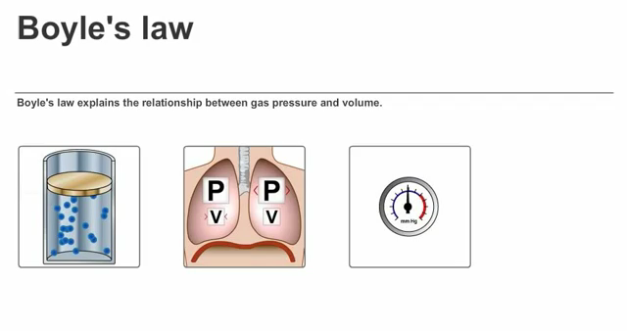

Slide 24
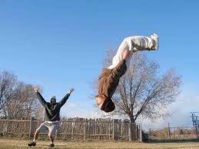
Boyle’s Law Calculations
Example#1. A sample of oxygen gas has a volume of 150.0 mL when its pressure is 0.947 atm. What will the volume of the gas be at a pressure of 0.987 atm if the temperature remains constant?
Let’s try to use FLIPS when solving for a variable!!!

Slide 25
Example#1. A sample of oxygen gas has a volume of 150.0 mL when its pressure is 0.947 atm. What will the volume of the gas be at a pressure of 0.987 atm if the temperature remains constant?

Slide 26
Example#2. A sample of oxygen gas has a volume of 300.0 mL when its pressure is 0.80 atm. What will the pressure of the gas be if its final volume is 250.0 mL if the temperature remains constant?

Slide 27
A sample of oxygen gas has a volume of 300.0 mL when its pressure is 0.80 atm. What will the pressure of the gas be if its final volume is 250.0 mL if the temperature remains constant?

Slide 28
Summarize Boyle’s Law in your own words…
Write your response in the space at the bottom of page 11.

