Slide 1
Carnivores = meat eaters

Slide 2
Omnivores = both meat and plant eaters

Slide 3
*Detritivores = eats dead bodies

Slide 4
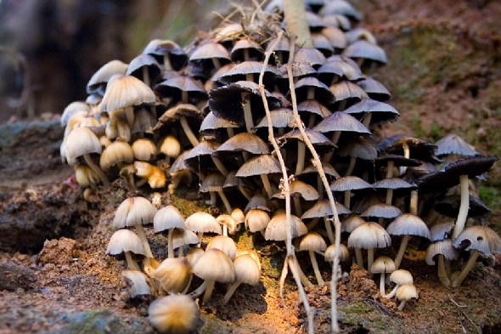
*Decomposers = break down nonliving organic matter into simpler parts

Slide 5
Types of Consumers
Herbivores – plant eaters
Carnivores – meat eaters
Omnivores – plant AND meat eaters
*Detritivores – consume detritus, nonliving organic matter (dead bodies, waste products)
*Decomposers – breaks down nonliving matter into simpler parts (fungi)

Slide 6
What’s the difference between a detritivore and a decomposer?

Slide 7
Cellular Respiration
http://www.brainpop.com/science/cellularlifeandgenetics/cellularrespiration/

Slide 8
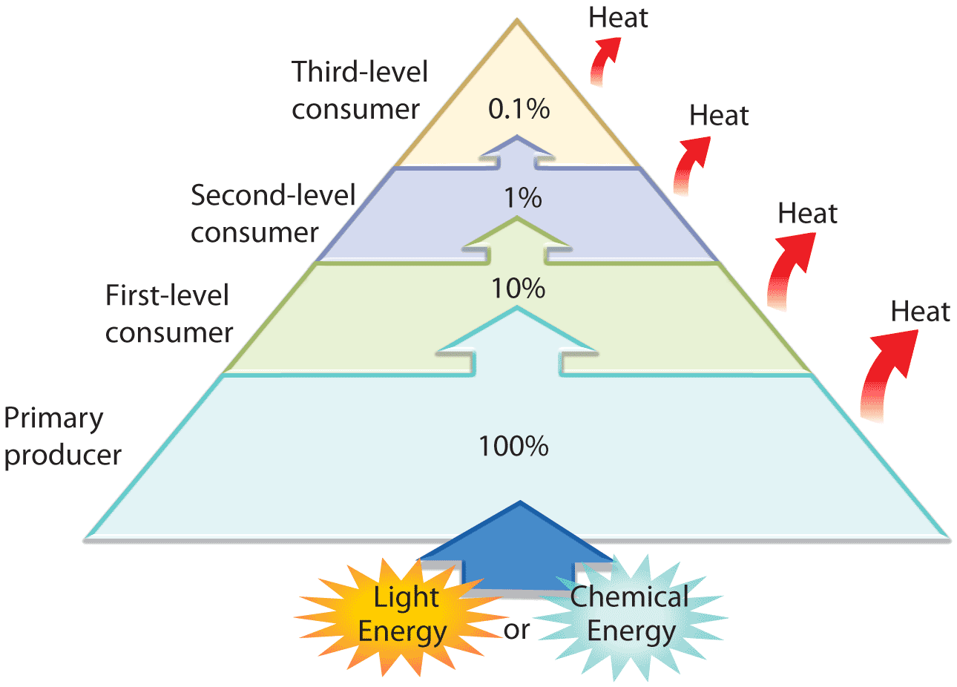
Energy and Biomass
Trophic level is the rank in feeding hierarchy.
Primary producers are ALWAYS at the first-trophic level in food pyramids.

Slide 9
Energy and Biomass
When energy is transferred from one system to another, NOT ALL energy is transferred. Some is lost in the form of heat.
The 10% Rule States each trophic level contains only ten percent of the energy of the trophic level below it.

Slide 10
Side Note on Energy
The Law of the Conservation of Energy states that energy CANNOT be created or destroyed. It simply takes different forms.
What are some different forms of energy?
Energy is measured in Joules.
1 Calorie from food is equal to 4.2 kilojoules or 4200 Joules.

Slide 11
Summary
Producers | Consumers
- Make food through photosynthesis or chemosynthesis | Consume food via cellular respiration to break down sugars
Energy is conserved 10% Rule – Each trophic level in an energy pyramid contains only 10% of the energy of the trophic level below it

