Slide 1
Catalyst: friday, 10/18/13
Why does water take a while to “drip” from a faucet? Explain in terms of hydrogen bonding.
Place all work in the bin during the first FIVE minutes of class. DO NOT get up after the Catalyst to place it in the bin!

Slide 2
Agenda 10/18/13
Catalyst
Announcements
Science Joke of the Day
Properties of Water Discussion
Class Work Time
Exit Slip
Macromolecules Project Instructions

Slide 3
GPoints
Your class can earn class points if:
everyone in class:
Comes to class quietly and on time
Stays focused and on task during class
Leaves classroom neat and organized
Students are teaching other students
Majority of class participates
Follows all classroom expectations and procedures
And more…
P6: 50 pts (on time, neat room, on time, majority were focused)
P10: 51 pts (on time, came in quietly, neat room)

Slide 4
Science joke of the Day

Slide 5
Objective(s) 10/18/13
We will be able to
Describe the properties of water


Slide 6
Properties of WATER
Open your textbooks to page 69 and 70.
Write the following key terms:
Hydrogen Bonding
Cohesion
Resistance to Temperature Change
Ice Density
Universal Solvent
Write down at LEAST two bullet points for each key term. Leave SPACE under the bullet points so we can add more information later if we need to.

Slide 7
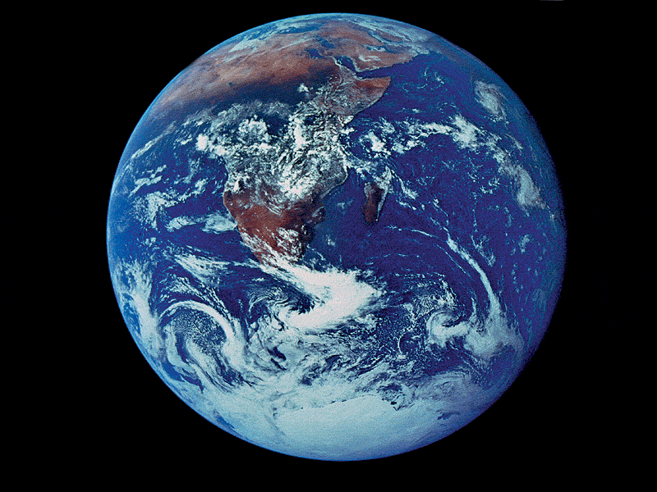
Water is the solvent of life

Slide 8
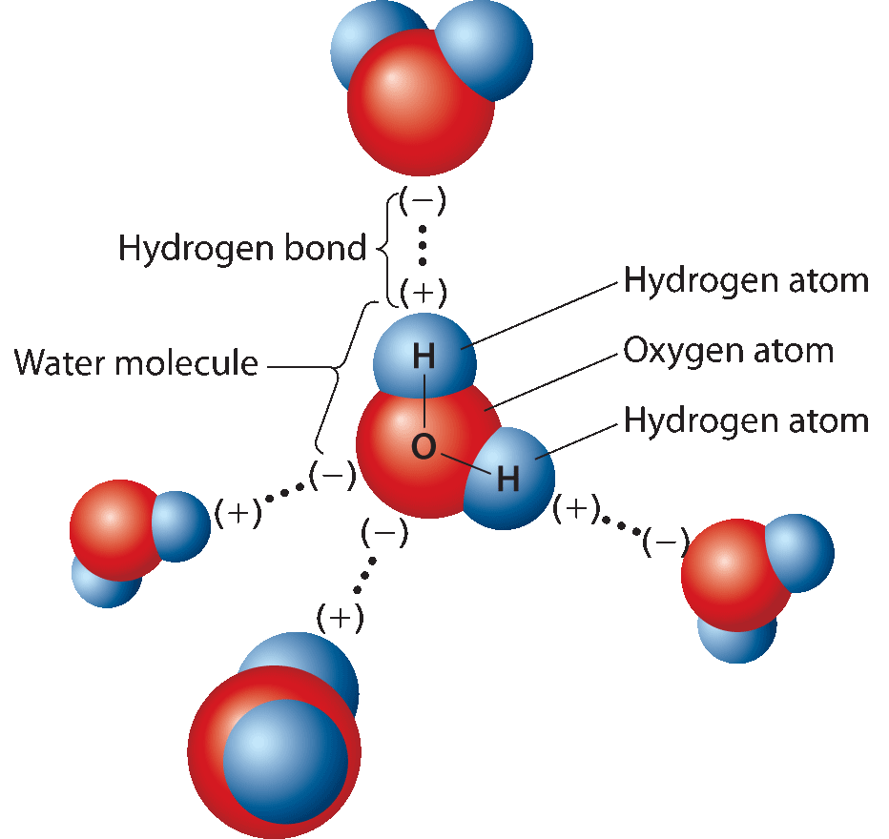
Water
Water is required by all living things for survival.
Hydrogen bonding gives water many unique properties:
Cohesion
Resistance to temperature change
Less dense when frozen
Ability to dissolve many other molecules

Slide 9
A little more on hydrogen bonding
http://www.youtube.com/watch?v=wZ9CCj4X28Q

Slide 10
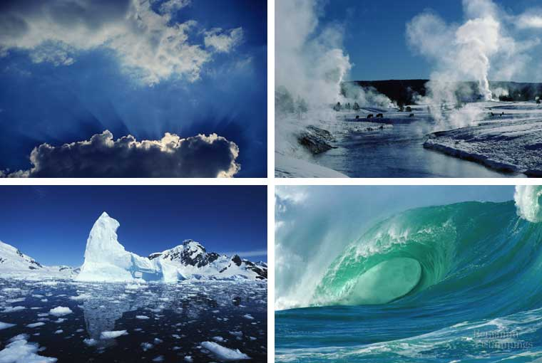
Unique properties of water
Polar Molecule
Cohesive
Stabilizes Temperature
Solvent of Life

Slide 11
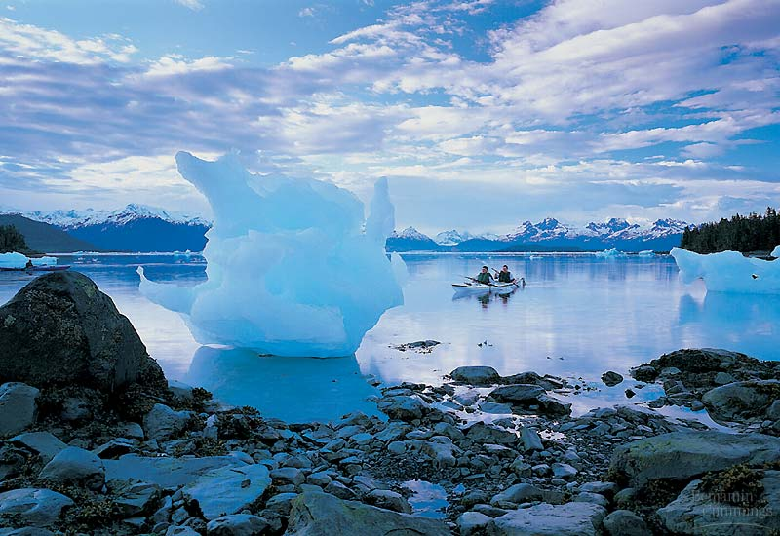
Like no other common substance, water exists in nature in all three physical states:
as a solid
as a liquid
as a gas

Slide 12
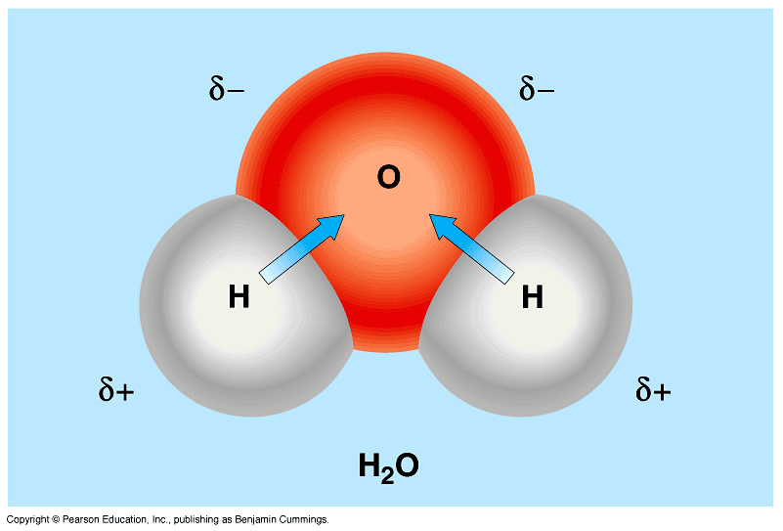
Polar covalent ~ water
In a water molecule, the oxygen is more electronegative than hydrogen
Oxygen pulls the shared electrons toward itself;
partial negative
the electrons spend more time near the oxygen atom.
partial positive

Slide 13
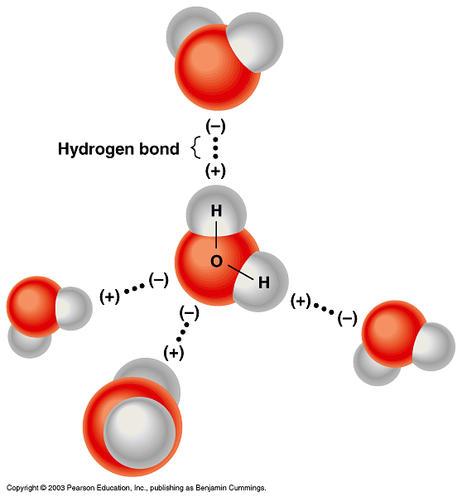
Water molecules form hydrogen bonds
Hydrogen atoms in one polar covalent molecule are attracted to an electronegative atom in another polar molecule
This creates H-bonds
Very important for function in biological molecules

Slide 14
Water’s polarity leads to hydrogen bonding and other unusual properties
Hydrogen bonds are weak; forming and breaking constantly - but strong in high numbers
If you could stop water in an instant most molecules would be H-bonded to another
These characteristics (polarity & H-bonding) give water the properties of cohesion, temperature stability, and make it a universal solvent

Slide 15
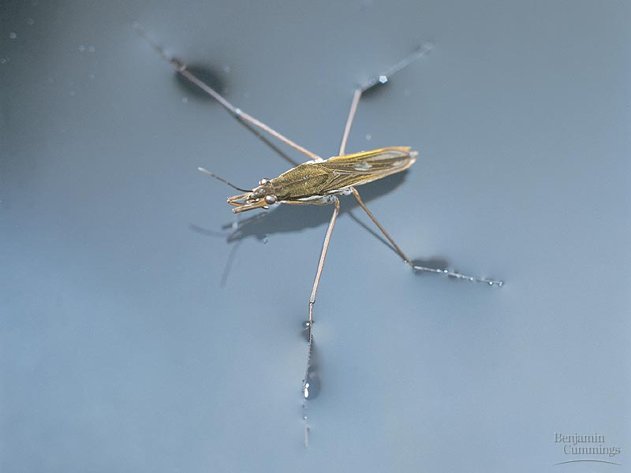
Cohesion:
Water molecules stick together
surface tension

Slide 16
Cohesion: water molecules can move great distances

Slide 17
Temperature
Water’s hydrogen bonds moderate temperature
Water can absorb a great deal of heat energy without a large increase in temperature because it takes a lot of energy to disrupt hydrogen bonds
Heat = amount of energy associated with molecular movement
Temperature = measure of the intensity of heat: measures a substance’s molecular motion

Slide 18
Add more heat to water, it disrupts H-bonds rather than increasing molecular motion
This causes separation of water molecules and evaporation
A water molecule takes a large amount of energy with it when it evaporates: evaporative cooling

Slide 19
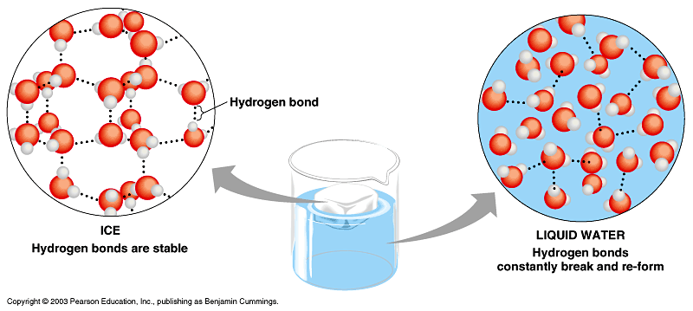
Ice DENSITY
Water molecules in ice (solid water) are farther apart than the molecules in liquid water
Which is more dense? Ice water or liquid water?

Slide 20
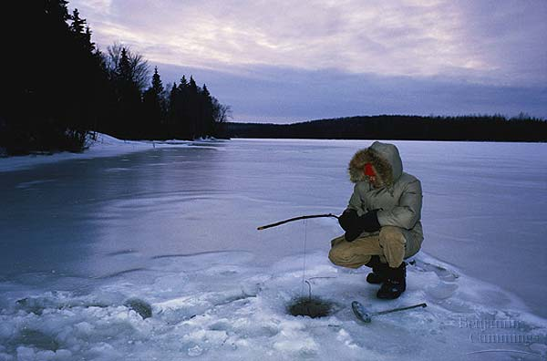
Ice is therefore less dense than liquid water, causing it to float..
Why is this a good thing?
If ice sank, it wouldn’t thaw
Creates a blanket of insulation

Slide 21
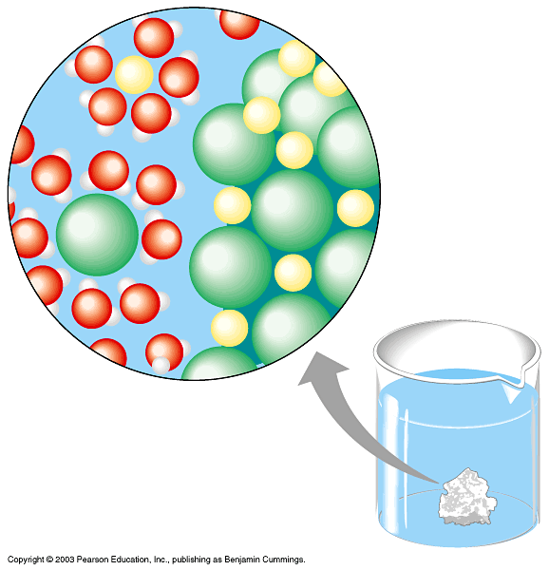
Water is the universal solvent
Solution - a homogenous mixture of two or more substances
Solvent - dissolving agent (water)
Solute - substance dissolved
Polar or charged solutes
can “stick” to water
molecules
(i.e. Dissolve)

Slide 22
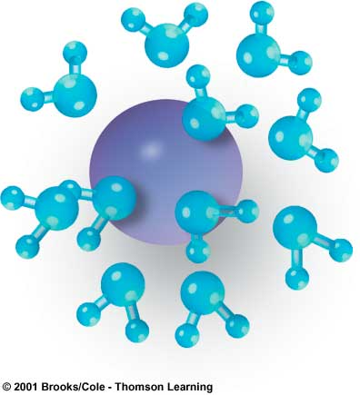
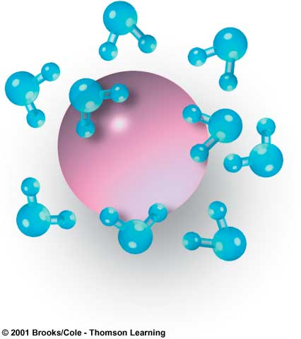
–
–
+
+
+
–
+
+
–
+
Na⁺
–
+
+
+
+
–
–
Cl–
+
–
+
–
+
–
+
+
+
+
–
+

Slide 23
Classwork Time
Chapter 3, Lesson 1 in Packet
Answer the Chapter 3 Lesson 1 Assessment Questions (due at the end of the period.)

Slide 24
During Classwork Time
Stay focused on the assignments you are given.
Do the questions INDEPENDENTLY (on your own).
Keep the noise level down.
Ask THREE before you ask ME.
You may put earphones on and listen to music quietly as you do your work.
You must finish a certain number of questions (depends on the person) by the end of the period.

Slide 25
Exit Slip
On a half a slip of paper, summarize the four main properties of water. (At least one sentence per property.)
Include FULL NAME, DATE, and PERIOD
This will be collected in 5 minutes.

Slide 26
So far…
Atoms and Compounds
The nucleus, Protons, neutrons, and electrons
Compounds and Molecules
Ionic and Covalent Bonding
Water and Its Properties
Hydrogen bonding
Cohesion
Density
Resistance to temperature change
Universal solvent

