Slide 1
Soil Characteristics
By: Ashley & E’Mani

Slide 2
Agenda !
Do Now
Power point review
Quick video
Soil activity

Slide 3
Do NOW !
Make up a rap or song about soil ! (Individual WORK!)
It has to have a beat, and it has to make sense!
Only 30 seconds to a minute long!!
You will be performing at the end of class.
Best rap/song will get a treat!

Slide 4
Objectives 3/13/14
We will be able to
List the characteristics of soil !

Slide 5
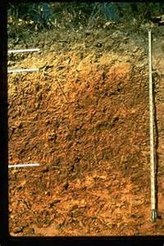
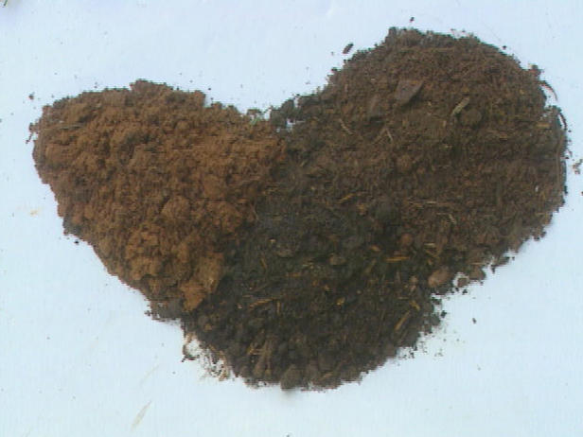
COLOR
The color of soil shows features about its richness and arrangement.
Soils that are dark are luxuriant in humus (dark organic material in soils).
Pale soils has less humus and nutrients.
Farmers and ranchers use to use the color of topsoil (top layer of land) to determine their fertility.

Slide 6
TEXTURE
Soil texture is based on its particle size.
Clay, silt, sand, and loam are different types of soil texture.
Clay – has particles less than 0.002 millimeter in diameter.
Silt – has particles 0.002 to 0.05 millimeter in diameter.
Sand – has mostly particles of 0.05 to 2 millimeters in diameter.
Loam – soil with an even mixture of all three particle sizes.

Slide 7
TURN TO PAGE #356

Slide 8
Structure !
Soil structure explains the arrangement of soil particles.
Clumpy soil has a abundant deal of humus (the soil is rich in nutrients and is able to hold water).
Soil clumps that become too outsized from grazing cattle can stop plant roots from growing.

Slide 10
pH
It’s a measure of acidity of an aqueous solution.
A soil’s acidity affects its ability to support plant grow
Different plants require different pH levels.
Some plants die in soil that are to acidic for them.
Few plants can grow in acidic soil.
Acidic soil is soil that is below 7 on a pH scale.

Slide 12
Quick Video
http://www.youtube.com/watch?v=fAbsHR7b33w
Now….get ready to perform you’re song/rap !
Soil Activity is next!

Slide 13
Soil Activity !!
FOLLOW DIRECTIONS..IF YOU DON’T……YOU WILL GET A POW POW!
Form your own group of 4-5.
Ashley will pass out the soil, and I will pass out the microscopes.
I will tell you what to do after, DO NOT TOUCH ANYTHING GUYS !!!!!!!!

