Slide 1
Soil Formation
Indira cruz & Carlos Flores

Slide 2
Objective:
How Does soil form?

Slide 3
Agenda 3/13/14
Do-now
Discussion
Video
Exit Slip

Slide 4
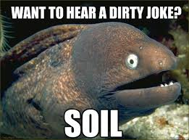

Slide 5
Take out a piece of paper & answer the following question(s)
What do you know about soil formation?
What would you like to learn?

Slide 6
3 processes in which soil forms:
Weathering
Deposition
Decomposition

Slide 7
Weathering: Rocks breaking down to smaller particles
Physical Weathering:
Wind & rain
Rocks weaken as they repeatedly expand with heat & contract with cold
Chemical Weathering
Become different materials
Don’t break down

Slide 8
Deposition
Erosion is a destructive process

Slide 9
Decomposition
Activities of living things (Plants, Animals, Humans)
When they waste or die & decompose nutrients incorporated the soil
Broken leave’s nutrients become part of the soil

