Slide 1
Catalyst 4/8/13
Complete Chapter 14 Lesson 1 Assessment on page 425.

Slide 2
Agenda 4/8/13
Catalyst
Announcements:
  HW: Keep track of how much water you use in a day. Start recording the volume of water you use from the moment you wake up. Use a table to show your results. (Use mL for your units.)
Ground Water Review
Uses of Water Discussion
Responsible Water Use Project

Slide 3
Class Points
Your class can earn class points if:
everyone in class:
Comes to class quietly and on time
Stays focused and on task during class
Leaves classroom neat and organized
Students are teaching other students
Majority of class participates
Follows all classroom expectations and procedures
And more…
P5: 10 pts (for being awesome)

Slide 4
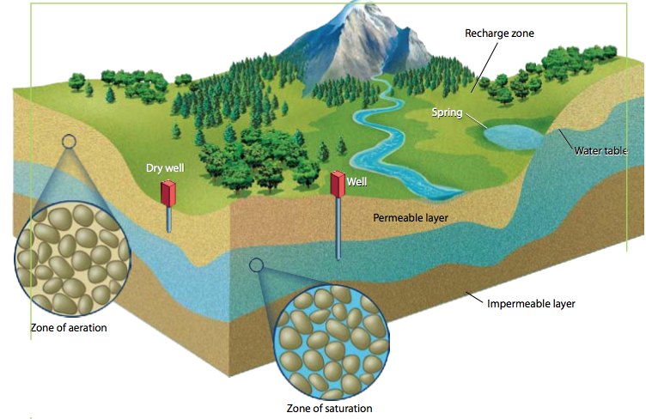
Groundwater
Groundwater seeps through the soil and becomes contained in underground aquifers.
Aquifers are permeable layers of rock and soil that hold water.
The water table separates the zone of saturation from the zone of aeration.
An Aquifer
Did You Know? The average age of groundwater is 1400 years. Groundwater recharges very slowly.

Slide 5
Aquifers

Slide 6
Groundwater, the hidden source of life
http://www.youtube.com/watch?v=Iht9WBBXepA

Slide 7
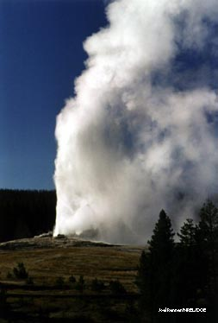
Groundwater
• Aquifers release 1.9 trillion L (492 billion gal) of groundwater to the surface each day via springs, geysers, and wells.
Geyser video:
http://www.youtube.com/watch?v=X4zA_YPCyHs
Old Faithful, a well-known geyser in Yellowstone National Park, shoots groundwater over 100 feet into the air many times a day.
Notes:
Image - http://www.flickr.com/photos/carolynconner/4264882098/ (Creative Commons licensed)
Geyser info source - National Park Service: http://www.nps.gov/yell/planyourvisit/noldfaith.htm

Slide 8
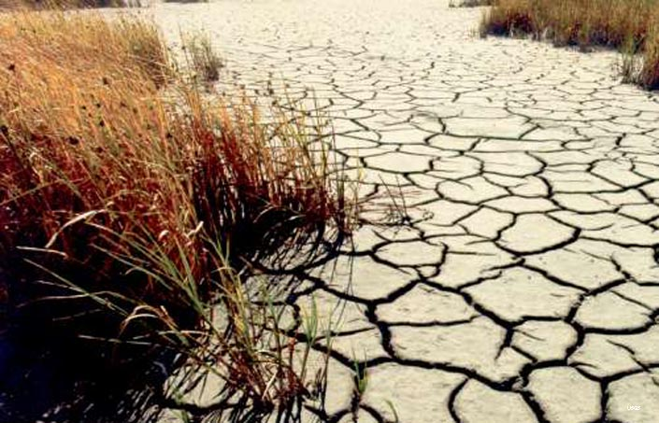
Lesson 14.2 Uses of Fresh Water
One third of all the people on Earth are affected by water shortages.

Slide 9
How do we use water?

Slide 10
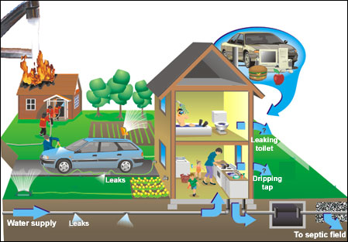

Slide 11
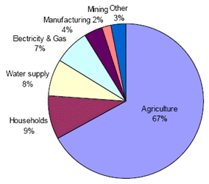
How does the world use water?

Slide 12
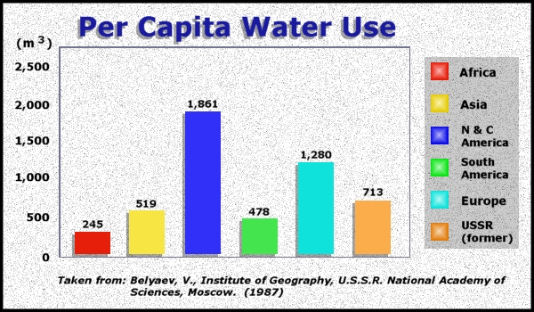

Slide 13
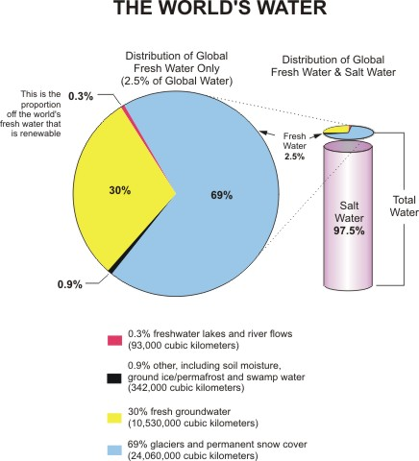

Slide 14
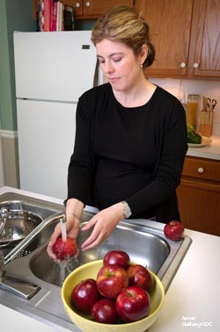
How We Use Water
Lesson 14.2 Uses of Fresh Water
Three main uses of fresh water include:
Agricultural
Industrial
Personal
Did You Know? The average American uses 250 L of fresh water a day for personal uses, such as bathing and brushing teeth.

Slide 15
Using Surface Water
Lesson 14.2 Uses of Fresh Water
Most freshwater used in the U.S. is surface water.
Surface water is diverted by canals and dams.
Drought and overuse have caused significant surface water depletion.
Did You Know? The Aral Sea was once the fourth largest body of fresh water.

Slide 16
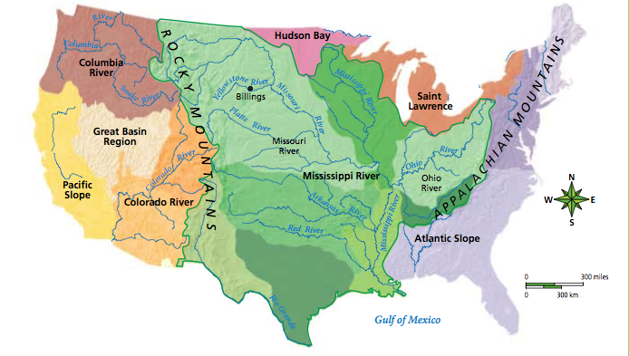
Surface Water
Surface water includes still bodies of waters and river systems.
Watersheds include all of the land area that supplies water to a river system.
Every waterway defines a watershed.
Watersheds of the U.S.
Did You Know? The Mississippi River Basin covers 3 million square kilometers (1.2 million sq mi), making it the third largest watershed in the world. It drains 41% of the land area of the contiguous US.

Slide 17
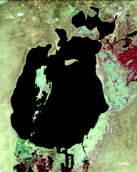
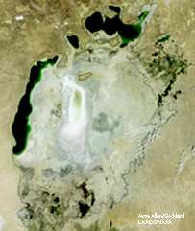
Using Surface Water
Lesson 14.2 Uses of Fresh Water
Did You Know? The Aral Sea was once the fourth largest body of fresh water.
Aral Sea, 1997
Aral Sea, 2009

Slide 18
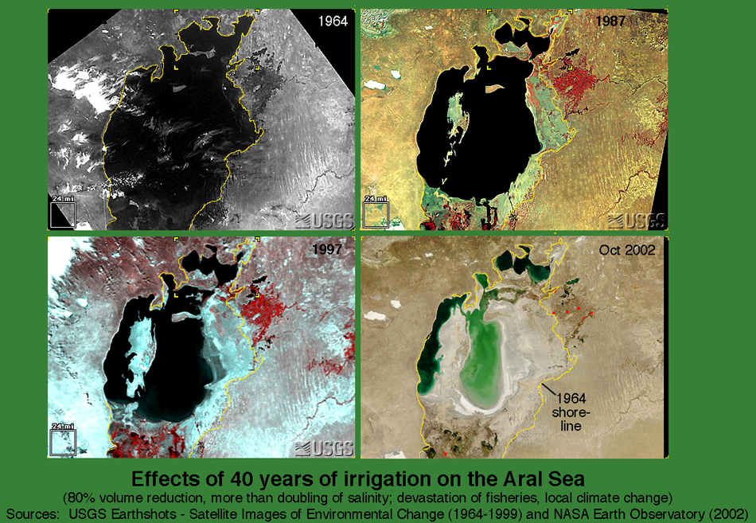
Aral Sea Crisis

Slide 19
Dams – Why might we need them?
http://www.youtube.com/watch?v=T2JMVxnMqxU

Slide 20
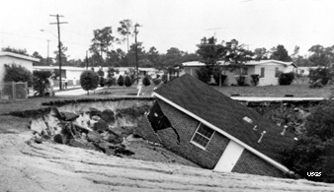
Using Groundwater
Lesson 14.2 Uses of Fresh Water
68% of groundwater in the U.S. is used for irrigation, most of which is very inefficient.
Groundwater mining turns groundwater into a nonrenewable resource because it is withdrawn from the ground faster than it can be replaced.
When groundwater is
depleted, the falling water
tables can cause cities to
sink, and undrinkable
saltwater to move into the
depleted aquifers.

Slide 21
Solutions to Freshwater Depletion
Lesson 14.2 Uses of Fresh Water
Increase supply:
  Desalination: “Making” fresh water by removing salt from saltwater.
Decrease demand:
  Agricultural: Drip-irrigation, climate-appropriate plants
  Industrial: Water-conserving processes, recycling wastewater to cool machinery.
  Personal: Xeriscaping, water conservation

Slide 22
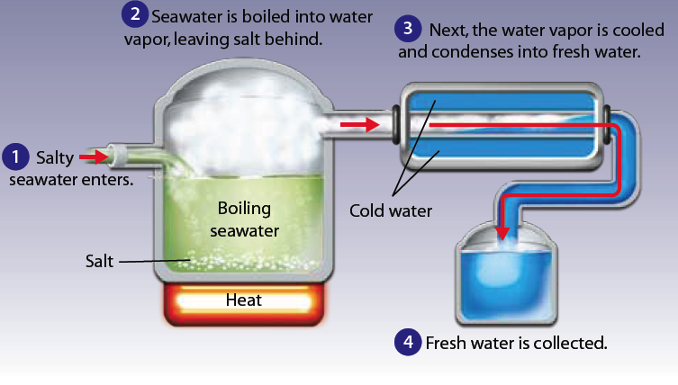
Desalination

Slide 23
Responsible Water Use
As we have learned, water can be a limited resource if not used responsibly. Your task is to convince the students and staff in Halsey AOF to use water more responsibly. Create a 1-minute video that describes how to use water responsibly and why it is important. You may create a poster as an alternative. You may work in pairs or by yourself. Be creative! Final product is due Friday, April 12.

