Slide 1
Catalyst 4/11/13
Review your water treatment plant design. Make sure you can clearly explain why you chose to include a certain structure and its purpose.
Once you are finished with the task above, complete the first page of your water packet.
Please make sure your ID and uniform are on properly.

Slide 2
How can humans control water pollution?

Slide 3
Agenda 4/11/13
Catalyst
Announcements:
HW: Read and outline pages 435 – 443. (Notebook check on Friday.)
Chapter 14 Packet DUE next Tuesday, April 16th.
Water Pollution Discussion
Chapter 14 Review Assessment

Slide 4
Class Points
Your class can earn class points if:
everyone in class:
Comes to class quietly and on time
Stays focused and on task during class
Leaves classroom neat and organized
Students are teaching other students
Majority of class participates
Follows all classroom expectations and procedures
And more…
P5: 12 pts (neat room)

Slide 5
Class Discussion
Starting today, I will begin to monitor your level of participation in class discussions, which will be reflected in your weekly discussion grade. ALL OF YOU are capable of higher level thinking and I would like to hear your ideas. You should aim to contribute to the class discussion at two to three times in a class.

Slide 6
Class Discussion Expectations
No disrespectful language (teasing, name-calling, cursing, etc.)
Speak one at a time.
Address the IDEA NOT the person.
Clarify another student’s response by rephrasing or asking a clarifying question.
Avoid general statements like “all _____ people do______”
Use “I” statements
Take notes to keep track of good ideas that may come up
Be mindful of “air time.”

Slide 7
Solutions to Freshwater Depletion
Lesson 14.2 Uses of Fresh Water
Increase supply:
Desalination: “Making” fresh water by removing salt from saltwater.
Decrease demand:
Agricultural: Drip-irrigation, climate-appropriate plants
Industrial: Water-conserving processes, recycling wastewater to cool machinery.
Personal: Xeriscaping, water conservation

Slide 9
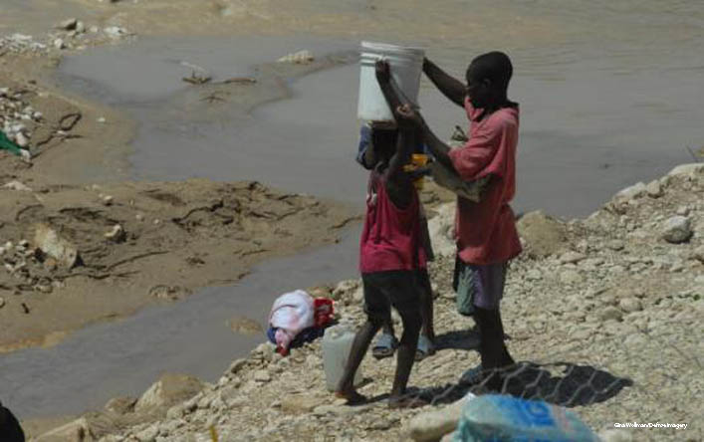
Lesson 14.3 Water Pollution
3,800 children die every day from diseases associated with unsafe drinking water.

Slide 10
Think. Pair. Share.
Talk to a partner and discuss the following question for one minute. Keep notes of your discussion on Notability or Pages.
What are the different types of water pollution?

Slide 11
Water Pollution Video
http://www.youtube.com/watch?v=fxZ4IMpM45Y

Slide 12
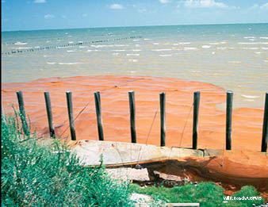
Types of Water Pollution
Lesson 14.3 Water Pollution
Point-source pollution: From a discrete location, like a factory or sewer pipe
Nonpoint-source pollution: From many places spread over a large area, such as when snowmelt runoff picks up pollutants along its path
Point source oil pollution Oil after a spill, Trinity Bay, Texas

Slide 13
Nutrient Pollution
Lesson 14.3 Water Pollution
THE PROCESS OF EUTROPHICATION
Excess phosphorous and other nutrients in the water is nutrient pollution.
Eutrophication occurs naturally.
Nutrient pollution can cause cultural eutrophication.
Nutrients build up in water.
Algae and aquatic plant growth increases.
Organisms die. Decomposition requires oxygen.
Dissolved oxygen levels decrease.

Slide 14
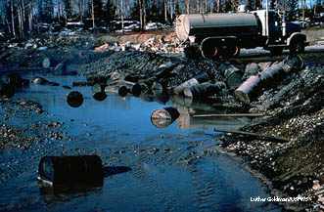
Toxic Chemical Pollution
Lesson 14.3 Water Pollution
Occurs when harmful chemicals are released into waterways
Can be organic or inorganic
Harms ecosystems and causes human health problems

Slide 15
Sediment Pollution
Lesson 14.3 Water Pollution
Sediment pollution:
Unusually large amounts of sediment that change an aquatic environment
Sediment pollution results from erosion.
Can degrade water quality, cause photosynthesis rates to decline, and disrupt food webs
.

Slide 16
Thermal Pollution
Thermal pollution:
A heat source that raises the temperature of a waterway
Heated water holds less oxygen

Slide 17
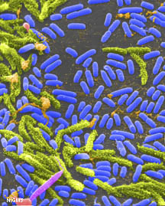
Biological Pollution
Lesson 14.3 Water Pollution
Biological pollution occurs when pathogens enter a waterway.
Biological pollution causes more human health problems than any other form of water pollution.
Water treatment reduces biological pollution.
Cholera bacteria
Did You Know? Giardiasis is the most common form of waterborne disease in the U.S.

Slide 18
Groundwater Pollution
Lesson 14.3 Water Pollution
Sources of groundwater pollution include natural sources, surface pollutants leaching through soil, and leaky underground structures.
Chemicals break down more slowly in groundwater than in surface water.
Most efforts to reduce groundwater pollution focus on prevention.
Did You Know? The EPA repairs and replaces leaky underground gas storage tanks to reduce groundwater pollution. Over the last 25 years, over 1.7 million tanks have been repaired or replaced.

Slide 19
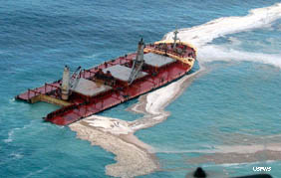
Ocean Water Pollution
Lesson 14.3 Water Pollution
Oil pollution in the ocean comes from many widely spread small sources. Natural seeps are the largest single source.
Ocean organisms bioaccumulate mercury pollution.
Nutrient pollution can cause red tides.
A 2004 oil spill off the Alaskan coast
Did You Know? According to the U.S. Oil Pollution Act of 1990, by 2015, all oil tankers in U.S. waters must have double hulls to help prevent against leaks.

Slide 20
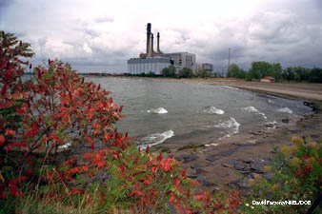
Controlling Water Pollution
Lesson 14.3 Water Pollution
Government regulation decreases water pollution.
The Clean Water Act
Set water pollution standards
Required permits to release point-source pollution
Funded sewage treatment plant construction
Lake Erie
Did You Know? The Great Lakes show that humans can change their ways and clean up trouble spots. In the 1970s, Lake Erie was declared “dead” but is now home to some flourishing species, especially the walleye.

Slide 21
Water Treatment Design
In groups or individually, brainstorm a design of how a water treatment plant should work. Justify the function and/or purpose for each piece of your design. Complete in Notability and email by the end of the day.

Slide 22
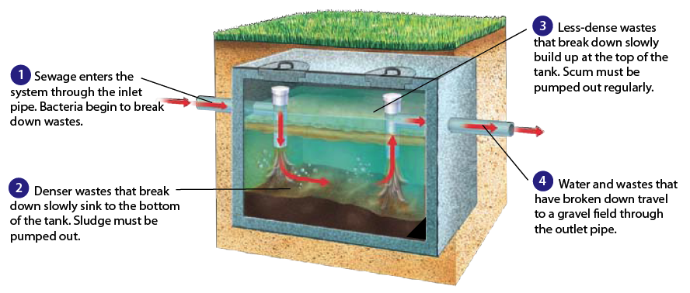
Water Treatment
Lesson 14.3 Water Pollution
Drinking water is treated to remove pollutants before humans consume it.
Wastewater is treated to remove pollutants before human-used water is released back to the environment.
Septic systems are the most popular method of wastewater disposal in rural areas of the U.S.

Slide 24
Water Treatment
One example of a water treatment plant:
http://www.youtube.com/watch?v=9z14l51ISwg

Slide 25
Chapter 14 Review Assessment
Quickly go over the Study Guide on page 446.
Complete questions 1 – 33 on pages 447 – 449 INDEPENDENTLY (no talking or sharing answers, but you may use my slides and the textbook as resources). You must finish the first 10 questions by the end of class. (You will get a stamp.)
The whole assessment is due tomorrow. This will count as a test/quiz grade.

